Slide 1
Welcome to the NHS Lincolnshire CCG Final Annual Public Meeting – 26th September 2022

Slide 2
Agenda
1. | Welcome and Introduction – ICB Chair | Sir Andrew Cash, OBE Interim Chair NHS Lincolnshire Integrated Care Board (ICB)
2. | Minutes of the NHS Lincolnshire Clinical Commissioning Group (CCG) Annual Public Meeting held in September 2021 | Dr Gerry McSorley, ICB Non-Executive Director (former Acting Chair of NHS Lincolnshire CCG)
3. | Chief Executive’s presentation: Reflections of the last 18 months Current position and forward look Presentation of the NHS Lincolnshire CCG Annual Report and Accounts 2021/22 | Mr John Turner, Chief Executive, NHS Lincolnshire ICB
4. | Questions from members of the public | Sir Andrew Cash and Mr John Turner
5. | Closing Comments | Sir Andrew Cash

Slide 3
Welcome and Introduction
Sir Andrew Cash, OBE
NHS Lincolnshire Integrated Care Board (ICB) Interim Chair

Slide 4
Minutes of the NHS Lincolnshire CCG Annual Public Meeting 2021
Dr Gerry McSorley,
Non-Executive Director
Note the minutes of the previous NHS Lincolnshire CCG Annual Public Meeting held on September 2021

Slide 5
Opening Comments
John Turner, ICB Chief Executive
1. Reflections of the last 18 months (NHS Lincolnshire Clinical Commissioning Group (CCG) 1st April 2021 to 30th June 2022 and NHS Lincolnshire Integrated Care Board (ICB) from 1st July 2022)
2. Current position and forward look
3.Presentation of the CCG Annual Report and Accounts 2021/22

Slide 6
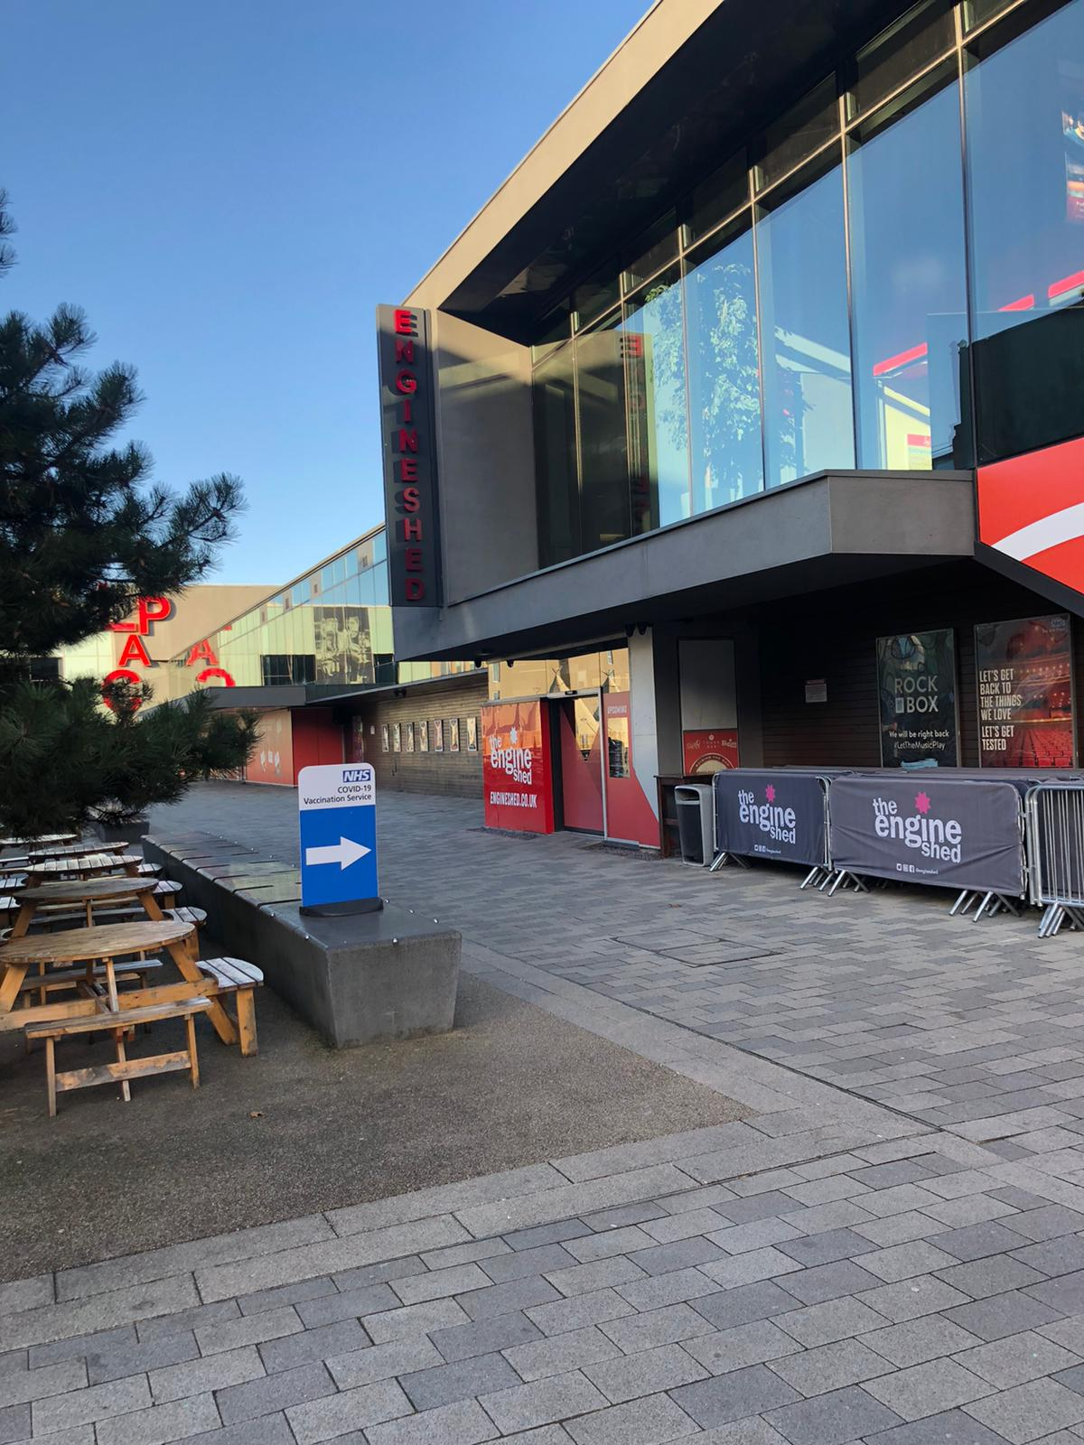
Reflections of the last 18 months
Profound impact of the COVID-19 pandemic
Strong partnership and delivery through the last 18 months
Key highlights
Vaccination Programme
Full restoration of NHS services
On-going recovery programme
Excellent progress on catch up (e.g. operations etc)

Slide 7
Reflections of the last 18 months
Ways of working
Deep commitment of NHS workforce across the county
Strong partnership working with local government, third sector, care sector and NHS partners
Striving to meet the health needs of the people of Lincolnshire
Conclusion of Acute Services Review (ASR)

Slide 8
On-going good progress
Mental Health Transformation
Development of Primary Care and Primary Care Networks (PCNs)
Safeguarding
Health Checks for people with learning disabilities and severe mental illness
Partnership with the University of Lincoln
Partnering with Towns Fund programme
Sustainability/green agenda and estates
Health Inequalities

Slide 9
On-going challenges
Health Inequalities
Urgent and Emergency Care (including Ambulance handovers, A&E and discharge)
Cancer
Elective operations
Primary Care
Financial position
Workforce

Slide 10

Final comments on the last 18 months
Commitment and dedication of staff and partners
Thanks to CCG Board Members – namely Mr Sean Lyons, Mr Jim Connolly, Mr Murray Macdonald, Ms Sue Liburd, Mrs Fenella Chambers, Mr Graham Felston and Mrs Janet Inman
NHS Receiving the George Cross from Her Majesty the Queen

Slide 11
Current Context and Forward Look
Better Lives Lincolnshire – the Lincolnshire Integrated Care System (ICS)
Lincolnshire Integrated Care Partnership (ICP)
NHS Lincolnshire Integrated Care Board (ICB)
Lincolnshire Health and Care Collaborative (LHCC)
Statutory and Non-Statutory Partners
Improve outcomes in population health and healthcare
Tackle inequalities in outcomes, experience and access
Enhance productivity and value for money
Help the NHS support broader social and economic development

Slide 12
Current Context and Forward Look (Con’t)
Workforce
Digital
Immediate performance priorities – winter and urgent care
Maintaining strong performance on elective catch-up
Tackling cancer performance
Access to primary care including Pharmacy, Ophthalmology and Dentistry (PODs)
Addressing Health Inequalities
Transformation and integration of health and care (designing and delivering health and care for the people of Lincolnshire – ‘not for or to’)

Slide 13
NHS Lincolnshire CCG Annual Report and Accounts 2021/22
Final Annual Report and Annual Accounts for the CCG for the period 2021/22
ICBs are required to produce and publish CCG Months 1-3 Annual Reports for the period 1st April 2022 to 30th June 2022) – the timescale for the publication has yet to be confirmed by NHS England but is not expected to be until early Summer 2023

Slide 14
Questions and Answers
Questions were invited prior to the meeting and any received will be responded to at this point.
Any questions received as part of the Q&A facility available during the meeting will be responded to where possible.
All questions and responses will be published on the NHS Lincolnshire ICB website: www.lincolnshire.icb.nhs.uk

Slide 15

Thank you and good evening

