Slide 1



0300 303 1555
www.carersfirst.org.uk

Slide 2




The Lincolnshire Carers Service
Notes:
Presentation on Carers Service provided in Lincolnshire

Slide 3



A single service delivered in partnership
Notes:
The Lincolnshire Carers Service is commissioned by Lincolnshire County Council to provide support to residents who provide care for a relative or friend.
The service is delivered in partnership by Carers FIRST and the Lincolnshire Customer Service Centre.
Lincolnshire young carers service is provided by children's service, linking in to existing support through schools and other services.
The primary access for the core service is through the LCC customer service centre, which is the gateway to accessing carer support. From here, carers are referred to CF when specialised support is needed. The pharmacy project has a specified referral route
CF Support carers and families by providing emotional and practical support, advice, information and guidance, statutory carers assessments & opportunities for carers to access training, social groups, short breaks, respite, activities, support groups, emergency planning, surgeries and on line support

Slide 4
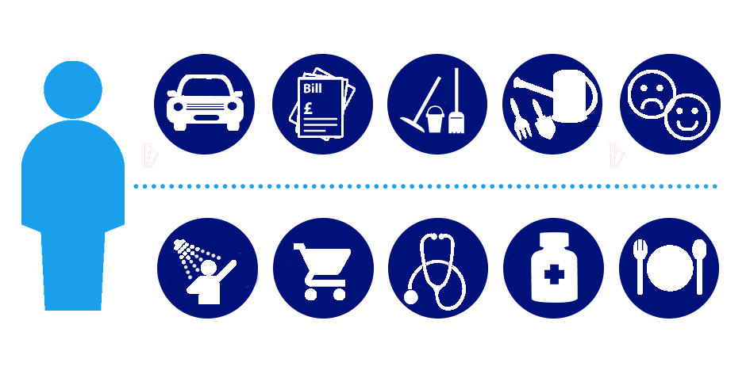
Who are carers?
A carer is someone of any age who looks after a relative or friend who due to ill health, physical or mental illness, disability, frailty, or addiction cannot manage without their support
Notes:
Age - Carers can be any age / wide variety of caring responsibilities including tasks such as washing and dressing, paying bills, transport, emotional support, health appointments, medication and domestic tasks
Rewarding - For many, caring is a rewarding and positive experience, but for others, without the right help and support caring can feel overwhelming.
Others for some, caring can trigger feelings of loneliness and frustration and many often find their physical and emotional health, work or finances affected.
Ages - Young Carers up to 18 yrs, Young Adult Carers 18 – 24 yrs, Carers 24 yrs plus, Parent Carers

Slide 5
What is the aim of the carers service?
Identifying carers
Recognising carers
Preventing breakdown and crisis
Notes:
Identifying carers - Raise awareness about what it means to be a carer so that more people self identify and recognise themselves as carers and seek information.
Recognising carers - Encouraging people to see that their responsibilities amount to a 'caring role' and that they are able to talk to someone about their situation. Encouraging the wider community, including employers and schools, to recognise carers, support them and make reasonable adjustments
Preventing breakdown and crisis - Raise awareness of available support for carers so that they are informed and able to access information, advice and support to maintain their role. Supporting carers to maintain other areas of their lives, for example work and leisure activities, to avoid relationship breakdown between the carer and the person they look after. Encouraging carers to talk to someone early, even if they're coping, and pursue interests to keep their own life in balance.

Slide 6
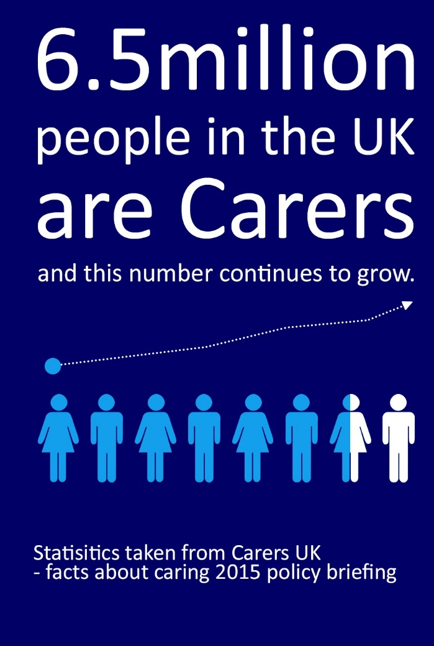
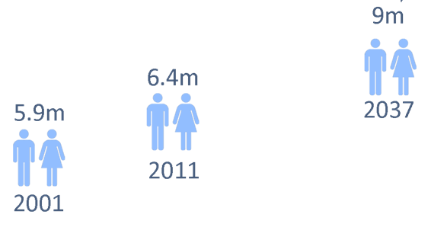
Why support carers?
6.8 million
people in the UK are Carers
79,262
People in Lincolnshire are carers
Notes:
Morally and financially it make sense to provide specialist support for people who have caring responsibilities
3 in 5 of us will be carers at some point in our lives
The number of unpaid carers both nationally and locally is set to increase over the next twenty five years, and it is anticipated that the number of carers in England will increase to 9 million by 2037
11.1% of the population in Lincolnshire are carers (Geographical Reasons etc)

Slide 7

The economic value of the contribution made by carers in the UK is
£132 billion a year
Source: Carers UK facts about caring 2015
Notes:
The total health spending in England in 2017.18 is nearly £124 billion or roughly £2,200 per person.
Carers are unpaid

Slide 8

Carers in Lincolnshire contribute
£1.7 billion a year
that’s £194,000 every hour
Notes:
Some local Stats

Slide 9
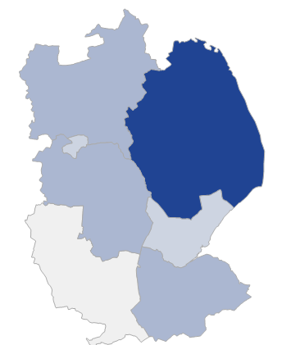
Over 20,000 carers provide more than 50 hours of caring a week in Lincolnshire
East Lindsey is ranked 2nd highest in the UK for the provision of care for 50 hours or more per week
Notes:
East Lindsey - Geographical – Retirement, Holiday homes, extended periods of time spent in area by some people

Slide 10

The impact of caring
62% of carers in Lincolnshire have a disability or long standing illness
Source: Lincolnshire JSNA 2014
25% of carers in Lincolnshire tell us their own health is poor or at risk
36% if carers in Lincolnshire tell us they are experiencing stress, anxiety or difficulties with relationships
Source: Carers Star, 1490 responses
Notes:
Carers often put the health and wellbeing of the person they care for before their own!
In Carers UK State of Caring 2017 survey, 6 out of 10 people (61%) said their physical health has worsened as a result of caring, while 7 out of 10 (70%) said they have suffered mental ill health.
Carers providing round the clock care are more than twice as likely to be in bad health than non carers

Slide 11
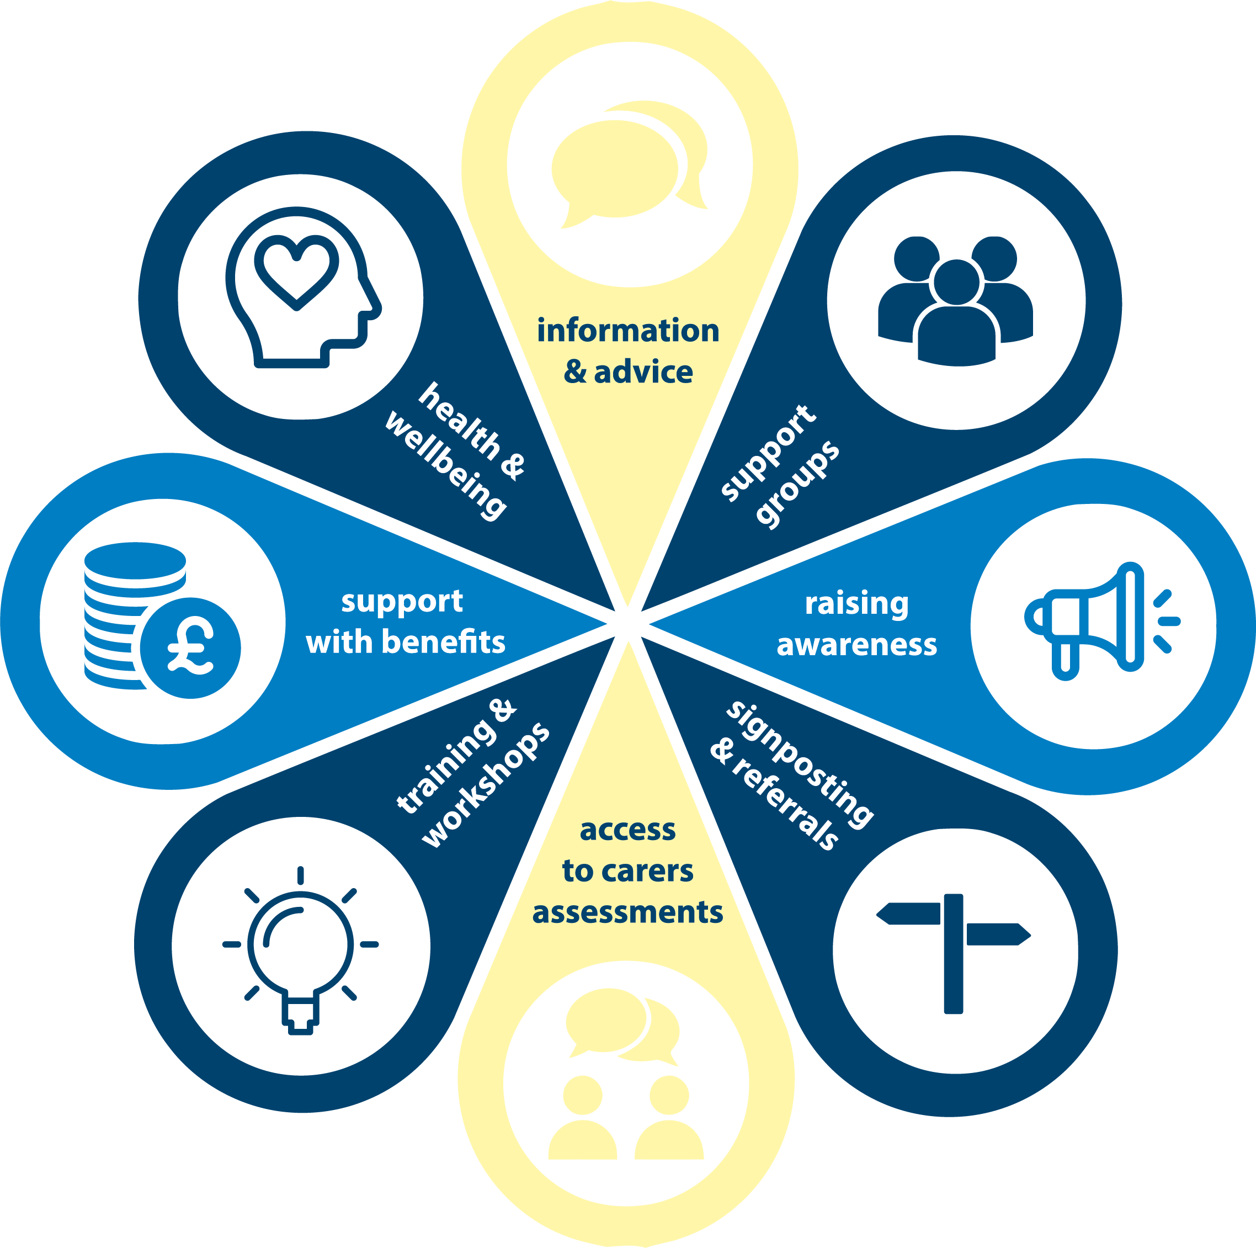
What we do
Notes:
Carers can contact the Carers Service to talk to someone about their caring situation and we will listen and provide support to them with their caring role whilst maintaining their own health and wellbeing:
Community based information, advice and guidance
the opportunity to talk in detail about their caring role to establish if they are able to access additional support such as respite care and help around the home
support with conversations with people including GPs, social services and hospitals
practical training to help with the caring role
help to check eligibility for benefits and financial support
Provide opportunities to access support groups and activities so you can meet others in a similar situation to yourself
Raise awareness amongst employers, agencies and the general public, so that they can look out for carers.

Slide 12
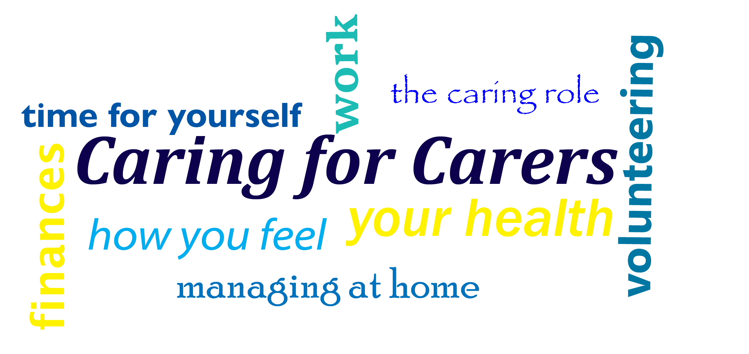
Personalised Support
Notes:
Carers FIRST understands that each caring role is unique to those individuals and as such offers a personalised support plan based on the needs of the individual carer.
Carers FIRST used the Carers Star, an accredited outcomes tool developed by Triangle and Carers Trust which looks at the 7 main aspects of a carers life.

Slide 13
Projects
Employment for Carers
Carer Friendly Pharmacies
Health Engagement
Notes:
Better care fund
Employment: - Carers FIRST will lead on the work with individual carers to support them around employment, through workshops, 1-1 support, goal setting, and advocacy around employment. Our partner Every-one will work with employers to raise their awareness of the benefits of supporting carers within their workforce, linking into the work Every-one does around the Carers Quality Award.
Pharmacy: - We will link into the Carer Friendly Pharmacy project and work with and support pharmacy staff to better identify carers within their community and refer into specialist support offered by the Lincolnshire Carers Service
Health: - Dedicated staff working closely with GP practices supporting them to identify and support carers

Slide 14

Pharmacy Project
One of three projects (together with dedicated Health and Employment projects) that will engage and consult with carers, establishing stakeholder groups to represent carers interests and influence the Lincolnshire carers support service.
Notes:
Carer Friendly Pharmacy Project working with all Pharmacies tobuild on the work in place making pharmacies Community Hub Points

Slide 15
Did you know?
Lincolnshire has 122 Pharmacies
100 pharmacies are registered as Healthy Living Pharmacies with Designated Health Champions
Lincolnshire has approximately 80,000 carers, of these only 10,000 are currently being supported
Evidence suggests 20,000 carers are providing over 50 hours unpaid care a week (Critical Group to target)
On average each community pharmacy will be visited by 13 carers a day
“Without the support of Carers FIRST I really don’t know where I would be today”
Linda - Parent Carer
Notes:
All Lincolnshire pharmacies will be invited to join the project
Lincolnshire Carers make up approx. 11.1% of the counties population (80,000)
Lincolnshire Carers – 69k without support / aware of support available IDENFIFY
Critical Group are providing over 50 hours support a week– IDENTIFY

Slide 16
Project Aims
Identification & support of carers within primary care & community settings
Healthy Living Pharmacies / health champions trained to recognise and sign post carers needing support
Establish a diverse and proactive steering group
Co-production of services - added value, increased awareness services, building loyalty.
“The trust really values the partnership working with Carers FIRST, it enables us to make sure that the carers of our patients can be identified and offered help from Carers FIRST while their loved ones are in our care”
Sharon Kidd - Patient Experience Manager
United Lincolnshire Hospital Trust (ULHT)
Notes:
IDENTIFY – Through Training and Support within this project, Some known to Pharmacies, Some identified through conversation
STEERING GROUP – Involves Carers and Pharmacy staff, anyone can express an interest to be part of the group (10 Members)
PHARMACIES – Benefit from loyalty, football, building Carer Friendly Community Pharmacy
Primary care is the day-to-day healthcare given by a health care provider

Slide 17
Outcomes
Increase in…
  Carers identified & referred into support services by pharmacies
  Uptake of the flu vaccination for carers
  Awareness of carer support services in the community
  Uptake of pharmacy services by carers and Loyalty
  Carers Emergency Service Card
Decrease in…
  Carers presenting at breaking point
Notes:
Remember 69k without support in Lincolnshire – we aim to reduce this
Flu Vacc in pharmacy – Revenue for pharmacies and improved Health Care for Carers
Carer Support services on board in pharmacy, Carers week promotions
Absolutely need to reduce carers presenting at Breaking point, success with the projects will show more referrals, but ultimately more carers aware of services early in their journey

Slide 18
What Next?
ALL Pharmacies signed up to the carer awareness training and ongoing support from Carers FIRST
70% of pharmacies to engage in a Carer awareness programme
25% of pharmacies to have visible Carer information and designated Carer Champions8
Notes:
Training – awareness by CF during pharmacy roll out, followed by accredited training delivered by Every1
Recognised Carer Champions in pharmacy
Visible carer information - boards, counter top, available to staff, consultancy rooms
Carers being referred regularly through secure systems

Slide 19
How to contact us
The Customer Service Centre is the first point of contact for all general enquiries regarding support for carers:
01522 782224 or CarersService@Lincolnshire.gov.uk
Carers registered with us:
0300 303 1555 or hello@carersfirst.org.uk
Notes:
NOTE
Pharmacies will have a designated referral route to monitor the project uptake

Slide 20



Keep in touch
Visit www.CarersFIRST.org.uk
Follow us @Carers_FIRST
Like our page @CarersFIRST
Notes:
Keep in Touch
Thank you
Any Questions

