Slide 1
The role of champions and allies
Equality, Diversity and Inclusion Leads:
Sophie Ford, LPFT
Rachel Higgins, LCHS
Kamljit Obhi, Lincs East CCG
Tim Couchman, ULHT

Slide 2
WRES Expert Programme
WRES Implementation, phase 2:
“The next phase of the WRES will focus on enabling people to work comfortably with race equality.”
WRES Expert programme is one of the strategies.
Third cohort of WRES Experts commenced last week.
I was privileged to be on WRES Expert, cohort 1.
It has been the most empowering, challenging and inspiring programmes I have experienced.

Slide 3
WRES Expert, the programme
Racial Identity Development models
Impact of racism – biological weathering
Cultural Intelligence – developing CIQ
Data – drill down & benchmarking
Using data QI approach for appreciative inquiry
Presenting data & personal stories for maximum impact
The power of BAME networks – Cherron Inko-Tariah, MBE
Policy, strategy, governance and system levers
Communication strategy
Celebrating success & role models

Slide 4
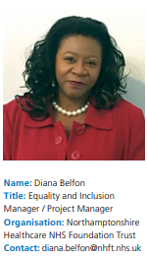
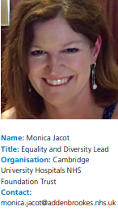
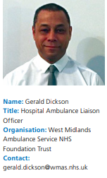
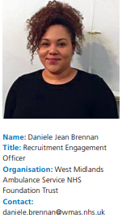
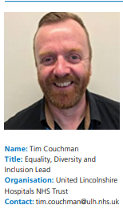
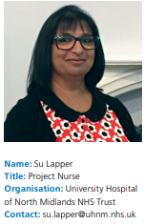
Meet your WRES Experts East & Midlands

Slide 5
LPFT E&D Structure

Slide 6

LCHS E&D Structure

Slide 7

The role of equality champions and allies at LCHS
The aim:
Promote equality, diversity and inclusion in your team and area of work.
Sign post colleagues and patients to areas of support.
Attend the bi-monthly update meetings.
Provide leadership in your team for equality and diversity
Keep up to date on equality areas and what is happening locally and nationally.
Actively contribute with ideas to promote equality, diversity and inclusion.

Slide 8

LCHS engaging with staff
Pilot of Reverse Mentoring
Pilot aimed at the staff networks
4 BME Staff Network
2 LGBT Staff Network
3 Disability Staff Network

Slide 9
On your tables
What makes a good…
  Executive sponsor
  Visible Leader
  Ally/ Champion
What kind of things could and should each be doing?
Notes:
Using flipcharts provided think about what are the things you would want to see.
There are examples of different Trusts role models/ allies and champions on your tables for ideas.

Slide 10
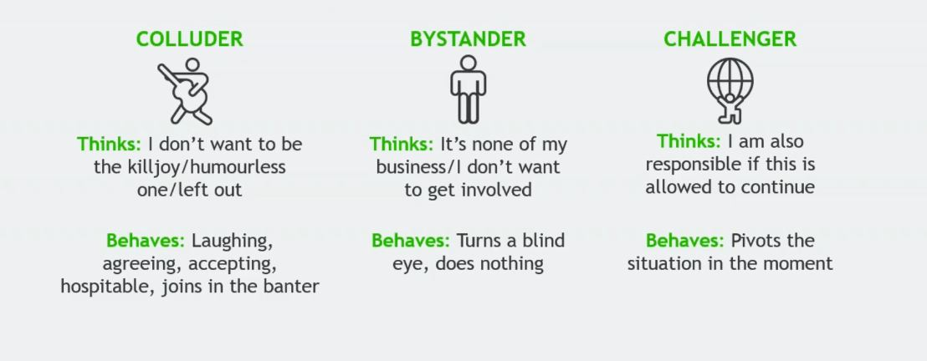
Where do you stand?
Taken from a webinar delivered by the MindGym: 2017

Slide 11
Lunch and mobile exhibition

