Slide 1
Workforce race equality:
Lincolnshire NHS
Yvonne Coghill CBE, Director –
WRES Implementation Team
NHS England
October 2019

Slide 2

The NHS Constitution
The NHS belongs to the people.
It is there to improve our health and wellbeing, supporting us to keep mentally and physically well, to get better when we are ill and, when we cannot fully recover, to stay as well as we can to the end of our lives. It works at the limits of science – bringing the highest levels of human knowledge and skill to save lives and improve health. It touches our lives at times of basic human need, when care and compassion are what matter most.

Slide 3
Race inequality: a global challenge
There is irrefutable evidence globally that people from black and minority ethnic backgrounds (BME) that live in white majority countries like the US, UK, Canada, Australia and New Zealand have poorer life chances and experiences compared to their white counterparts.
Across all indicators BME folk, in general, are more likely to:
  Health – get chronic diseases and die sooner
  Wealth – make less money over their life course
  Housing – live in poorer areas and accommodation
  Judiciary – to be convicted and imprisoned
  Employment – have poorer experiences and opportunities in the workplace

Slide 4
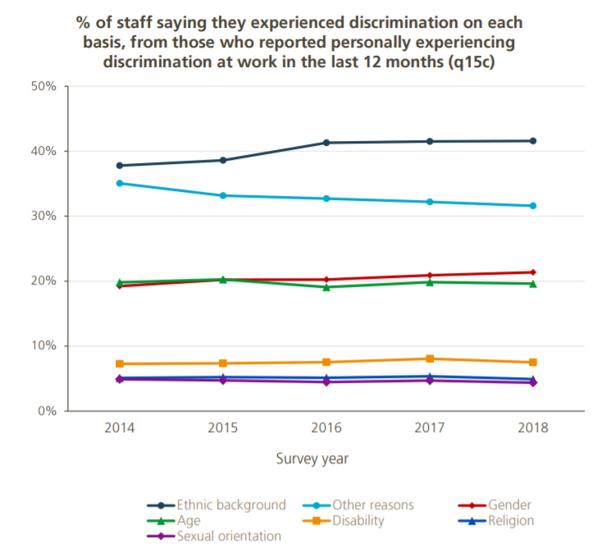
Discrimination by protected characteristic
In the 2019 survey 12.8% of staff reported experiencing discrimination at work (q15a & b).
Ethnic background continues to be the most common reason for discrimination.

Slide 5
Infant Mortality by Ethnicity
England and Wales, 2011 Birth Cohort
Deaths per 1,000 live births, known gestational age, Office for National Statistics, 2013

Slide 6
Child Poverty Rates U.K. 2009/10 – 2012/13
Fisher and Nandi, Joseph and Rowntree Foundation, 2015: Measure of deprivation and poverty line.

Slide 7
Biological Weathering – Arline Geronimous
Chronological age captures duration of exposure to risks for groups living in adverse living conditions
Blacks are experiencing greater physiological wear and tear, and are aging, biologically, more rapidly than whites
It is driven by the cumulative impact of repeated exposures to psychological, social, physical and chemical stressors in their residential, occupational and other environments, and coping with these stressors
Compared to whites, blacks experience higher levels of stressors, greater clustering of stressors, and probably greater duration and intensity of stressors

Slide 8
Experiences of racism while at work
‘Jokes’, ‘banter’ and practical jokes, particularly in relation to accent and the pronunciation of names;
Name calling;
Physical violence, threats, intimidation and verbal abuse;
Employers refusing to accommodate and/or recognise faith practices;
Being subjected to ignorant, insensitive and excessive questioning relating to culture and religion;
Being passed over for promotion and additional training opportunities in favour of White counterparts, including where more qualified;
Being subjected to excessive surveillance and scrutiny by colleagues and supervisors;
Witnessing ethnic minority clients, customers and service users being provided with inferior service;
Customers refusing service from ethnic minority employees;
Exclusion from social events and racism from colleagues outside the workplace, including work-organised social events and informal gatherings.

Slide 9

The consequences for people
Disillusionment
Unhappiness
Depression
Lack of confidence
Anger/Rage
Lack of belief in the system
Lack of engagement and buy in
Resentment
Influences performance
Impact on patient care…!

Slide 10
Black and Minority Ethnic (BME) staff in the NHS, 2018 – scale of the challenge
But…
8 BME CEOs (from ~231 Trusts)
9 Chairs
10 Executive Directors of Nursing
37 Medical Directors
Less than 6% very senior managers from BME backgrounds
7% BME board representation
This is a significant improvement from 2015
1.4 million people work in the NHS
20% staff from BME backgrounds
28% GPs from BME backgrounds
40% of Hospital Doctors are from BME backgrounds
21% Nurses and Midwives (qualified and unqualified) rising to more than 50% in London

Slide 11
Sir Robert Francis QC – Freedom to speak up: a report into whistleblowing in the NHS
More BME staff are unsatisfied with the outcome of workplace investigations than white staff (40%:27%)
BME staff are more likely to be victimised by management than white staff (21%:12.5%)
BME staff are less likely to be praised by management after raising a concern than white staff (3%:7.2%)
BME staff are more likely than white staff to not raise a concern for fear of victimisation (24%:13%)
Impact on patient care…!

Slide 12
The reasons for tackling workforce race inequality in the NHS
THE LEGAL CASE
  Equality Act 2010 and the PSED
THE MORAL CASE
  The right thing to do
THE QUALITY CASE
  Helps ensure high quality care, patient satisfaction and patient safety
  Link between staff satisfaction and patient outcomes
THE FINANCIAL CASE
  Staff engagement and organisational efficiency
  Implications for boards

Slide 13
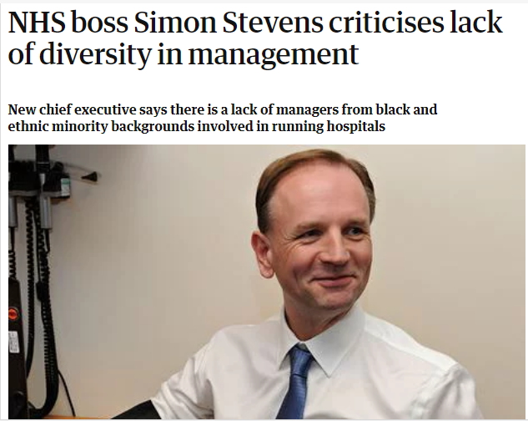
WRES background:
Simon Stevens appointment, May 2014
"It can't be right that 10 years after the launch of the NHS race-equality plan, while 41% of NHS staff in London are from black and ethnic minority backgrounds, similar in proportion to the Londoners they serve, only 8% of trust board directors are, with two-fifths of London trust boards having no BME directors at all.
"Similar patterns apply elsewhere, and have actually been going backwards”

Slide 14
WRES indicators of workplace experience and opportunity
Indicator 1
Percentage of staff in each of the AfC Bands 1-9 or Medical and Dental subgroups and VSM compared with the percentage of staff in the overall workforce
Indicator 2
Relative likelihood of BME staff being appointed from shortlisting compared to that of white staff being appointed from shortlisting across all posts
Indicator 3
Relative likelihood of BME staff entering the formal disciplinary process, compared to that of white staff entering the formal disciplinary process
Indicator 4
Indicator 1
Relative likelihood of BME staff accessing non mandatory training and CPD as compared to white staff
Indicator 5
Percentage of staff experiencing harassment, bullying or abuse from patients, relatives or the public in last 12 months
Indicator 6
Percentage of staff experiencing harassment, bullying or abuse from staff in last 12 months
Indicator 7
Percentage believing that trust provides equal opportunities for career progression or promotion
Indicator 8
Indicator 9
In the last 12 months have you personally experienced discrimination at work?
Percentage difference between the organisations’ Board membership and its overall workforce

Slide 15
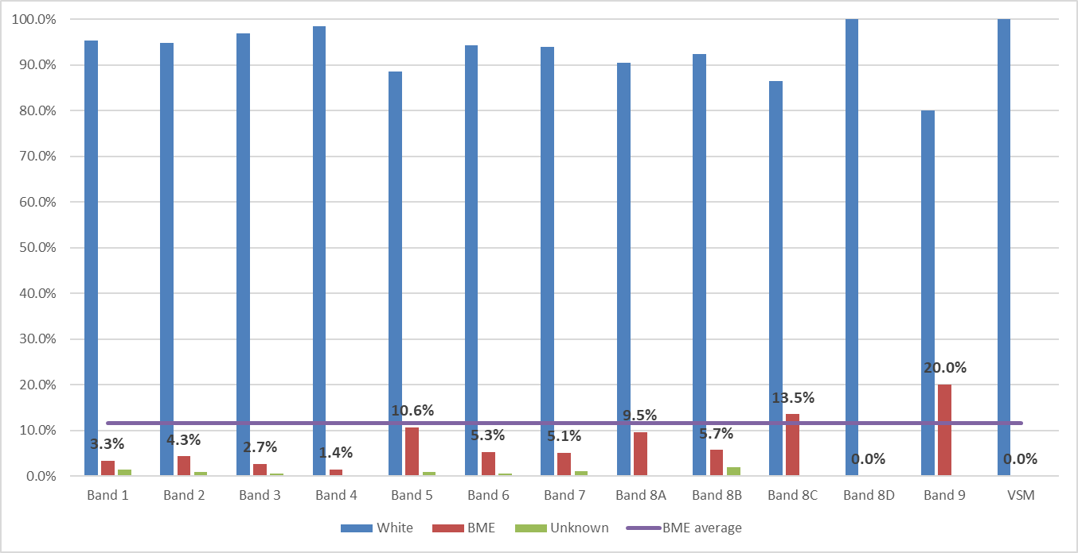
Ethnicity and AfC pay bands, 2019
(Source: WRES data submission for 2019)
11.6% (886) of staff are from a BME background.
94.7% (834) of BME staff work in clinical roles.

Slide 16
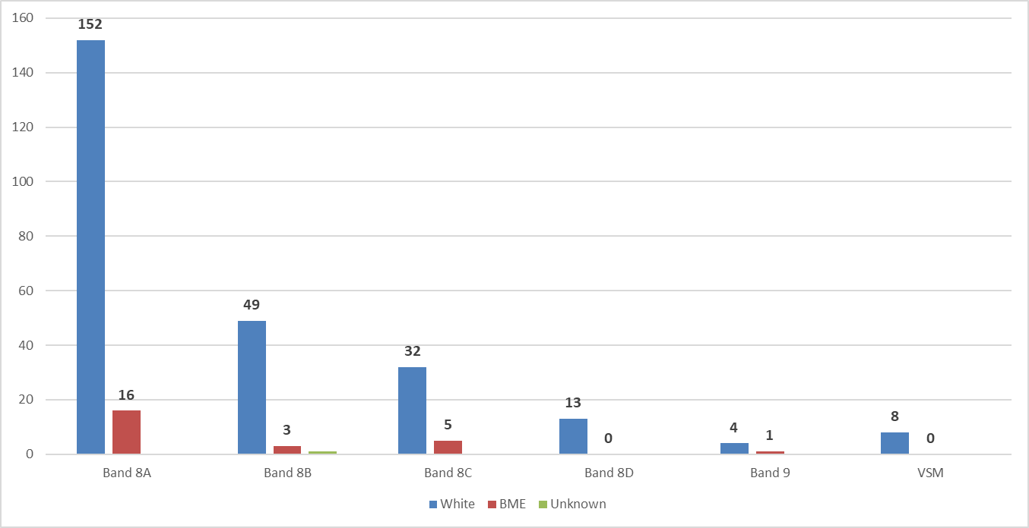
Ethnicity and AfC Band 8a – VSM, 2019
(Source: WRES data submission for 2019)
6 (9.4%) of staff at AfC band 8c and above are from a BME background.

Slide 17
WRES indicators 2 – 4 data, 2019
(Source: WRES data submission for 2019)
BME staff were relatively:
  less likely to be appointed from shortlisting (but continuous improvement over time)
  more likely to enter the formal disciplinary process (fluctuations)
  less likely to access non mandatory training and CPD (close to parity)

Slide 18
WRES NHS staff survey questions: 2019
(Source: 2019 NHS Staff survey)
BME staff reported a worse experience than white staff for all of the four WRES NHS staff survey questions.
BME staff are almost twice as likely to have personally experienced discrimination.

Slide 19
Strategies for improving
Reducing managerial bias through education (e.g. diversity training, unconscious bias training) and feedback (diversity evaluations):
  does not increase diversity in representation or at senior levels.
Mentoring and networking:
  has very modest effects.
Mandatory programs, or programs with explicit authority, accountability, support from the leadership, developing psychologically safe spaces and monitoring interventions:
  most effective.

Slide 20
WRES indicator 9: board representation
(Data as at 31 March 2019)
BME representation on the board on the board is lower than BME representation in the trust.

Slide 21
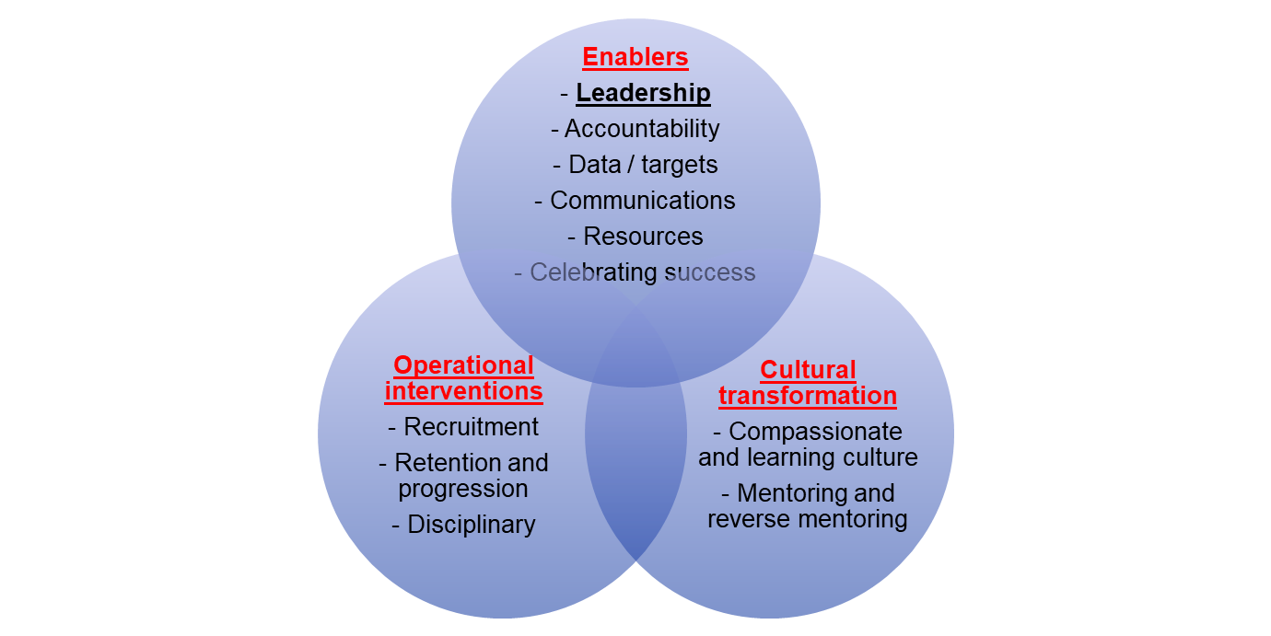
An evidence based approach

Slide 22

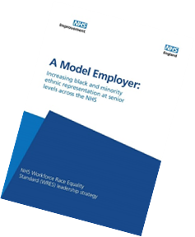
The NHS Long Term Plan, NHS People Plan and WRES
Respect, equality and diversity will be central to changing the culture and will be at the heart of the workforce implementation plan.
Through the WRES, we are making progress in addressing these issues from the perspective of BME staff.
Working with the WRES team, each NHS organisation will set its own target for BME representation across its leadership team and broader workforce.
This will help ensure senior teams and boards more closely represent the diversity of the workforce and local communities they serve.

Slide 23
Delivering through Diversity.
(McKinsey’s and Co, January 2018)
1007 companies, 12 countries.
Follow up to “Why Diversity Matters” that was published in 2015.
Companies in the top-quartile for gender diversity on executive teams were 21% more likely to outperform on profitability and 27% more likely to have superior value creation.
Companies in the top-quartile for ethnic/cultural diversity on executive teams were 33% more likely to have industry-leading profitability.

Slide 24
Recruitment for leadership diversity
Notes
The analysis uses 2018 data.
BME proportions are recorded as a total of known ethnicities..
.

Slide 25
Recruitment for leadership diversity
Notes
For all AfC bands, the trust is on track to deliver equity by 2028.

Slide 26
A fair experience for all
The need for accelerated improvement: Within 76.2% of NHS trusts in England, in 2018, the relative likelihood of BME staff entering the formal disciplinary process compared to white staff was outside the 0.8 – 1.25 non-adverse relative likelihood zone.
Variation in rates of disciplinary action: London region remain the most challenged. Acute and mental health trusts have seen year-on-year improvements in reducing BME entry into the formal disciplinary process. In general, community provider and ambulance trusts have not shown the scale of improvement .
Our ambition - closing the ethnicity gap in disciplinary action: reach equality in terms of the likelihood of staff entering the disciplinary process for both white and BME staff across at least 90% of all NHS organisations by 2022.

Slide 27
Lessons learnt
Importance of demonstrable and compassionate leadership
Everyone’s agenda and not just to pass on to the EDI Lead
Middle managers are key and tend to be missed out in discussions and planning
Tokenism and copying-pasting of ‘good practice’ without adequate planning
  consultancy firms, unconscious bias training, reverse mentoring
Not tracking progress – waiting just to report WRES data at the end of the year
Hardwiring the agenda into corporate objectives and activities
Peer relationships between trusts – making better use of healthcare footprint (STPs)

Slide 28
NELFT WRES staff survey questions comparison with peers
NELFT white staff have a better experience than white staff at peer Trusts.

Slide 29
NELFT BME Staff compared to white staff
Focus on WRES has not been at the expense of white staff.
As the experiences of BME staff have improved, so have those of white staff.

Slide 30
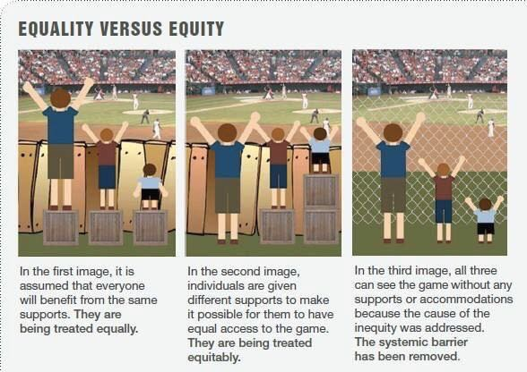
“There is nothing more unfair than the equal treatment of unequal people.”
- Thomas Jefferson 1743 - 1826

Slide 31
Resources and further information
Website:
www.england.nhs.uk/wres/
Email:
england.wres@nhs.net
Twitter (#WRES):
@WRES_team

Slide 32

Refreshments

