Slide 1
NHS Long Term Plan
-Tobacco Dependency Service
Lincolnshire ICB Board – Tuesday 25th June 2023

Slide 2

ICS ambition for treating tobacco dependency
Ambition for England to become ‘smokefree’ by 2030
Every patient admitted to hospital and pregnant women - smoking status captured
Opt-out referral made to Tobacco Dependency Service
Access to appropriate pharmacotherapy / NRT
Personalised plan developed to support quit attempt

Slide 3
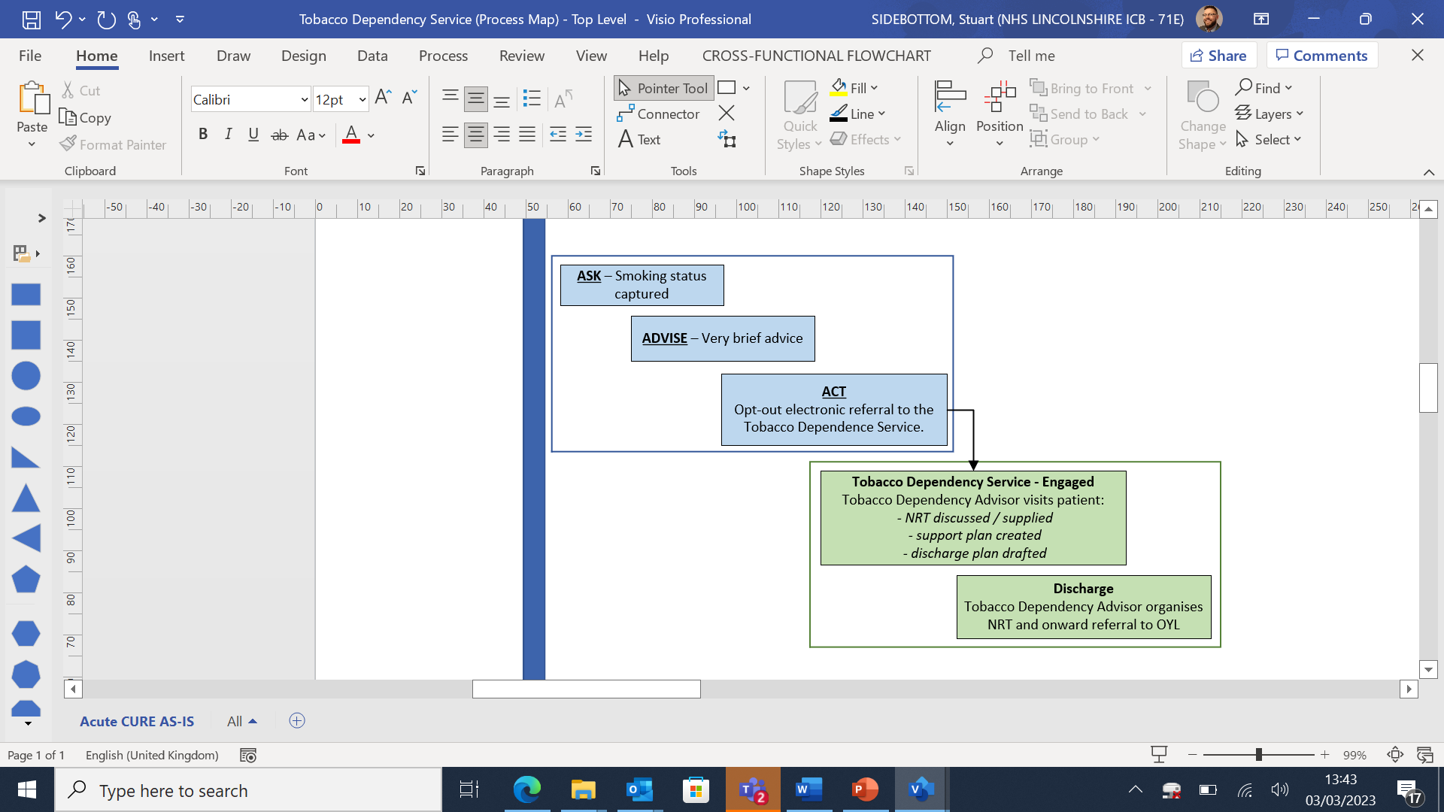
What is a Tobacco Dependency Service?

Slide 4
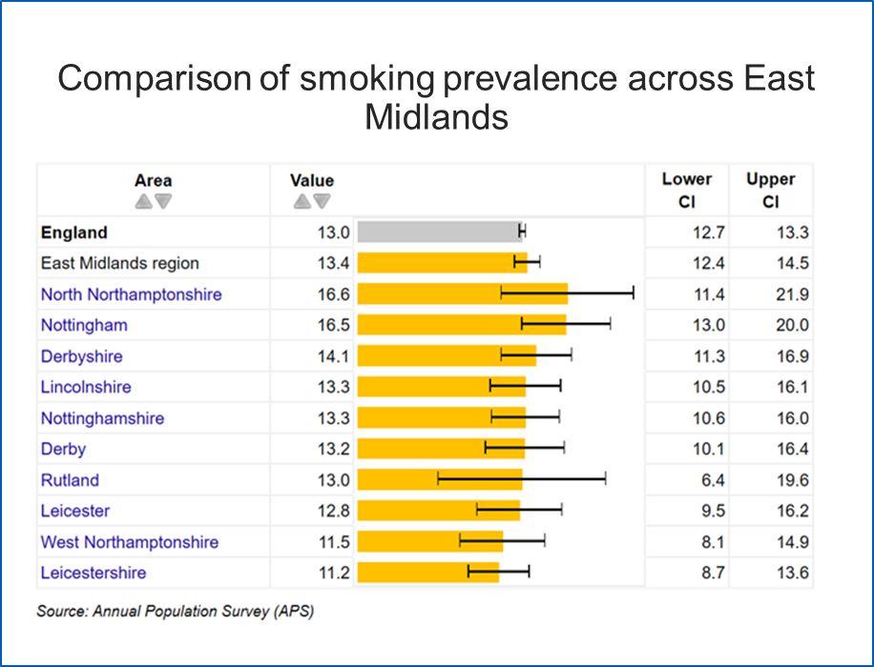
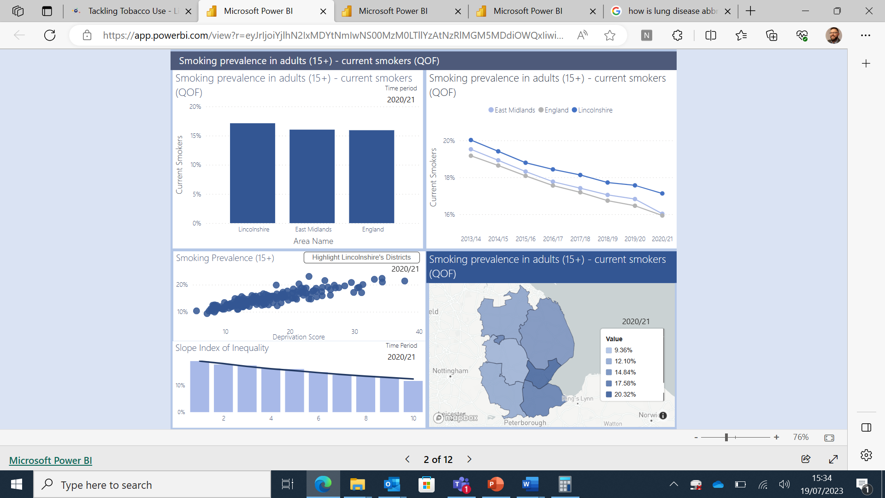
Why is this important for Lincolnshire?
* Left: APS – Annual Population Survey - 2021
* Right: QOF 2013 - 2021

Slide 5
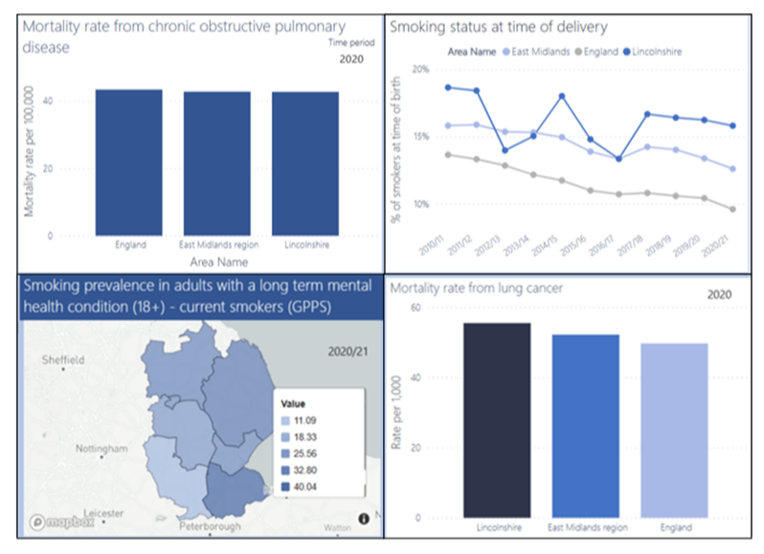
Smoking and the wider effects
COPD
Lung Disease
SATOD
SMI

Slide 6
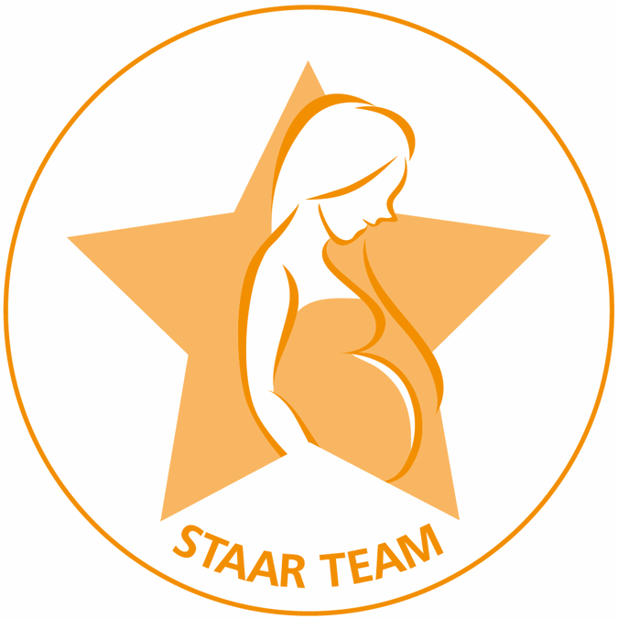
Progress and Next steps – Maternity
Phase 1: Service commenced – Boston, Skegness and Spalding (Jan 2023)
Phase 2 - Expansion of Service to Gainsborough and North Lincoln (June 2023)
Phase 3 - Fully operational service (March 2024)
No. of referrals to TDS | 350
No. of patient opt-outs | 171
No. of quits dates set | 100
No. of 4 week quits achieved | 12
No. of 12 week quits achieved | 5
No. of smoke-free births | 1
* Data as of 17th June 2023

Slide 7



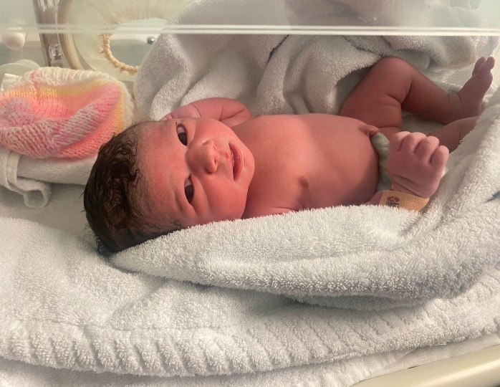
Celebrating Success
The STAAR team are celebrating the delivery of the first smoke-free baby.
Lady X, a Bulgarian lady from Boston, first met Lauren one of the Tobacco Dependency Advisors on the 2nd March 2023. Her quit journey has included:
6 appointments
Behavioural support
Pharmacotherapy utilising a range of Nicotine Replacement Therapy (NRT)
Utilisation of the translation service
A healthy baby girl was born on the 8th July weighing 3.14kg (7.5 lbs)
Gillian Walker, Tobacco Dependency Lead Midwife says “this is a fantastic achievement for all involved. Congratulations to the mother on their smokefree journey and to the STAAR team for their continued support to achieve this outcome”
Securing the best start for women and families in Lincolnshire

Slide 8

Progress and Next steps – Mental Health
No. of referrals to TDS | 77
No. of patient opt-outs | 41
No. of quits dates set | 30
No. of 4 week quits achieved | 7
No. of 12 week quits achieved | 4
Phase 1: Service commenced – Rehab Units (Jan 2023)
Phase 2 - Expansion of Service to all inpatients (April 2023)
Phase 3 - Fully operational service (March 2024)
* Data as of 17th June 2023

Slide 9

Progress and Next steps – Acute
Phase 1: Commencement of Services – Elective inpatients (Anticipated October 2023)
Phase 2: Fully operational service (March 2024)

Slide 10

Progress and Next steps – Community
Scoping of requirements ongoing
Fully operational service (March 2024)

Slide 11
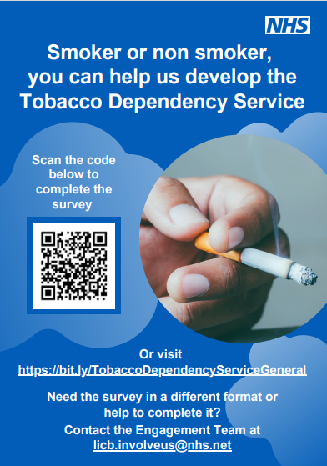
Comms and Engagement
This purpose of our engagement poster is to help:
Understand what would help people stop smoking.
Identify further support or information needed to help people stop smoking
Obtain experiences of those who have used a stop smoking service in the past
Capture thoughts on the new dedicated tobacco dependency service.
This document is also created in multiple different languages to allow for inclusivity amongst the number of growing communities across the county.

Slide 12
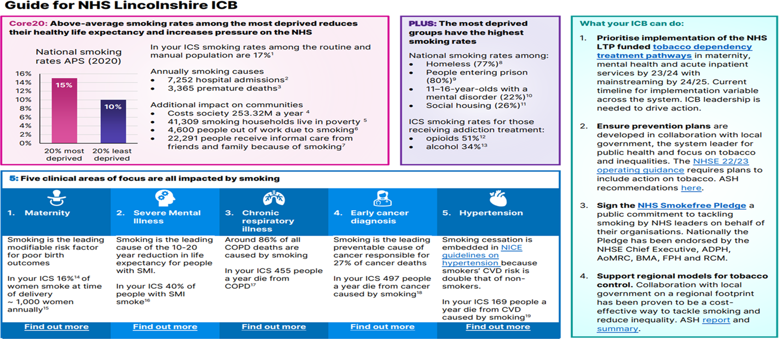
Impact of smoking on Core20PLUS5
* ASH Report – April 2022

Slide 13

Any questions

