Slide 1


System Level Access Improvement Plan
Update Report
November 2024

Slide 2
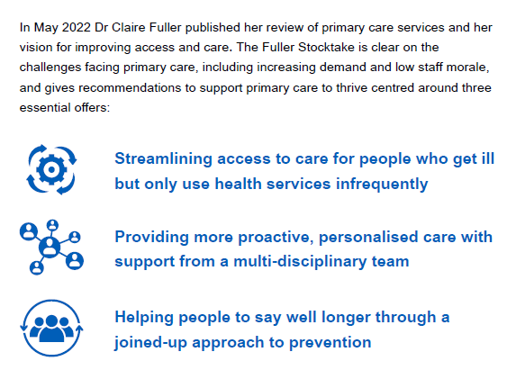
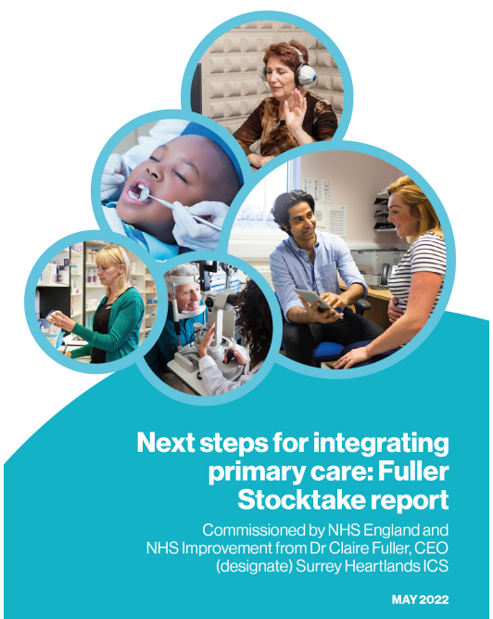
Background

Slide 3
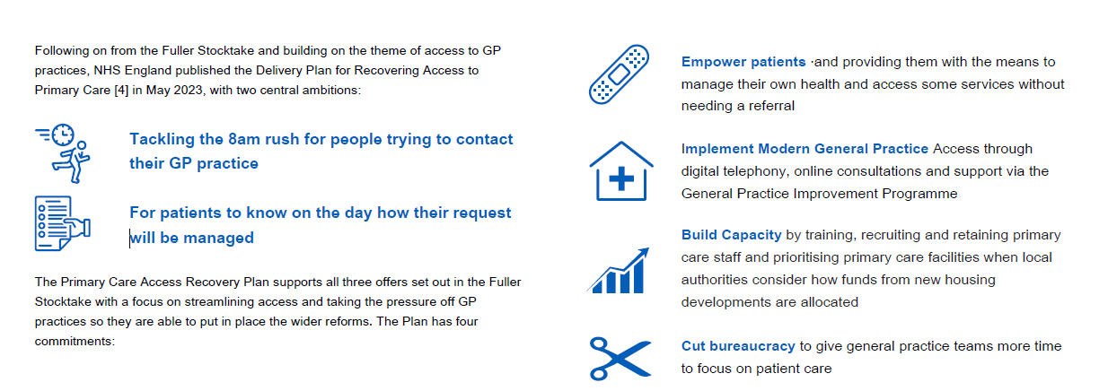
Background

Slide 4
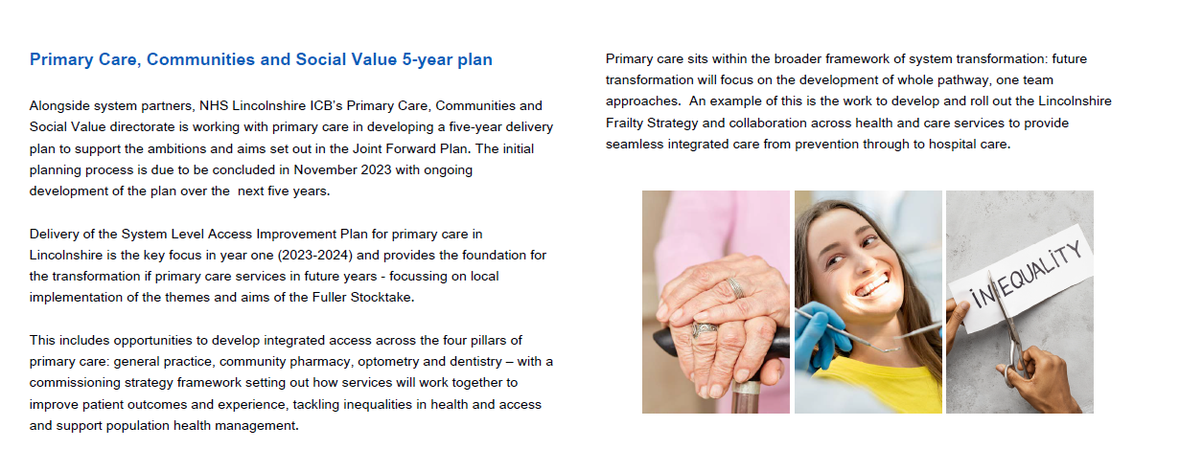
Background

Slide 5
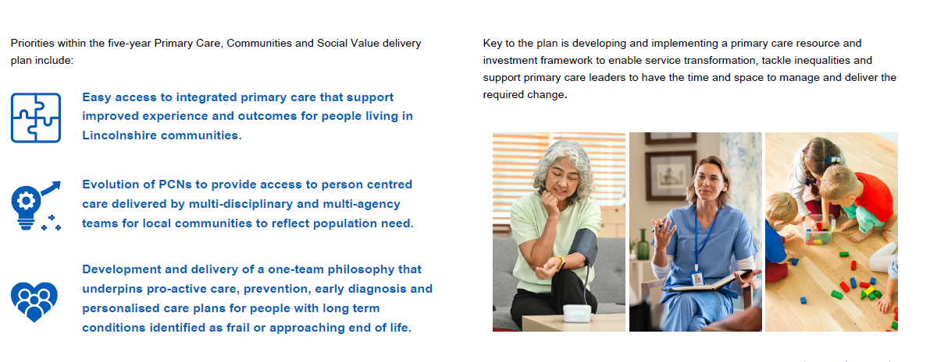
Background

Slide 6
Background
NHS England refreshed the plan for 2024/25 to build on progress over 2023/24 – record numbers of GP appointments, the biggest expansion of pharmacy services in years, a significant increase in direct patient care staff numbers and new digital pathways enabling patents to access care online.
NHS England » Delivery plan for recovering access to primary care: update and actions for 2024/25
This report sets out the progress in Lincolnshire on delivering the local primary care access improvement plan and next steps to continue the work and build on achievements into 2025/26.
The current context for GP practices is challenging, demand has increased significantly over recent years with GP practices responding by providing more appointments than ever before alongside opening up online access routes that require changes in work processes and staff deployment. Pressures across the wider health system affect GPs too, longer waits for elective care mean patients may contact their GP to find out when they are likely to be seen in secondary care or because their condition is changing. GP practices have raised the issue of financial pressures, including rising staffing costs, and the impact on practice viability and the range of services they can offer – this is within the context of limited system finances to invest in primary care.
As a response to the 2024/25 contract changes and ongoing pressures on practices, a majority of GPs voted in a BMA ballot in July 2024 to take collective action, this commenced in August and is ongoing at time of writing - further information is available on the BMA’s website: GP contract 2024/25 changes. Implementation of the action is variable across the County with some practices not taking part – where practices are introducing limits to the number patient appointments per day for clinicians there is likely to be some impact on access for patients. This is being monitored and the ICB is working with system partners to mitigate where required.
The ICB is working with GP practices, PCNs and system partners to support and enable resilient and vibrant primary care and to develop more integrated primary care and community partnerships. Priority areas for the coming 12 months supporting these aims include:
Development of the Lincolnshire GP strategy including a review of locally commissioned primary care services – due for completion by April 2025 and implementation thereafter
Involvement in the National GP Pilot – Lincolnshire is one of 7 systems involved in better understanding the demand-capacity gap for general practice and developing solutions to address this, including accelerating implementation of the NHS Long Term Workforce Plan. Three Primary Care Networks are involved: Apex, IMP and Lincoln Healthcare Partnership

Slide 7
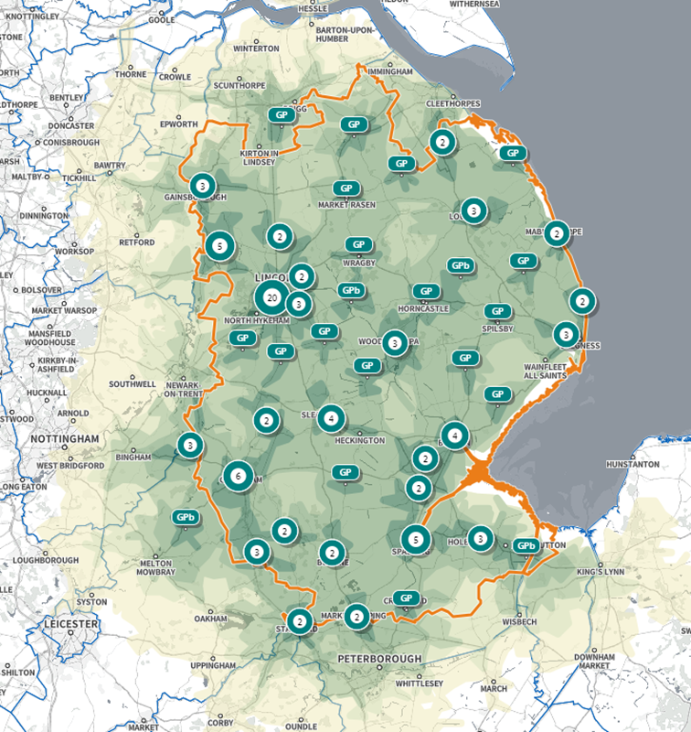
General Practice in Lincolnshire – access overview
Lincolnshire has 81 GP practices delivering care across 114 sites.
Lincolnshire’s rurality significant coastline means access to care is variable across the County, the majority of the population is within a 15-minute car journey of a GP practice, however, access via public transport for people without a car can be very limited. GP practices are often the most accessible service for some communities – for example, access to community pharmacies can be more of a challenge which impacts on use of services like Pharmacy First.
Travel times to other care services, e.g. urgent care, is more limited with car travel times of 20-30 minutes for some communities and more significant limitations associated with public transport.
Patient experience
The national GP patient survey 2024 results for Lincolnshire (gp-patient.co.uk/icsslidepacks2024)
were broadly similar to the regional and national results, in Lincolnshire:
GP practice website ease of use was rated more highly overall (49% vs 43% for Midlands)
Reception and admin staff were more likely to be rated as helpful (84% vs 82% for Midlands)
Waiting time for appointments was more likely to be rated ‘About Right’ (71% vs 66% for Midlands)
It is important to note that there is variation of ratings across the County at GP practice level. The national survey results have been reviewed and are being used to inform local practice access improvement plans, alongside Friends and Family Test information and the recent local GP strategy engagement events feedback.
Car travel time to GP – 5-minute increments (lighter shading is longer)

Slide 8
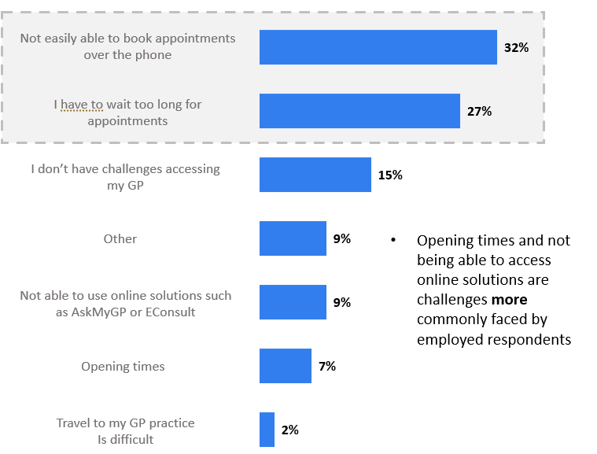
General Practice Strategy – public engagement
Between July and September 2024, the ICB’s engagement team held 31 community engagement events and carried out a survey to gather people’s experiences of GP services in Lincolnshire and how they might like to access care and treatment on future with 2,466 response received.
96% (1268) respondents know how to access their GP. However, not being able to easily book appointments over the phone and having to wait too long for appointments are the most common challenges that respondents face when accessing GP services.
Extended opening hours and more available appointments, such as keeping AskMyGp/E-consult open for longer, particularly for those who are employed or work night shifts, the ability to prebook appointments for non-urgent issues and re-introducing walk-in centres are most commonly suggested as what might make accessing GP services better or easier.
Feeling listened too, being treated holistically and timely access to appointments are most important to respondents when receiving support from GP services.
Those who are healthy say they are less likely to experience challenges accessing their GP than those with minor/major conditions, this could be due to the fact they are more likely to self-care/do not need to access the GP as much.

Slide 9
General Practice Strategy – public engagement
Some people who took part also offered suggestions as to how GP access could be improved, the feedback and suggestions will inform the ICB’s GP strategy, currently being drafted, and the GP Access Improvement Work programme.
What would make accessing GP services better or easier?
Extended opening hours | Longer opening hours such as Saturday and Sunday and later in the evening for those who work Keep online systems open for longer and during out of hours for enquiries or admin requests
Appointment availability | More online appointments so there’s not an 8am rush. Some people work may not be able to call at this time Having the ability to prebook appointments when a GP is required but not needed on the day More appointment should be available for non-urgent issues (5 weeks wait is too long) Reintroduce walk-in/open surgeries for people who don’t mind waiting
More GPs | Employ more GPs to work full time Offer more face-to-face appointments Open more GP practices
Online/email/ telephone solutions | Online appointment booking system which is easy to use Offer more opportunities for email appointments Offer a specific call back option especially for those who work or cannot just answer their phone when they want Being able to easily book appointments over the telephone and not being told you have to use online solutions
Reception/ triaging | A better initial triage procedure via qualified medical professional Employ more staff to answer the phones/introduce more phone lines Consistent training/rules followed by reception staff

Slide 10



Lincolnshire GP Access Improvement Plan Delivery 2024/25
In line with year two of the national Primary Care Access Recovery Plan, delivery of the Access Improvement plan for Lincolnshire builds on the progress and foundations achieved in 2023/24. Highlights have been reported to the ICB Board previously and include:
Roll out of digital telephone systems with advanced functions to support phone access
Development and improvement of GP practices websites to make them easier to access and navigate
Ongoing development of online tools and processes including AskMyGP, AccuRx
Ongoing support for systems that help GP practices manage patient care and administrative tasks e.g. Ardens
Supporting practices implement Modern GP Access through the Support Level Framework and GP Improvement Programme – the ICB Primary Care and Quality Teams are working together in a more integrated way to deliver the local approach
Support to PCNs to deliver their Capacity Access Improvement Plans and maximise the use of the available funding to support access
Empowering patients by supporting digital access – joint working with local authorities on digital inclusion
Working with system partners to promote and increase self-referral opportunities
Supporting the local roll-out of Pharmacy First and extended community pharmacy services including blood pressure checks and oral contraception
The following section of this report provides a detailed update on delivery of the local plan and achievement of outcomes and targets over the last 18 months as well as setting out next steps and areas for further improvement.

Slide 11
GP Access Key Performance Indicators Summary - December 2024
GP appointments and Pharmacy First | Total Appts (previous 12 months) | Appts within two weeks | Same day appts | Pharmacy First, OC & BP consultations
Latest performance | 5.6 million | 85.3% | 45% | 7,869
Workforce and self-referral | Additional Nurse & DPC roles (Oct ’24) | Additional GPs (Oct ‘24) | Self-referral/month (September data) | Total self-referrals (Apr - Sep ‘24)
Latest performance | -11 WTE | +5 WTE | 3,486 | 17,075
Digital | Practices with digital telephony | Practices using online tools | NHS App: patient record views (Aug 24) | NHS App: repeat prescriptions | Practices using online registration
Latest performance | 100% | 100% | 658,258 | 76,807 | 95%
National GP Survey 2024/ | Satisfaction with GP practice | Ability to get through to GP practice | Ease of contact | Know on day how request will be managed | Making contact with GP using the NHS App
Latest performance | 73% Good | 47% Easy | 67% Good | 84% Yes | 45% Easy
The tables above provide a high-level view of GP access performance in Lincolnshire at November 2024; it is important to bear in mind that there is variation in performance across practices and PCNs in Lincolnshire. RAG ratings indicate delivery to target or ambition:  on or above target or comparator,  within 10% or target or comparator,  over 10% below target or comparator.

Slide 12
Access Improvement Plan Aims – Empowering Patients
General practice is delivering more appointments than ever
Enabling patients to take a more active role in the management of their health and care by utilising technology that i) provides patients with access to information to inform their health decisions; (ii) removes inefficiencies and (iii) increases flexibility for the workforce.
FOCUS AREA
Supporting patients to manage their own health and care, by rolling out tools and technology that give accurate and trusted information, and expanding services offered by community pharmacies.
NHS App and online access online appointment booking, repeat prescriptions, patient records
People can book and cancel appts online People can order repeat prescriptions online People can view their care record online
Patients can be more in control of their care and how they access it.
Self-referral pathways 54 potential pathways available to patients across community services
People can self-refer to a range of services – increased to 54 possible pathways People have access to information on health and care services.
Seeing a GP won’t always be required, access will be quicker and simpler.
Community pharmacy Pharmacy First, blood pressure checks and oral contraception
Pharmacies offer a wider range of services: NHS 111, urgent care and GPs can refer patients where appropriate
People will use community pharmacies more often

Slide 13




Empowering Patients – NHS App and digital channels
Progress so far
What has worked well?
Risks & issues
Next steps
Established digital co-production with PPG chairs meeting every six weeks:
Understand public requirements.
Understand hurdles in NHS app adoption – population view.
Held in practice workshops:
Supported patients to understand digital tools
Supported practices in NHS app benefits
Began single point of digital access for Lincs population T&FG:
A single starting digital starting point for the population.
Single website to be used across the system (NHS (Primary / Secondary), Councils, Third Sector etc)
Limited ICB resource to support practices across the county.
Digital inclusion group work to enable more people using the NHS app by addressing inequalities.
Work has begun to create a single point of access for all matters health and care for the population alongside LCC, the three provider Trusts and voluntary sector.
Good uptake of NHS app and digital pathways.
ICB is working with LMC to support practices enable access to records
Achievements and impact
100% GP’s offer online repeat prescription ordering – 183,269 ordered in August 2024
100% GP’s have online access to records – 658,258 record access events in August 2024
100% GP’s offer online appointment management – 30,198 booked in August 2024
49% of population registered users of NHS app.
Monthly NHS app logins at ~458,000

Slide 14
Empowering Patients – Self referrals
Progress so far
What has worked well?
Risks & issues
Next steps
The ICB continues to work with system partners to improve reporting and ensure that activity for agreed pathways is captured accurately in reporting.
This has focused on established self-referral pathways and also aims to provide data where self-referral data becomes available for new services.
Work on data quality and completeness is ongoing with providers
Discussions on onboarding new providers to report data is ongoing with Lincolnshire County Council.
Patient information available via ICB website
Current awareness of pathways across public and professionals
Data quality requires further improvement
Ongoing focus on data quality with all providers
Promotion to GP practices – particularly in relation to triage and signposting
Explore making information on self-referral pathways available to patients through online tools
Engagement with providers and improved activity
Co-production of web information with patients
Improving data quality
Achievements and impact
Significant increases in self-referral activity and achievement of NHSE monthly targets: from 2,116 self-referrals in August 2023 to 3,060 in August 2024
Data quality has improved with self-referral’s coded for unspecified services reducing from 56% of all activity in August 2023 to 21% in August 2024
13,589 self-referrals in total from April to August 2024 equate to an estimated 400 hours of reception capacity and 500 clinical hours saved

Slide 15
Empowering Patients – Community Pharmacy & Pharmacy First
Progress so far
What has worked well?
Risks & issues
Next steps
Historically, Lincolnshire was a regional outlier in terms of GP referrals into Community Pharmacy Consultation Service now known as Pharmacy First-minor illness.
Significant variation across practices – rurality and location of services impact on referral numbers. Lincolnshire has highest population in the midlands (200,000) living > 2 miles from a community pharmacy and highest % of dispensing practices in midlands- impacting on referrals
Significant uptake in Clinical Pathways consultations due to the patient walk-in
UEC referral pathway implemented
Training to pharmacies and locums to support service continuity
Multiple digital issues impacting on GP referrals into Pharmacy First
High walk-in activity may impact on pharmacy income.
Rurality and access
Resolving digital issues for practices to support and improve referral rates.
Ongoing promotion of Pharmacy First
Development of Community Pharmacy Strategy and alignment with GP strategy to support further integration.
Increasing pharmacy oral contraception sign up
Achievements and impact
22,500 Pharmacy First consultations from April to September 2024 – exceeding the planning ambition for this year
17,100 blood pressure consultations over the same period
959 oral contraception consultations
Pharmacy First has saved an estimated 3,756 GP practice hours from April to September 2024

Slide 16






NHS Community Pharmacy Overview – Lincolnshire ICB
April 2024 – September 2024
NHS Community Pharmacy is one part of primary care, alongside GP Practices, Optometry and Dentistry. Together they support more patients every working day than any other single part of the health system.
ACCESS
Pharmacy First
PREVENTION
22,541
UEC SUPPORT
Cardiovascular Disease
NHS Community Pharmacy Teams across Lincolnshire have completed 22,541 Pharmacy First consultations that would otherwise have happened in GP practices, urgent care settings or at NHS111.
NHS Community Pharmacy Teams across Lincolnshire have opportunistically measured the Blood Pressure of
Discharge Medicines Service
3,756 Hours Saved
17,031 patients
NHS Community Pharmacies have improved access for patients and saved 3,756 hours of GPs and other healthcare professional time.
NHS Community Pharmacy teams across Lincolnshire have completed 15,888 Discharge Medicines Service referred from hospital trusts, thereby avoiding 1588 hospital readmissions resulting in better patient care, increased patient safety and saving financial costs of
They have confirmed high blood pressure using ambulatory monitoring in 638 of these patients so their high blood pressure can be managed.
That equates to 4 additional
full-time clinicians!
Oral Contraception Service
1,196 oral contraception consultations completed for Initiation and Repeat Supply. NHS Community Pharmacies are helping to improve access to contraception and help prevent unintended pregnancies.
Assuming these patients comply with management for the next 5 years 5 deaths, 10 strokes and 6 myocardial infarctions have been prevented!
£3,574,588
1,196
There are 115 NHS Community Pharmacies in Lincolnshire situated in the heart of communities

Slide 17
Modern General Practice Access
Patient experience scores 6% points higher than national average using this model
Patients shouldn't be told to call back another time to secure an appointment on the day. Better digital online contact tools and telephony, and changes to workflow have successfully increased accessibility for patients - the Modern General Practice Access Model.
FOCUS AREAS
Enabling patients to know on the day how their request will be handled, based on clinical need and preference for appointment type, reducing long waits on the telephone and providing patients with more timely information
Digital telephony
All practices are using digital telephone systems Digital systems will provide more functions including queuing and call back
Contacting GP practices by phone will be quicker and easier. People will be able to access their practice online.
Simpler online requests
All practices use high-quality online consultation tools by April 2024 Practice websites will be simpler and easier to use – the ICB is supporting practices
People will be able to message their practice and communicate online.
Care Navigation and assessment
Practice teams are being trained in care navigation and the use of the local directory of services
People will be rapidly assessed and directed to the right person or service for their needs – within the wider practice team or another service.

Slide 18
Modern GP Access – digital telephony
Progress so far
What has worked well?
Risks & issues
Next steps
All practices moved away from analogue to cloud based telephony (CBT).
Most practices on better purchasing framework (BPF) contracts.
Upgraded 67% (54) practices CBT systems to BPF contracts.
Telephony is controlled by GP contractors - resulting in variation.
Practices under-resourced for answering calls – lack of benefits realisation.
Not all practices upgraded to BPF due to buy-out costs and lack of central funding. .
Potential single telephony system for county and system-wide with potential central call centre
Contracting and installation complete for practices in scope.
Improved telephone access for patients
Good engagement and willingness from practices.
Strong support from national procurement hub
Achievements and impact
All GP practices have moved onto digital phone systems with improved functionality
Improved patient experience of telephoning their practice – there is still further improvement required and patients still report issues with calling their practice. Practice use of Friends and Families feedback as well as reviewing telephony data will support improvements
The number of telephone appointments provided by Lincolnshire GP practices has increased by 15% over the last 12 months with around 5,300 per day in September 2024.

Slide 19
Modern GP Access – simpler online requests
Progress so far
What has worked well?
Risks & issues
Next steps
Some practices taking the plunge to embrace total triage OCT (always on) – this has supported demand management and improved on the day access
Initiatives to increase take up of systems
Increased use of online questionnaires
Maintained practice choice of single system despite challenges
Reduced financial waste by moving practices to just one system rather than hybrid
Working with PPGs to increase take up of online opportunities
Variation in system and process at practices resulting in lack of a uniform pathway
System change can result in a drop in usage
National Framework and funding changes have impacted on roll out
Practice capacity capacity means online systems may be switched off during core hours
Sharing learning on total triage approaches across practices
Promotion of online opportunities to patients
Ongoing work with PPGs to promote and to improve patient experience
Achievements and impact
100% practices have access to an Online Consultation/Triage tool
The number of daily online appointments reported has doubled over the last 12 months with 985 online appointments provided per day across Lincolnshire in September 2024

Slide 20
Modern GP Access – care navigation and assessment
Progress so far
What has worked well?
Risks & issues
Next steps
Most practices have participated in care navigation training through earlier training offers.
The most recent online training programme is designed to equip reception teams with the skills and confidence to deliver effective care navigation.
Delivered in a ‘train-the-trainer’ format, this will enable cascade of learning helping to embed modern, patient-centred general practice.
70 out of 81 Lincolnshire practices have undertaken the training, with an additional 6 practices booked.
GP practice team capacity to release staff for training.
The ICB is continuing to support practices to ensure that every practice has at least one staff member trained in care navigation over 24/25.
Promotion of care navigation community of practice
Positive engagement with practices to take part in training
Training can be tailored to practice or PCN needs.
Achievements and impact
Improved patient experience: reception teams to guide patients more effectively, ensuring they are directed to the right clinician or service based on their individual needs
Optimisation of resources: practices can allocate resources more efficiently by directing patients to the most suitable clinician or service.
Strengthened care coordination: by embedding care navigation in daily operations, practices can improve coordination between healthcare providers, ensuring patients are more likely to be supported in managing their health and wellbeing effectively.
Empowering reception teams: Reception staff often serve as the first point of contact for patients. This training equips them with the skills and confidence to support the patient journey, leading to greater job satisfaction and a sense of empowerment within the team.

Slide 21
Modern GP Access – GP Improvement Programme and Practice Level Support
General Practice Improvement Programme (GPIP): is a programme of tailored support to general practice to make changes and improvements as they move toward a modern general practice model and better align capacity with demand, improve the working environment for staff, improve patient experience, build their capability to sustain improvement.
Practice Level Support (PLS): is an element of GPIP and offers a hands-on support package available for practices willing and ready to improve how patients contact the practice and are navigated to the most appropriate care.
Progress so far
What has worked well?
Risks & issues
Next steps
Transfer of PLS programme access from NHSE to Lincolnshire ICB to enable better alignment with wider GP practice support offer.
18 practices have undertaken GPIP/PLS over 2023/24 to 2024/25.
1 PCN Lincolnshire has completed the PCN programme
Positive feedback from practices taking part in the PLS programme (please see below)
Backfill funding for engagement is not available – the time commitment can be an issue for practices.
Future funding not confirmed
Full management of the PLS programme will move to ICB next year
Ongoing engagement with practices and promotion of the offer
Develop a local impact assessment and evaluation approach – digital phone data availability will support
Lincolnshire Practice Manager feedback on GPIP/PLS:
“We audited, we tested, we learned, and we changed, and it really worked! Our staff and patients are reaping the benefits.”
“I found the whole session so engaging and exciting - it really does put fire in your belly so that we can envisage change together as a collaborative.”
Achievements and impact
Local impact data isn’t currently available although positive feedback from participants indicates the programme has had a positive effect
National evaluation shows a reduction in call wait times, abandoned calls and improvement in online consultation usage

Slide 22
Modern GP Access – Support Level Framework
The Support Level Framework (SLF) is a tool intended to support practices in gaining an understanding of what they do well, what they might wish to do better, and where they might benefit from development support to achieve those ends.
Progress so far
What has worked well?
Risks & issues
Next steps
Local SLF approach developed and rolled out: practice self-assessment followed by an ICB facilitated assessment.
2023/24 target of 25% practices completing SLF process achieved:
  - 29 practices in total (36%)
Limited ICB resource to support practices across the county
GP practice capacity to engage with the approach
Ongoing promotion and delivery of the SLF approach where indicated
Developing working approach across the ICB’s Primary Care and Quality team has enabled alignment of SLF with wider quality support offer
Achievements and impact
100% GP’s offer online repeat prescription ordering
100% GP’s have online access to records.
100% GP’s offer online appointment management.
49% of population registered users of NHS app.
Monthly NHS app logins at ~458,000

Slide 23
Building capacity
There is a shortage of GPs to meet the needs of a growing and ageing population, with increasingly complex needs. A focused effort is required to bring new doctors into general practice and retain current GPs
FOCUS AREA
Ensuring general practice is utilising all resources to manage increasing demand, managing more patient requests and optimising the use of the full practice team
Grow multidisciplinary teams
September ’24: 419 whole time equivalent additional roles in Primary Care Networks Total ARRS funding for 24/25 is £20.3 million, the current forecast spend is £19.6 million The ICB and PCN Alliance are working to maximise use of funding
People will receive care from a wider range of primary care staff.
More new doctors - retaining experienced doctors
The Lincolnshire Primary Care People Plan sets out how we will recruit, retain and support primary care workers. GP recruitment in Lincolnshire is positive with +16 WTE from April to October 2024 (+4%) GPs are being recruited through ARRS
The workforce will be there to support access.
Estates
Primary care is a priority for local authorities when planning new developments The ICB is working with GP practices to ensure buildings enable access and care PCNs are developing estates strategies
Estates will support access and future services.

Slide 24
Building Capacity – Primary Care People Plan
Having the right range of clinical and non-clinical staff is critically important to GP practices being able to provide good care and access. As well as attracting new staff into Lincolnshire retaining existing staff and supporting them to develop the skills, knowledge and experience they need are priorities. Developing a primary care workforce plan that aligned to wider system workforce plans means opportunities to develop a system wide approach to recruiting and retaining staff and for health care services to work together to ensure Lincolnshire has the healthcare workforce it needs.
Primary Care has an established strategic workforce group, the Primary Care People Group which meets every two months and has good representation and engagement with system partners. The group co-produced and launched a 3-year Primary Care People Plan in April 2023 with the overarching ambition to ‘Build Capability & Capacity for today and in the future’. The plan is refreshed annually and currently has five priorities and is aligned to the four system plan themes of Growing, Valuing, Developing & Retaining Our People.
The Primary Care People Plan is supported and enabled by a work programme of activities and links in with Dental, Pharmacy and Optometry strategic plans and forums. Development, recruitment and retention in rural and coastal communities is a priority theme running through this programme of work. Through a local Retention Subgroup concerted efforts to identify current issues and gaps has led to increased support and demonstrating that we value staff, in particular developing a GP Careers Enhance Programme targeted at multi-generational support from newly qualified GPs to those planning for retirement, and expansion of Fellowships & Champion roles. Complementary to this has been an Engagement Subgroup, set up earlier this year which has representation from across professions in primary care and has utilised a local GP Engagement exercise & GP Staff Survey results to pull out key themes. It has been particularly pleasing to see increased engagement with GP Receptionists and outputs include focussed support on Anti-Abuse resources, Health & Wellbeing support and Equality, Diversity & Inclusion investment. Currently primary care are slightly ahead of planned GP numbers, hitting our end of year projection with a good conversion rate from local trainees to recruited GPs. However, planned numbers for GP Nurses are not being met and this is where we have our acutest example of an ageing workforce although all professional groups are showing this trend. Targeted work is underway with senior nurses to develop data sets, identify risks and succession plan, support development and future pipelines.
Current risks identified by the PC People Group is quality & availability of data; reduced budgets; lack of centralised resources aligned to primary care – particularly in EDI, Occupation Health, HR & OD, and workforce planning, and lack of clarity about long term investment.

Slide 25
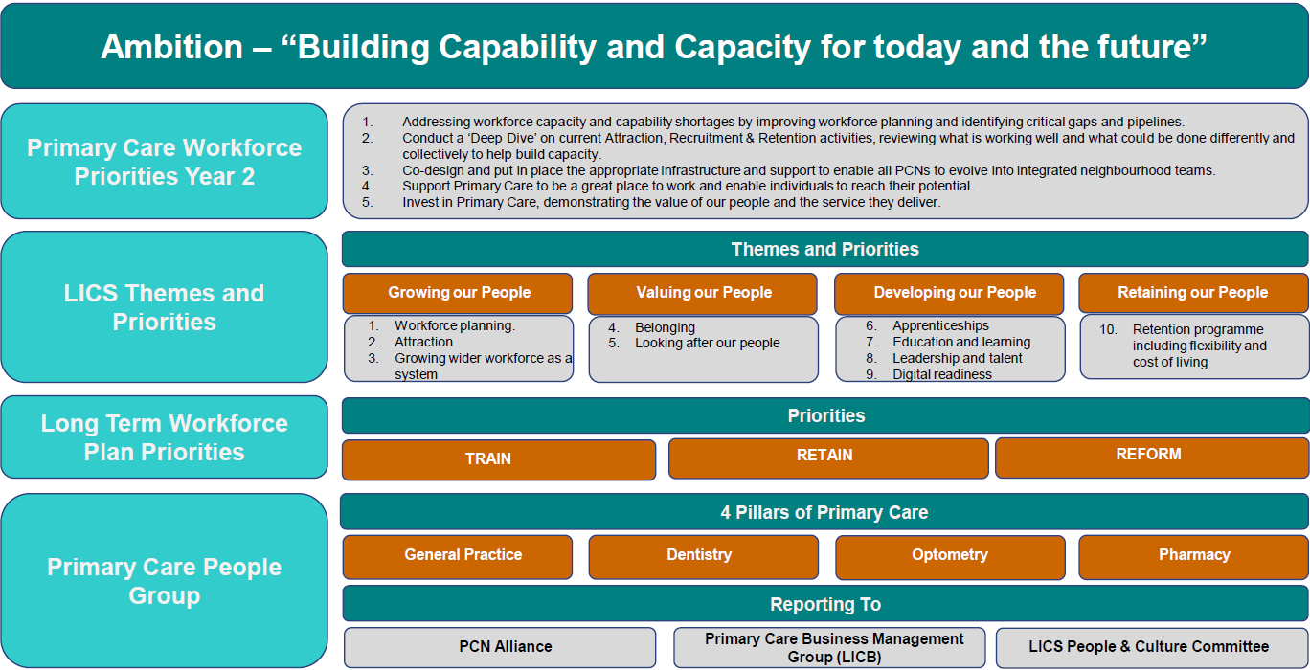
Building Capacity – Primary Care People Plan – Plan on a Page

Slide 26
Modern GP Access – growing multidisciplinary teams
ARRS position for 23/24
There has been a historic underspend on PCN ARRS in Lincolnshire (in 22/23 this was £3.2m) so a priority for the PCN Transformation programme in 23/24 has been to maximise the utilisation of the ARRS allocation. To do this a number of measures have been put in place including:
1:1 support for PCNs who are showing a significant ARRS underspend to help identify opportunities to recruit additional workforce.
Monthly ARRS reporting from PCNs to have an up-to-date position on the ARRS forecast.
Development of a plan for Palliative and End of Life Care Co-ordinators to utilise ARRS underspend.
Work with system partners to identify opportunities to use ARRS funding to create roles that may be more attractive and roles which may fit better in other organisations – e.g. collaborating with United Lincolnshire Hospitals NHS Trust (ULHT) on Clinical Pharmacy roles.
Making best use of new roles such as General Practice Assistants, now have 35 WTE in Lincolnshire, many of whom are on an Apprenticeship Scheme which was established by Lincolnshire Training Hub (LTH)
We have a strong relationship with LTH who have put a successful framework in place for Trainee Nurse Associates and Nurse Associates which has meant we have a healthy pipeline in place.
We have invested time in developing the Health and Wellbeing Coach(HWBC) role and through a contract with One You Lincolnshire we now have11 HWBC in post across 4 PCNs, as well as HWBCs also being directly employed by PCNs.
Our success with some of the newer roles is evident as we have the highest rates of Trainee Nurse Associates and Nurse Associates, and HWBC across the whole of the midlands region. We also have the second highest rate of General Practice Assistants in the region.
The forecast underspend for 24/25 is currently at £722,000 – this is a significant improvement on last year.
Key next steps
Implementation of the Primary Care People Plan – ongoing.
Develop and implement opportunities with the Primary Care Network Alliance and individual PCNs to reduce ARRS underspend.

Slide 27
Modern GP Access – growing multidisciplinary teams – summary of ARRS plans for 2024/25
Roles | Whole Time Equivalent (WTE) roles planned by month |  |  |  |  |  |  |  |  |  |  |  | TOTAL
 | Apr | May | Jun | Jul | Aug | Sep | Oct | Nov | Dec | Jan | Feb | Mar | WTE | Forecast (£000)
Clinical Pharmacist | 73.68 | 78.85 | 77.97 | 80.55 | 80.35 | 78.52 | 80.82 | 84.22 | 87.30 | 87.30 | 85.30 | 85.30 | 85.30 | 4,433.60
Pharmacy Technician | 40.20 | 41.20 | 40.40 | 40.47 | 37.00 | 34.07 | 36.97 | 36.17 | 36.97 | 36.97 | 36.97 | 36.97 | 36.97 | 1,349.13
Social Prescribing | 41.65 | 41.65 | 40.85 | 39.85 | 39.85 | 39.85 | 39.85 | 39.85 | 39.85 | 39.85 | 40.85 | 40.85 | 40.85 | 1,576.92
Health & Wellbeing Coach | 23.87 | 23.87 | 22.87 | 22.87 | 22.87 | 22.87 | 22.87 | 22.87 | 22.87 | 22.87 | 22.87 | 22.87 | 22.87 | 836.30
Care Coordinator | 72.38 | 70.98 | 69.51 | 73.00 | 73.07 | 71.73 | 72.73 | 72.68 | 74.68 | 74.68 | 73.68 | 73.68 | 73.68 | 2,272.10
Physician Associate | 5.20 | 4.66 | 5.66 | 5.66 | 5.66 | 5.66 | 5.00 | 5.00 | 5.00 | 5.00 | 5.00 | 5.00 | 5.00 | 224.25
First Contact Physiotherapist | 37.34 | 36.98 | 37.38 | 37.58 | 37.58 | 37.51 | 37.76 | 37.28 | 37.78 | 37.13 | 38.13 | 38.13 | 38.13 | 2,392.61
Dietician | 1.00 | 1.00 | 1.00 | 1.00 | 1.00 | 1.00 | 2.00 | 2.00 | 2.00 | 2.00 | 2.00 | 2.00 | 2.00 | 90.60
Podiatrist | - | - | - | - | - | - | - | - | - | - | - | - | - | -
Occupational therapist | 19.71 | 19.71 | 19.07 | 18.56 | 18.01 | 18.01 | 17.01 | 17.56 | 17.56 | 17.56 | 17.56 | 17.56 | 17.56 | 1,049.45
Trainee Nurse Associate | 16.19 | 16.19 | 17.19 | 17.19 | 17.19 | 17.19 | 16.19 | 15.19 | 15.19 | 15.19 | 15.19 | 15.19 | 15.19 | 472.95
Nursing associate | 13.86 | 13.86 | 13.86 | 14.86 | 14.70 | 14.20 | 15.20 | 15.20 | 15.20 | 15.20 | 15.20 | 15.20 | 15.20 | 455.95
Paramedics | 12.75 | 11.75 | 11.75 | 11.67 | 12.67 | 13.67 | 13.67 | 14.66 | 14.66 | 14.66 | 14.66 | 14.66 | 14.66 | 694.65
Advanced Practitioner | 2.00 | 2.00 | 2.00 | 2.00 | 2.00 | 2.00 | 1.80 | 1.80 | 1.80 | 1.80 | 1.80 | 1.80 | 1.80 | 128.16
Enhanced Practice Nurses | - | - | - | - | - | - | - | - | 1.50 | 2.00 | 2.00 | 2.00 | 2.00 | 39.87
Advanced Practitioner Pharmacist | 4.14 | 4.14 | 5.14 | 5.14 | 5.14 | 5.14 | 5.14 | 4.34 | 4.34 | 4.34 | 4.34 | 4.34 | 4.34 | 317.44
Advanced Practitioner Nurse | 4.11 | 4.11 | 4.11 | 4.11 | 3.11 | 4.61 | 4.11 | 4.11 | 4.11 | 4.11 | 4.11 | 4.11 | 4.11 | 237.85
Advanced Practitioner Physiotherapist | 1.00 | 1.00 | 1.00 | 1.00 | 1.00 | 1.00 | 1.00 | 1.00 | 1.00 | 1.00 | 1.00 | 1.00 | 1.00 | 70.58
Advanced Paramedic Practitioner | 1.00 | - | - | - | - | - | - | - | - | - | - | - | - | 5.42
Advanced Occupational Therapist Practitioner | 1.00 | 1.00 | 1.00 | 1.00 | 1.00 | 1.00 | 2.00 | 2.00 | 2.00 | 2.00 | 2.00 | 2.00 | 2.00 | 102.47
Digital and Transformation Lead | 7.82 | 8.72 | 8.82 | 8.82 | 8.82 | 8.82 | 9.02 | 9.02 | 9.02 | 9.02 | 9.02 | 9.02 | 9.02 | 596.65
General Practice Assistant | 33.85 | 34.35 | 34.45 | 34.45 | 34.45 | 36.20 | 35.20 | 35.20 | 35.20 | 35.20 | 35.20 | 35.20 | 35.20 | 1,003.18
Adult Mental Health Practitioner Band 4 | 1.00 | 1.00 | 1.00 | 1.00 | 1.00 | 1.00 | 1.00 | 1.00 | 1.00 | 1.00 | 1.00 | 1.00 | 1.00 | 15.51
Adult Mental Health Practitioner Band 5 50/50 | - | - | - | - | - | 1.00 | 1.00 | 1.00 | 1.99 | 1.99 | 1.99 | 1.99 | 1.99 | 19.27
Adult Mental Health Practitioner Band 7 | 6.32 | 6.32 | 6.32 | 6.28 | 6.28 | 6.52 | 6.52 | 6.52 | 6.52 | 6.52 | 6.52 | 6.52 | 6.52 | 184.92
Adult Mental Health Practitioner Band 7 50/50 | 19.80 | 20.80 | 20.80 | 21.80 | 21.80 | 22.80 | 22.80 | 22.80 | 22.80 | 22.80 | 21.80 | 21.80 | 21.80 | 631.74
CYP Mental Health Practitioner Band 7 50/50 | 5.00 | 5.00 | 5.00 | 5.00 | 5.00 | 5.00 | 5.00 | 5.00 | 5.00 | 5.00 | 5.00 | 5.00 | 5.00 | 154.97
Total | 444.87 | 449.14 | 447.14 | 453.85 | 449.54 | 449.36 | 457.71 | 460.26 | 470.14 | 469.99 | 467.99 | 467.98 | 467.98 | 19,592.19

Slide 28
General Practice - Estates
A key enabler for the Access Improvement Plan is primary care estate, that supports integrated primary care in fit for purpose buildings, equipped with the required technology, to support practices to provide the access required to meet the needs of their practice and PCN populations.
During 2024, Lincolnshire ICS have developed a draft Infrastructure Strategy to ensure that Lincolnshire has a clear and well-planned strategy for its infrastructure requirements, including for primary care.
Our vision for Lincolnshire’s infrastructure:
To have safe, good quality, sustainable infrastructure that enables the delivery of the right care in the right place to meet the needs of the Lincolnshire population and supports local communities to thrive.
Infrastructure that supports: the transformation and integration of care, seamless delivery, better patient outcomes, and empowers health, social care and partners to provide the best possible proactive, preventative care and wellbeing.
Our vision will be driven through robust system wide estate and infrastructure planning, providing the direction towards an accessible, adaptable/flexible quality, sustainable and efficient estate that acts as an enabler to deliver transformed services for the local population. Our principles for improving Lincolnshire’s infrastructure:
Developing modern health infrastructure in Lincolnshire to:
  Improve the patient experience of care and the health of the Lincolnshire population
  Improve the working environment for staff
  Enable more sustainable and efficient use of resources
  Ensuring investments align with our clinical vision-care as close to home as possible :
    Creating capacity based on clinical and population health needs, which improves access and facilitates the reduction in health inequalities –i.e. the right place, right size, right quality; investing in the community
    Taking a balanced approach to infrastructure investment across health and care –in terms of both sector and timeframe
  Co-producing developments with the people in Lincolnshire who use and deliver NHS services
  Supporting the delivery of Lincolnshire green plan ambitions and improving the sustainability of the NHS built environment
  Maximising our collective assets: collaborating with our ICS partners to evolve the Lincolnshire infrastructure so it delivers more integrated, patient-focused services, creates economic growth and generates efficiencies

Slide 29

General Practice - Estates cont.
The Infrastructure Strategy for the ICS built on existing programmes of work, including the development of draft PCN estates strategies.
Community Health Partnerships (CHP) worked with the National Association of Primary Care (NAPC) on behalf of NHS England, to produce a Primary Care Network (PCN) Estates Toolkit to provide PCNs (Primary Care Networks) with a flexible framework and support process for producing robust primary care investment plans with clear priorities that align to wider ICS strategies.
The toolkit had two objectives:
    To enable each PCN to identify and prioritise their estate optimisation, disinvestment, and subsequent capital investment requirements to address population health priorities and future service needs.
    To support the production of capital investment plans for PCNs and places and help ICSs to aggregate and prioritise local primary care investment requirements against other system demands for capital.
CHP commissioned advisors to work with the Lincolnshire PCNs.
Challenges for general practice estate remain, with an increase in workforce including PCN roles, with no associated increase in capital funding. Increased patient list sizes and local housing growth has compounded pressure on general practice estate.
Section 106 is a key enabler for primary care schemes. Section 106 of the Town and Country Planning Act 1990 allows local authorities to enter into a legal arrangement with a developer to ensure that appropriate funding is available to mitigate any impacts arising from housing development on health infrastructure. The ICB applies for funding on behalf of general practice and works with practices to ensure they utilise funds when they become available.

Slide 30
Cutting bureaucracy
30% of GP time is spent on indirect patient care
In some practices patient contacts have increased from 20% to 40% since before the pandemic; and there is a risk that GPs are overloaded and spend less time with patients. Reducing paperwork will improve efficiency
Reducing the time spent by practice teams on low-value administrative work, and improving join up between primary and secondary care services, to give teams more time to focus on patients’ clinical needs
FOCUS AREAS
Primary-Secondary Care interface
Lincolnshire has set up a forum to improve the interface across services Developing a Behaviour Concordat is underway Improving fit note processes is an early priority
GP practice time will be freed up to provide care.
Building on the Bureaucracy Busting Concordat
NHSE focus on reducing the asks of GP practices that take them away from providing care The ICB is reducing the asks of GP practices too
GP practice time will be free up to provide care.
Reducing PCN indicators and freeing up resources
NHSE has made funding available to PCNs and practices to improve access (on average, £11,500 per month)
Practices & PCNs have resources and time to improve access.

Slide 31

Modern GP Access – primary – secondary care interface
This work programme is being delivered by the Lincolnshire Interface Collaborative and includes primary, community and secondary care clinical leaders.
Progress so far
What has worked well?
Risks & issues
Next steps
Collaborative approach developed
Interface programme includes representation from across the system
Scope includes community providers as well as primary care and acute
Vision and key strategic themes agreed and developed
Working groups delivering against the four strategic themes:
  Operational interface
  Quality and learning
  Behavioural principles
  Communication and engagement
Clinical leader engagement
Partnership approach – improved relations
Culture of continual improvement
Initial focus on the Academy of Medical Royal Colleges guidance to support primary care capacity and access
Digital interoperability to fully enable eMED3s to support Fit note work
Inconsistent communication across primary and secondary care has a negative impact on the improvement of interface working
The scale of Secondary Care and staff retention
Capacity and dedicated time to improving interface alongside existing workload
Measuring the successful impacts of the changes
Lack of additional financial resources to support the changes needed
Primary Care Pressures
Exploring the opportunity of a bespoke interface e-learning module for all clinical staff.
Inclusion of FIT note in secondary care ward discharge and discharge lounge checklists.
Roll out of electronic Call and Recall appointment information for all specialties - reducing patient calls to practices regarding appointments.
Discharge Summaries - design and use of a standardised discharge letter template to enable consistency.
Diagnostics – development of guidance on who has responsibility for undertaking diagnostics and bloods
Onward Referrals – identify specialties where referrals are passed on to the GP. Development of and use of communication methods to refresh clinicians on the requirements
Achievements and impact
Please see the next slide for a summary of achievements by the four priority themes and associated working groups

Slide 32
Modern GP Access – primary – secondary care interface
Achievements and impact – by priority theme
Operational | Quality & learning | Behavioural | Communication
Central log of issues | Primary Care Education events on themes from interface work and wider ICS workstreams​ ‘Grand Round’ topics:​ Liver pathways​ Abnormal Bloods Pathway ​ Cardiology: palpitations pathway & ECG interpretation​ Dermatology for primary care​ Paediatric emergencies: Urgent Care (DKA significant event)​ | Behaviours and communication principles across primary and secondary care be respectful and patient care focused. Development of an agreed behaviour charter with 5 key areas is, being promoted: Make a difference for our population Hear and value everyone Honest conversations Learn together Kind to each other (person centred) | This is felt to be crucial to achieve success. Dedicated Responsible: The Lincolnshire Community and Hospitals NHS Group (acute provider / community services) have a dedicated Medical Director lead for Primary/Secondary Care Interface The LMC is leading on work to developing clinical networking and social events to help build and develop relationships across primary and secondary care, as well as wider clinical stakeholders
Fit note guidance and resources for secondary care: Patient posters displayed secondary care Development of Clinical Reference Guide Creation of a Med3 clinical timeframe guide
Call and Recall: Patients receive a text message at the point of referral, allowing them to securely access online information about their appointment information
Lincolnshire Psychotropic Medicines Prescribing Principles to provide a framework for the seamless pharmaceutical care of patients
Central Point of Contact: Collective contact for primary and secondary care
GP Liaison Role in Secondary Care: Proactively work with practices, be a point of contact for resolving issues.

Slide 33
Modern GP Access – Capacity and Improvement Payment (CAIP)
The aim of the Capacity and Access Payment (CAIP) is to provide the space, funding and licence for Primary Care Networks (PCNs) to focus on
making improvements to help manage demand and improve patient experience of access, so patients can access care more equitably and safely,
prioritised on clinical need. It also supports the accurate recording of general practice activity, so that improvement work can be data-led.
Progress so far
What has worked well?
Risks & issues
Next steps
CAIP 23/24 - The total National CAIP funding available for Lincolnshire was £979,330.22
The total Local CAIP achievement for Lincolnshire was £854,894.31
PCNs can utilise the payments to support a wide range of initiatives aimed at meeting local patient needs. This flexibility has led to improvements in patient experience and general access to services, as well as an increase in digital interactions.
Reduced workforce capacity during the delivery of vaccinations and winter pressures poses significant challenges Primary Care Networks (PCNs) and practices. Not mapping appointments could impact other funding streams, such as the Investment and Impact Fund (IIF).
Review and better understanding of data sets. Additionally, engagement from all practices within the PCNs is crucial to support the achievement of these goals.
CAIP 24/25 - The total National CAIP funding available for Lincolnshire was £2,05,918.
The total Local CAIP achievement for Lincolnshire was £1,159,679.
PCN support is available to help achievement of the 3 domains.
Achievements and impact
The majority of practices are now offering cloud-based telephony or have plans in place, along with online consultation tools. There were good examples of how patient feedback was reviewed and acted upon, leading to improvements in patient experience survey results. Enhancements included the improvement of websites, employment of additional ARRS roles, care navigation training, and increasing or establishing Patient Participation Group (PPG) engagement and involvement. There was also an increase in GP referrals to the Community Pharmacy Consultation Scheme, reviews of telephone call data to identify areas for development, and improvements in slot mapping and increased activity being recorded on rotas.

Slide 34
GP Access Funding
Primary Care Access Recovery Programme Expenditure | 2023/2024 | 2024/25 (forecast)
Area | £'000 | £'000
Transition Cover | 642 | 636
Cloud Based Telephony | 964 | -
Online Consultation and batch messaging tools | 780 | 1,000
Unconditional Capacity and Access Support Payment (70%) | 2,285 | 2,706
Local Capacity and Access Improvement Payment (30%) | 979 | 1,160
SDF - Digital First - Ardens and CPCS licences | 362 | 365
SDF - Fellowships and Mentors | 945 | 651
SDF - Workforce and Training | 356 | 260
SDF - Primary Care Networks | 358 | 343
Winter Funding - ARI hubs | 336 | 55
Winter Funding - Same Day Access Clinics | 166 | -
Discharge Funding - ARB | 179 | 179
Additional Roles Reimbursement Scheme | 15,819 | 19,600
Total PCARP expenditure | 24,171 | 26,955

Slide 35
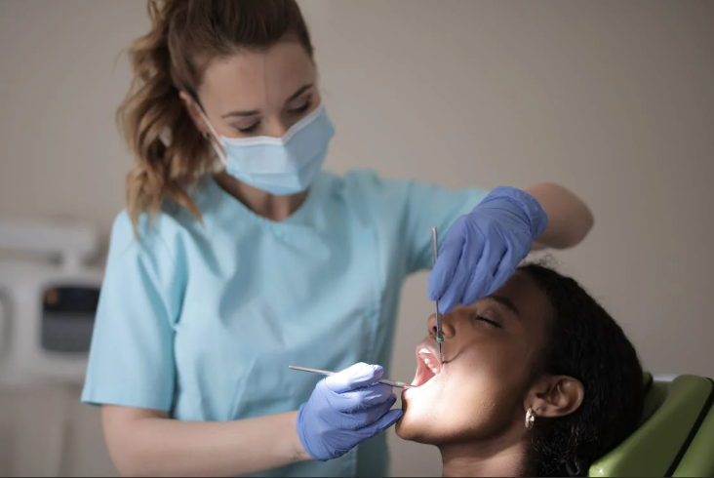

Integrated Primary Care - Community Pharmacy, Optometry and Dental
The ICB has focussed on access as a priority for all pillars of primary care, integrating primary care development to support access improvement. This has enabled both improvements to general practice access but also supported integration and access to community pharmacy and dentistry.
Dental
On 7th February 2024, NHS England announced changes building on the first reforms to the dental contract in 15 years that were
previously announced in July 2022. The plan to recover and reform NHS dentistry includes:
  • NHS dentists will be given a ‘new patient’ payment
  • Targeted funding to encourage dentists to work in areas which historically have been difficult to recruit to
  • A further increase in the minimum indicative units of dental activity value
  • Improving access in underserved areas through the use of dental vans
In addition, the plan also announces a range of government-delivered public health initiatives to improve the oral health of children
and recommits to the workforce growth and development outlined in the Long-Term Workforce Plan.
To support the delivery of the dental recovery plan, Lincolnshire have also developed and implemented the Lincolnshire Dental Strategy.
Community Pharmacy
patient need.
A Community Pharmacy Strategy is in development, to support the integration and development of Community Pharmacy services in Lincolnshire and across the East Midlands. This will build on the successful implement of Pharmacy First in Lincolnshire, providing improved access and choice for patients to be able to access additional services from their local pharmacy. This has also provided support to general practice, allowing some routine conditions to be easily seen by neighbouring community pharmacies, allowing practices to focus on long term condition management and urgent

Slide 36
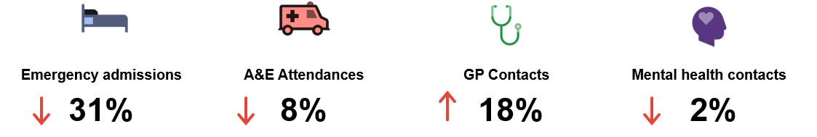
Integrated Primary Care - System Programmes and Strategies
Urgent and Emergency Care (UEC)
Alignment across the Primary Care-Communities and UEC work programmes has been a priority and key to delivering outcomes for Lincolnshire system. Areas of focus have included supporting discharge through commissioning additional GP capacity to support patient care in transitional beds, implementation of the Lincolnshire frailty strategy including the development of falls prevention services with enhanced frailty management pilots in primary care and a High Intensity Users (HIU) pilot – early data indicates this has significantly reduced UEC attendances by for people supported by additional case management capacity deployed through Primary Care Networks. People supported through the HIU pilot have a significantly improved experience and feel listened to and supported.
At the nine-month evaluation point Trent PCN reported the following for the cohort of 43 people supported through pilot:
There is ongoing work on supporting the interface across NHS 111 and primary care, including the development of 111-Pharmacy First referral processes which, alongside the impact discharge medicine service noted earlier in his report (slide 16), has supported urgent care pathways and patient access to same day care in the community.
Two PCNs involved in the national GP pilot project are looking at how they can optimise same day appointments within primary care and how this capacity can be aligned with local urgent care pathways. The pilot is at an early stage but the learning from this work will inform the development of the local GP strategy and balancing capacity and demand in primary care across preventative care, long-term condition management and access to same day care.

Slide 37
Integrated Primary Care - System Programmes and Strategies
Planned and Elective care
Primary care has supported the development and roll-out of redesigned cancer pathways (e.g. FIT testing) and is supporting the roll out of Community Diagnostic Centres (CDC) e.g. through the provision of physiological measurements services to support CDC diagnostic pathways in Grantham and on the east coast where access to diagnostics is more challenging. GPs will be on site at the Skegness and Lincoln CDC sites five days per week to support patient care.
This work provides a basis for primary care support to delivery of the system diagnostic strategy planned for development in 2025.
The ICB continues to support primary care and patient access to planned care pathways through:
Elective Activity Coordination Hub (EACH) – this service assists patient referrals to community and acute services and aims to improve patient experience, support choice and reduce some of the administrative burden for GP practices
Clinical decision support and population health management tools – the ICB commissions Ardens Clinical and Ardens Manager to support GP practices access up-to-date information on referral pathways and to streamline referral processes, freeing up clinical time and capacity.

Slide 38

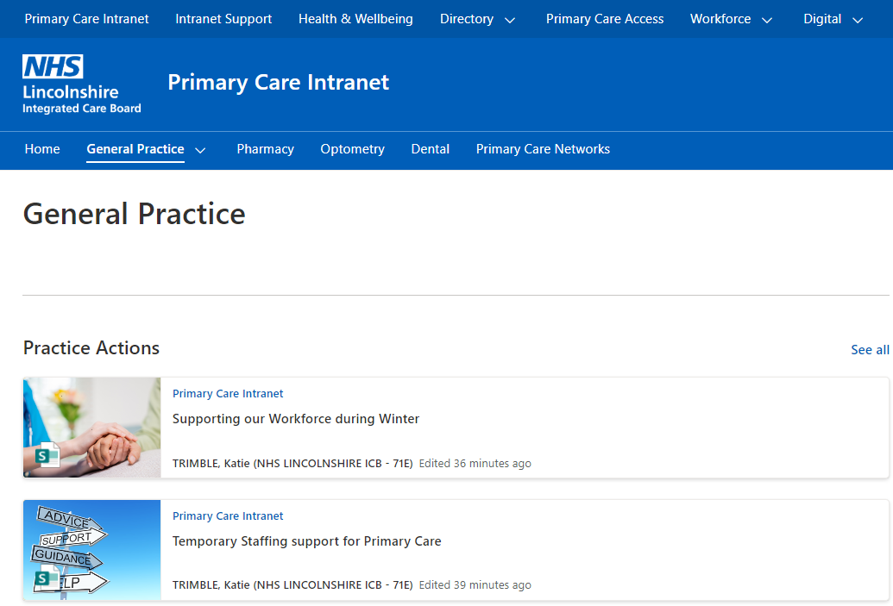
Communications
Communications to the public to raise awareness and support people being able to access care and to health and care partners within system are a critical element of the overall primary care access work. Delivery of key messages has been aligned to national communications programmes as well the development of local communications where required. A key area of focus earlier in the year was the public engagement on the development of the local GP strategy – referred to earlier in this update (slides 8 and 9).
Communications to practices has been underpinned by the roll out of the Lincolnshire Primary Care Intranet.
Communication campaigns undertaken in 2024/25 include:
NHS staff respect – and ongoing campaign to support GP practice teams by promoting civility and respect and creating a positive environment for all
Promoting access routes and making service information available to GP practice teams
Supporting PCNs to provide improved Enhanced Access information to the public
Public campaign to reduce waited appointments (Did Not Attends or DNAs)
Promoting sign up and use of the NHS App
Pharmacy First promotion
Hypertension case finding – optometrist and dentist pilot

Slide 39

Integrated Primary Care - NHS General Practice Pilot
Lincolnshire is one of seven ICB areas taking part in a national pilot to understand the gap between demand and capacity for GP practices. The pilot will use activity and financial data provided by PCNs at GP practice level to understand current demand and then provide additional funding for additional staff capacity and interventions to meet demand – this could include additional GPs or other staff, new service models e.g. enhanced same day care capacity or new digital solutions to improve back-office efficiency. The impact of interventions will be assessed through the pilot to inform future planning.
The pilot runs from September 2024 to March 2027 with three Lincolnshire PCNs taking part: Lincoln Healthcare Partnership, Apex and IMP. The initial data gathering phase has been completed and PCNs are now developing their plans for additional resource and interventions. Learning from the pilot sites will be shared with GP practices and PCNs as it becomes available.
Areas of Focus
Apex: same day access acute hubs to enable practices to focus on long-term conditions
Imp: streamline and optimise medication review processes to free up practice capacity
Lincolnshire Healthcare Partnership: managing demand across acute and long-term conditions and reduce administrative burden through digital opportunities.
Progress
The three PCNs have taken part in baselining weeks to understand how practice capacity is used currently, PCNs are developing plans for their areas of focus with recruitment of staff and implementation of plans from January 2025 onwards.

Slide 40
Programme Delivery Summary
Commitment | Work area | Status | Comments
Empowering patients | Self-referral |  | Achievement of target with further work on promotion planned
 | Community Pharmacy |  | Good progress but geography impacting, digital issues to be addressed.
 | NHS App |  | Uptake in line with national benchmark, work to improve access to records ongoing.
Modern GP Access | PCN Capacity Access Plans (CAIP) , SLF and GP Improvement Programme |  | Positive CAIP delivery in 23/24, GP collective action an issue in 24/25 – ICB supporting PCNs to secure available funding. SLF roll-out has slowed due to team capacity.
 | Digital telephony |  | Full roll out achieved and data reporting requirements met.
 | Online tools |  | Good access across Lincolnshire, funding an issue and team capacity to support optimal use and innovation spread required.
Building Capacity | Workforce |  | Workforce on plan and improvement in ARRS funding utilisation – recruitment and retention of all staff a challenge given financial concerns for practices.
Cutting bureaucracy | Primary –Secondary Care Interface |  | Positive progress on development of system collaborative and engagement with system clinical leaders – accelerating delivery of priorities underway.
Communication | Comms and Engagement Plan |  | Comms and engagement plan in place and aligned to national resources and messaging. Some further work to promote access work and raise awareness of opportunities, e.g. self;-referral, required.

Slide 41
Risks and Issues
Risk | Description | Rating | Mitigation
Estate | Estate capacity is a limiting factor and impacts on the potential for additional recruitment of workforce and patient consultations. |  | Use of digital access routes and remote working arrangements where appropriate so less reliance on traditional practice premises. Development of PCN estates strategies and alignment to system infrastructure strategy to develop medium term approaches. GP estates programme – use of available capital funding to optimise existing premises and support future developments.
Workforce | Recruitment and retention of workforce remains an ongoing issue for practices – recent budget announcements increase financial pressure and impact on GP practice capacity. |  | Primary Care People’s Plan including ongoing ARRS recruitment – aligned with system workforce plans and strategies. Development of ARRS partnership arrangements with system partners.
Digital | Digital framework paused – this has impacted on digital system funding and capability. |  | Streamlining of Online Consultation Tools with GP practices has retained functionality and mitigated financial pressures. Proposed development and expansion of Primary Care digital team capacity to support optimisation of digital opportunities.
GP Collective Action | Current collective action may impact on patient access to primary care. |  | The ICB continues to engage with GP practices, the LMC and system partners to mitigate and minimise impact on patient access. Sharing demand management best practice and innovation around Modern GP Access models. Ongoing work on Pharmacy First and primary-secondary care interface.
Pharmacy First | Digital issues and referral processes are impacting on GP referrals – geography and access to pharmacies is a factor in patient choice.

Slide 42
Appendices
Primary Care, Communities and Social Value Performance Report – December 2024

