Slide 1

Safeguarding considerations at the Learning Disability Annual Health Check
Dr Louise Roscoe
March 2023

Slide 2

Objectives
To understand the importance of the Annual Health Check for those with a learning disability
To look at the process of the Annual Health Check and the opportunities for picking up safeguarding concerns
To understand why those with a learning disability are at greater risk of abuse and neglect and how this may present
To understand the importance of professional curiosity, making safeguarding personal and reasonable adjustments

Slide 3
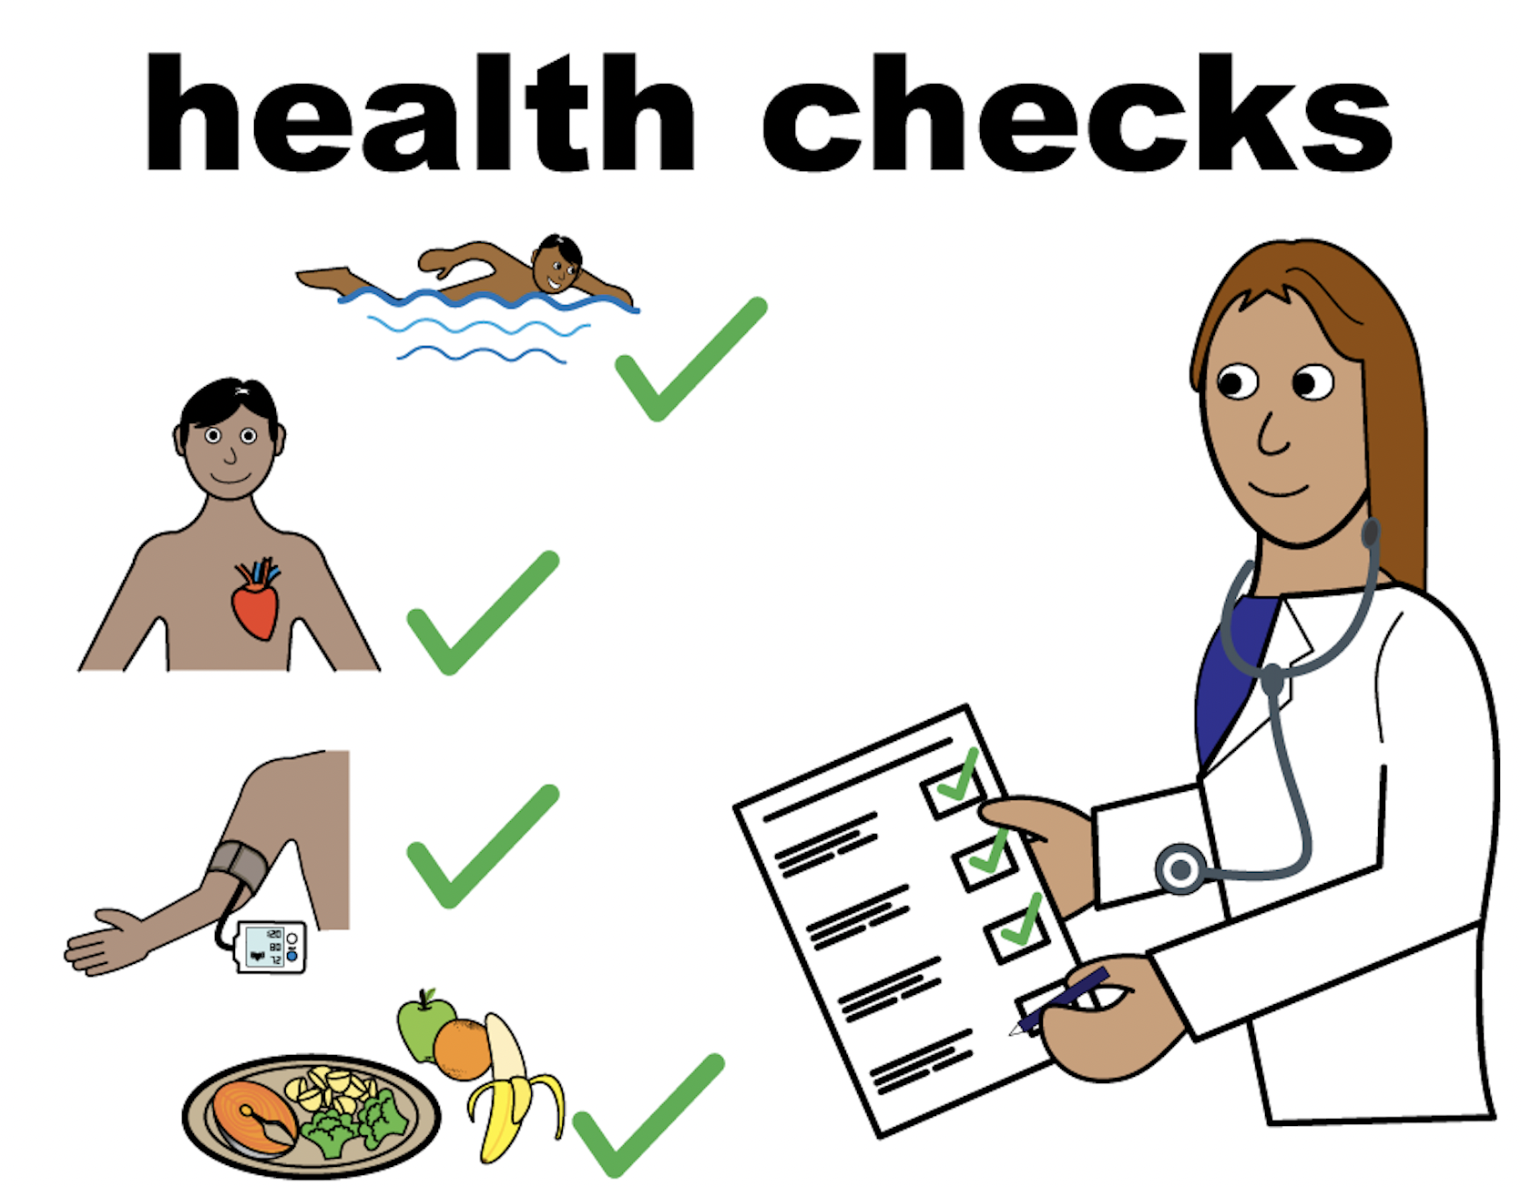
Why are Annual Health Checks important?
To help address health inequalities
Provide an opportunity to see a person when they are well
Allow us to
  gather and record information
  offer health promotion and screening
  identify new/potential problems
  manage chronic disease and review medication
AND provide an opportunity to understand their lived experience
  What is life like for you?
Notes:
We know that currently only about 25% of the estimated 1.1 million people in England with a learning disability are recorded on the current Learning Disability QOF register (Learning Disabilities Observatory, 2016). Improving the accuracy of the QOF register will help ensure people with a learning disability are offered Annual Health Checks.
The register should include those with moderate, severe and profound LD who are generally known to Community LD Teams) and those with mild LD with a second diagnosis such as ASD and mental health problems.
The annual health check is an evidence-based tool recommend by NICE (QS101,QS187) and an attempt to reduce health inequalities. Only 55%of those on LD registers had an Annual Health Check in 2017-18.
Health checks can identify undetected health conditions early, ensure the appropriateness of ongoing treatments and establish trust and support continuity of care. You may have seen the RCGP’s support pack that practices can use.
Completing a Health Action Plan provides the opportunity to positively promote health by encouraging cancer screening uptake, immunisations and healthy lifestyle. People with a learning disability are more likely to be obese, less likely to take up all national cancer screening offers and only 44.7% received a flu vaccination in 2018.
According to the NICE Guidelines on Medicines Optimisation, General practice has a key role in prescribing well to reduce harm (NICE NG5, QS120). For people with a learning disability, this includes reviewing the over- prescribing of psychotropic medication in the absence of a mental health diagnosis (STOMP initiative PHE, 2015).
We know that currently only about 25% of the estimated 1.1 million people in England with a learning disability are recorded on the current Learning Disability QOF register (Learning Disabilities Observatory, 2016). Improving the accuracy of the QOF register will help ensure people with a learning disability are offered Annual Health Checks.
The register should include those with moderate, severe and profound LD who are generally known to Community LD Teams) and those with mild LD with a second diagnosis such as ASD and mental health problems.
The annual health check is an evidence-based tool recommend by NICE (QS101,QS187) and an attempt to reduce health inequalities. Only 55%of those on LD registers had an Annual Health Check in 2017-18.
Health checks can identify undetected health conditions early, ensure the appropriateness of ongoing treatments and establish trust and support continuity of care. You may have seen the RCGP’s support pack that practices can use.
Completing a Health Action Plan provides the opportunity to positively promote health by encouraging cancer screening uptake, immunisations and healthy lifestyle. People with a learning disability are more likely to be obese, less likely to take up all national cancer screening offers and only 44.7% received a flu vaccination in 2018.
According to the NICE Guidelines on Medicines Optimisation, General practice has a key role in prescribing well to reduce harm (NICE NG5, QS120). For people with a learning disability, this includes reviewing the over- prescribing of psychotropic medication in the absence of a mental health diagnosis (STOMP initiative PHE, 2015).
General practice can play a vital role in improving person-centred care for people with a learning disability to help them have fulfilling lives in our community. This in turn can improve outcomes and ensure people live safely by raising awareness of the risk of abuse of vulnerable individuals.

Slide 4
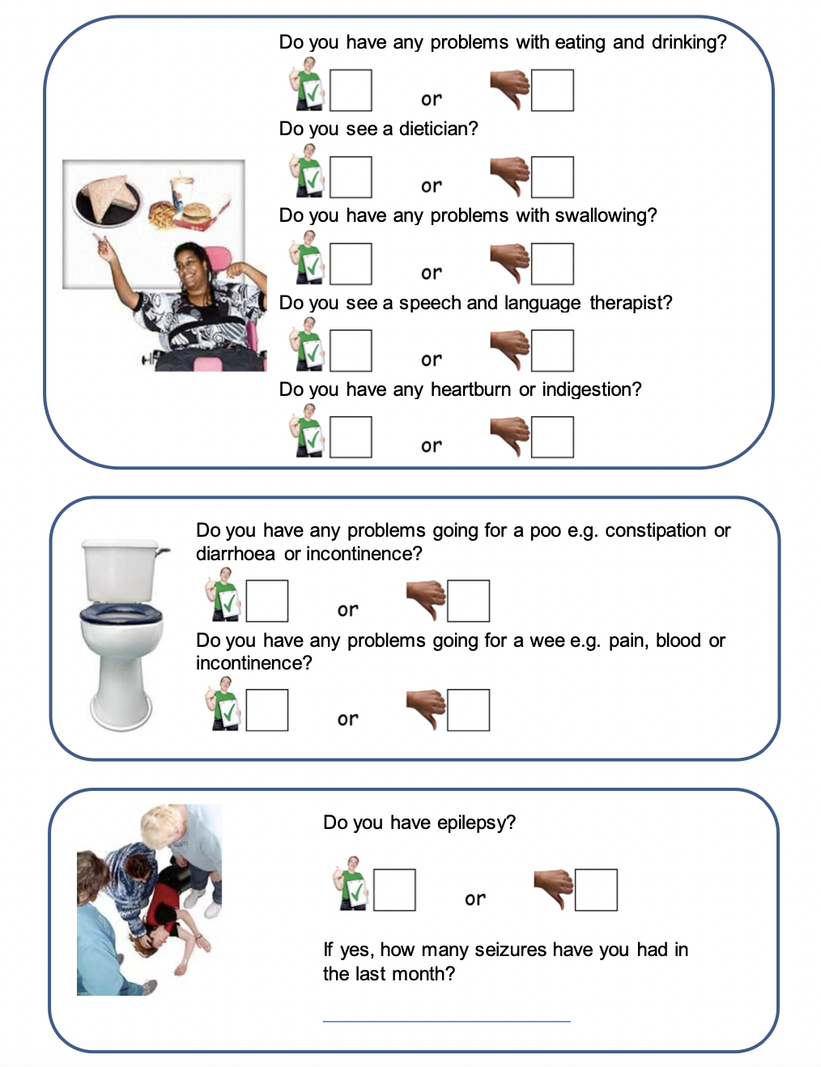
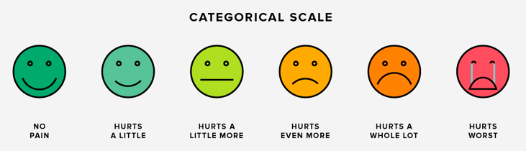
What happens at the Annual Health Check?
Accessible pre-check questionnaire
Use communication aids if needed
Bloods if appropriate
Appointment with a nurse or HCA
  Information gathering
  Height, weight, smoking, alcohol, exercise
  Health promotion and screening
  Check immunisations
  urinalysis
Pain scale diagram from Healthline
Pain Scale diagram from Healthline and Pre-check questionnaire image from Amazon
Notes:
Collect information regarding
A person’s living and care arrangements. It is important to identify carers so they can be supported and their health needs discussed
Details of those professionals involved in their care. This should include documentation of their social worker, involvement with local learning disabilities services and other professionals, such as dentist, optician, speech and language therapist, hospital consultants, voluntary agencies
Interests, employment, voluntary work and social life, which may directly relate to their mood and sense of wellbeing
Immunisation history
Participation in, and results of, national screening programmes
Demonstrate equipment as needed and perform general measures (such as height and weight)
Check if there has been any significant weight gain or loss. Ask about diet, sensory issues around food and who is responsible for providing food
Ask about their levels of physical activity and exercise
Perform urinalysis
Record details of smoking, alcohol consumption and any recreational drug use. Take the opportunity to provide suitable information for health promotion in these areas
Ask about relationships and sexual health, taking into consideration any information that may suggest abuse. Offer advice regarding contraception if appropriate. There are some great Easyhealth leaflets on this subject available on their website and the Family Planning Association has a range of resources for people with intellectual disabilities covering puberty, relationships, contraception, sexual health services and pornography https://www.fpa.org.uk/sex-and-disability
Ask about self examination of breasts/testes and offer information as needed
Look at the electronic record for evidence of co-morbidities. Ensure the person is being recalled for monitoring of chronic conditions such as diabetes and epilepsy
Offer annual ‘flu immunisation and one-off pneumococcal vaccination. Teenagers should receive human papilloma virus (HPV) immunisation.

Slide 5


What happens at the Annual Health Check?..
Appointment with GP – use Health Check Template
  General appearance
  Systems review
  Examination
  Syndrome specific checks
  Medication review
  STOMP: Stopping overmedication in people with a
  learning disability
  Health Action plan
Notes:
For some of the more common genetic syndromes associated with intellectual disabilities, there are syndrome-specific checklists. These can be very useful in tailoring the health check to the needs of the individual. Lists can be found in the RCGP Annual Health Checks for Learning Disabilities guidelines.
Ask about common problems and activities of daily living eg. Mobility, feeding, toileting
Also routine checks – optician/dentist and other sensory problems – hearing
Ask about self examination of breasts/testes and offer information as needed
For example, for people with Down’s Syndrome, it is important to actively ask about symptoms suggestive of sleep apnoea, coeliac disease and hypothyroidism. As mentioned previously, dementia screening should take place for those aged over 40yrs. Of particular relevance are musculoskeletal problems and symptoms that might indicate acute or chronic spinal cord compression eg. Pain in the neck or torticollis, unsteadiness or deterioration in bladder or bowel control.

Slide 6
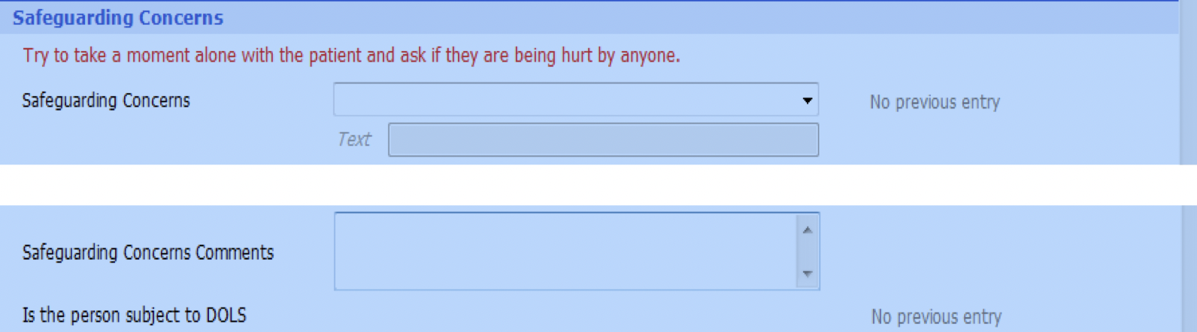
Safeguarding considerations
From the Ardens LD Annual Health Check template:
Could safeguarding be more than this box?

Slide 7
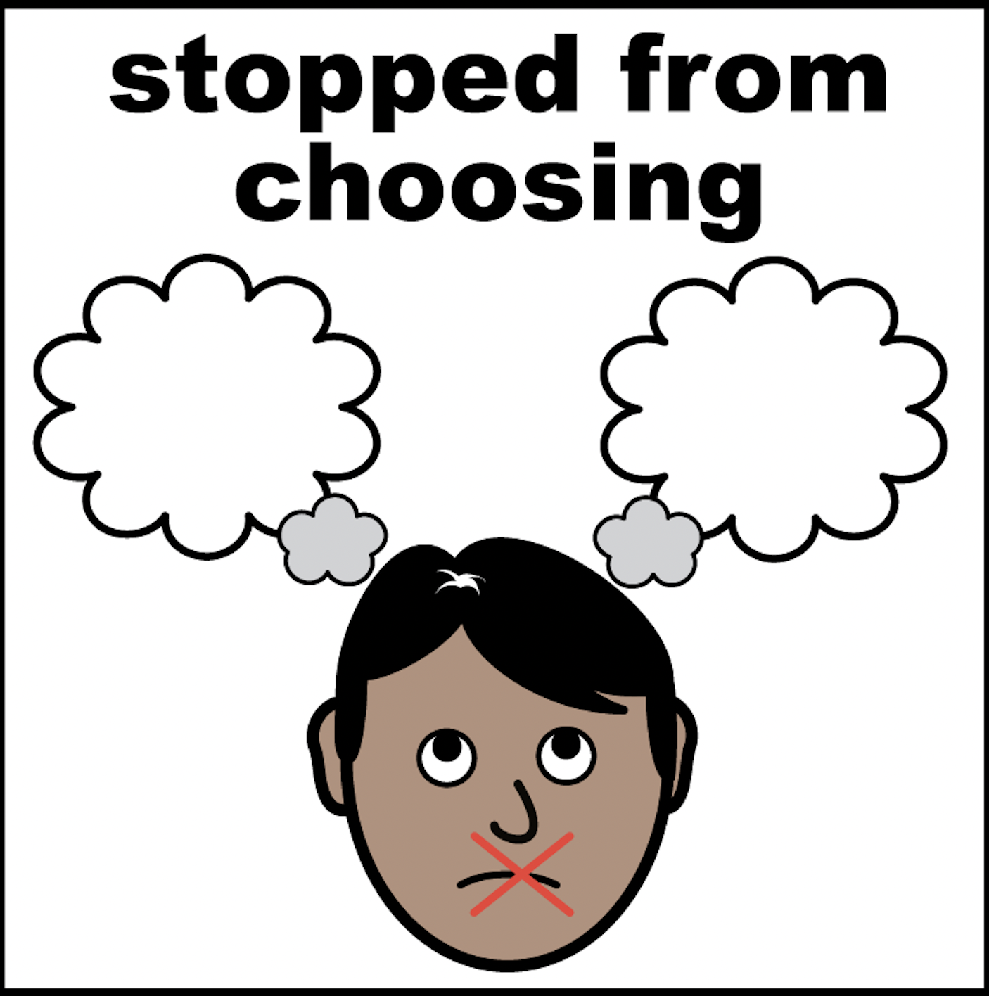
Why are those with learning disabilities more at risk of abuse and neglect?
Factors include:
  May have reduced awareness of social norms
  May have reduced ability to understand and recognise signs of abuse
  Dependence on others
    Personal care
    Accessing help
  Communication difficulties
  Social isolation
Abuse or neglect likely to go on for longer
Remember those going through transition (14-17yrs) are still children
Notes:
Care and support needs
More vulnerable to abuse, more likely for it to go unnoticed or unreported
Dependence on others for care and access to help/professionals

Slide 8
Types of abuse and neglect
Domestic abuse | Self-neglect
Financial abuse | Physical abuse
Neglect or acts of omission | Sexual abuse
Modern slavery | Discriminatory abuse
Organisational or institutional abuse | Psychological or emotional abuse

Slide 9

How might abuse or neglect present?
  Changes in appearance or weight
  Changes in behaviour
  Inappropriate care
  Signs of physical injury
  Sleep problems
  Distress, low mood, unhappiness
  Missing money or personal items
  Remember diagnostic overshadowing

Slide 10
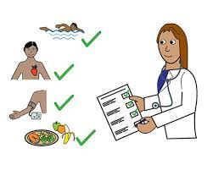
Case 1, Tom:
Tom is a 20 year old gentleman with Down’s syndrome with mild learning disability.
He is prescribed pregabalin for anxiety. Tom attends for his learning disability annual health check.
The nurse completes the observations and tells you she is concerned about Tom. He mentioned a new friend Kevin whom he met through an internet chat room. Kevin has recently moved into Tom’s flat and looks after Tom’s pregabalin. Kevin has told Tom to keep a knife under his bed “for my own safety.” Kevin’s friends visit the flat frequently and Tom has seen syringes on the floor. The nurse also noticed a bruise on Tom’s inner arm when checking his BP.
Use the signs of safety approach to consider:
What is working well?
What are you worried about?
What needs to happen?
How can you use the LD Annual health check to explore the issues further?

Slide 11
Summary
What is working well?
Tom has attended for AHC and nurse has raised concerns- professional curiosity
What are you worried about?
Unmet care and support needs?
? Cuckooing/home invasion
? Grooming
What needs to happen?
Can Tom consent to sharing information? Who should be responsible for capacity assessment?
Is Toms vulnerability and the situation’s exploitative nature taking away his freedom and capacity to make his own decisions? Who else needs to be involved?
Does the surgery use routine enquiry to ask about safety?
Does the surgery have a Safeguarding Lead and deputy, domestic abuse champion and LD lead?
What Policies and procedures are in place ?
LD annual health check
Housing, diet, living conditions, social history

Slide 12
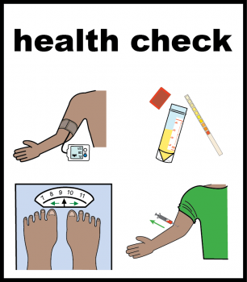
Case 2, Julie:
Julie is a 60 year old lady with learning disability
She has Type 2 diabetes and is not on medication
Her last blood test was 2 years ago (HBA1C 54 GFR70)
She lives in a residential setting and is brought to her LD health check with a carer. She is predominantly non-verbal though can answer yes or no questions.
Your practice nurse has completed initial observations; you note that her weight has dropped 6 kg since last years check, her BP is normal. The nurse remembers seeing her in previous years and comments that today she seems very withdrawn and quiet.
What other information would you be looking for as part of the LD health check and what actions may you need to consider?

Slide 13
Further Information:
Carer accompanying Julie works only part time with her but agrees a few years ago she was always giggling and liked music, recently she’s been quiet and takes herself to her room on her own.
Carer reports that sometimes she will check Julie’s BM when the manager asks her to, but can’t remember when it was last done and Julie doesn’t like it.
She thinks Julie probably eats less than she used to. They don’t keep a food intake chart at the home or monitor bowels or urine but there’s no problems she knows of.
Julie has 2 sisters she thinks, but they don’t visit often.
Clinical notes have coded that Julie was not brought to her Diabetes annual review earlier in the year.
Her manager says Julie wouldn’t want a blood test.

Slide 14
Summary..
What is working well?
Julie has been brought to her annual health check and is being supported by a carer
What are you worried about?
Unmet care and support needs?
? Untreated or worsening diabetes
? Mental health – withdrawn/quiet as marker of mood?
? Neglect – lack of monitoring at home of weight/diet etc, ‘Was Not Brought’ to appointment, loss of weight ?marker, withdrawn/behaviour change ?neglect or abuse
What needs to happen?
Professional curiosity – ask more questions, see Julie again, consider involving LD team or review in the community
Communication - how much information can Julie understand and give you, what might support her with this? use easy read tools, picture charts, LD team
Physical health – blood tests to monitor DM/renal/ check for other causes eg anaemia/thyroid. Can she consent to this? Does she have capacity?
If no capacity, follow best interest process; best interest meeting, who needs to be involved?
Reasonable adjustments – consider BT at home/surgery, emla, distraction, finger prick tests, desensitisation work and support with LD team
Diagnostic overshadowing
?Refer to safeguarding team
LD annual health check
Housing, diet, living conditions, social history, family
Systems review, unmet health needs?
Health action plan

Slide 15
Learning points
Annual Health Checks are a reasonable adjustment introduced to reduce the health inequalities faced by people with learning disabilities
People with learning disabilities are at increased risk of abuse and neglect
Annual Health Checks provides an opportunity to identify safeguarding concerns
Professional curiosity is key to understanding someone’s lived experience - think the unthinkable and ask the next question
Remember to make safeguarding personal – ‘no decision about me without me’
Use reasonable adjustments to help with communication, decision-making etc.
Remember the risks associated with diagnostic overshadowing

Slide 16
References and resources
Annual Health Checks
  Health Check Resources & Guides - NDTi
  Annual-Health-Check-Toolkit-Final.pdf (ndti.org.uk)
  Don't Miss Out - Annual Health Checks Mencap
  ES701458_CCS269_CCS0918615844-001_STOMP STAMP Narrative.pdf (england.nhs.uk)
  Medicine Information - Learning Disabilities Medication Guideline - University of Birmingham
Reasonable Adjustments
  Reasonable adjustments for people with a learning disability - GOV.UK (www.gov.uk)
  Blood tests for people with learning disabilities: reasonable adjustments case studies - GOV.UK (www.gov.uk)
  Easy read resources from Easy Health
  Leeds Learning Disability service – Easy on the i

Slide 17
References and resources..
Safeguarding
  BMA Mental Capacity act toolkit
  BMA Best Interests decisions toolkit
  RCGP Child Safeguarding toolkit
  RCGP Adult Safeguarding toolkit
  Safeguarding resources – Ann Craft trust
  Professional Curiosity – Norfolk Safeguarding Adults Board
  Making safeguarding personal – Ann Craft trust
  Diagnostic overshadowing: see beyond the diagnosis
  NSPCC guidance for protecting d/Deaf and disabled children and young people from abuse
  Thank you

