Slide 1
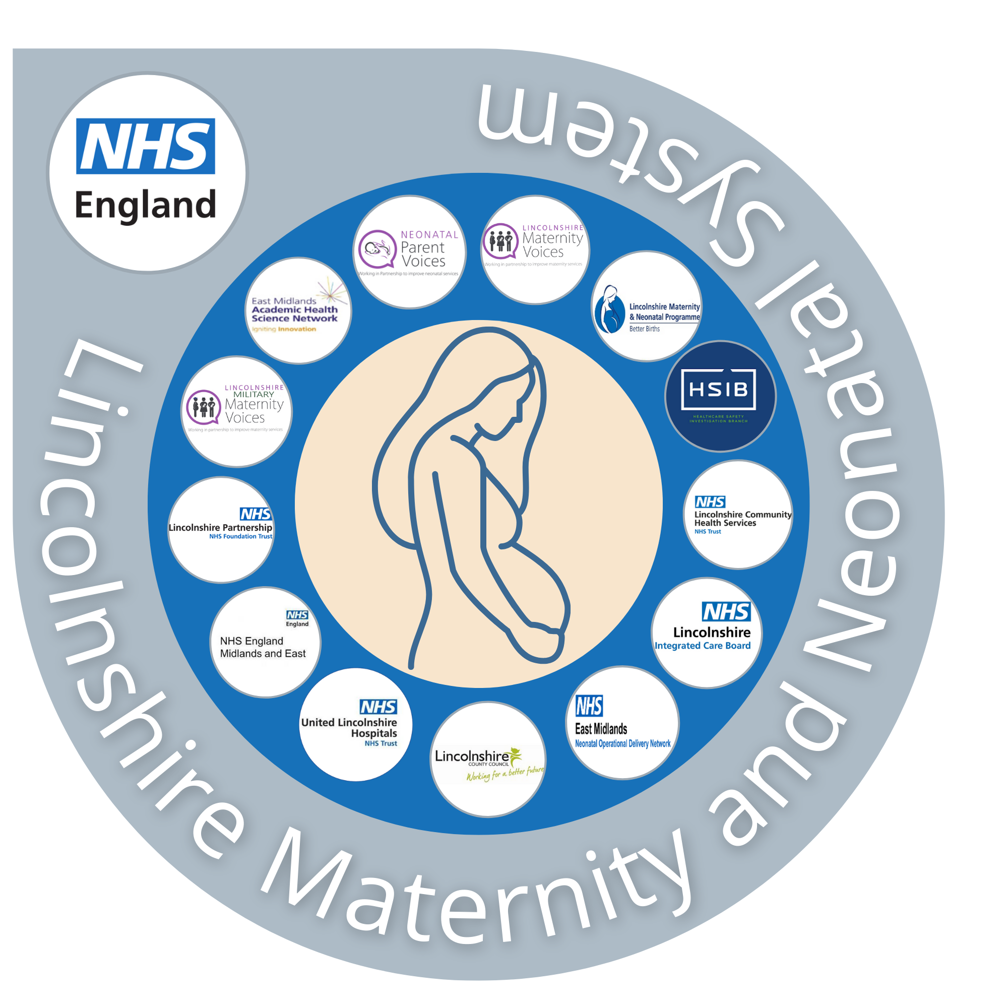
Lincolnshire Maternity and Neonatal System
Equity and Equality Action Plan
September 2022

Slide 2
The Big Idea
'Equity means that all mothers and babies will achieve health outcomes that are as good as the groups with the best health outcomes¹'
By producing the Lincolnshire maternity and neonatal equity and equality action plan we will:
Meet NHS guidance to improve equity and equality in maternity and neonatal care, aligned to the NHS five priorities¹
  Priority 1: Restore NHS services inclusively
  Priority 2: Mitigate against digital exclusion
  Priority 3: Ensure datasets are complete and timely
  Priority 4: Accelerate preventative programmes that engage those at greatest risk of poor health outcomes
  Priority 5: Strengthen leadership and accountability
Ensure the co-produced plan is informed by local intelligence, in-order to deliver interventions that are equal, equitable and specific for the Lincolnshire maternity and neonatal population.
¹ NHS England » Equity and equality: Guidance for local maternity systems

Slide 3
Lincolnshire Long Term Plan
‘We want everyone to have the best start in life by working to deliver healthy babies, support new mothers, improve children and young people’s health and wellbeing and reduce inequalities’

Slide 4
Who we are & our aims
The Lincolnshire Maternity and Neonatal System (LMNS) brings together all partners who are involved in providing and organising maternity care, including the maternity voice partnership who represent the voice of families.
We believe that maternity services should be safe, personalised, kind, professional and family friendly. Every woman should have access to information to make informed decisions and access support centred on their individual needs and circumstance.
Different populations have different risk and protective factors. Therefore, different approaches are needed for different populations: one size does not fit all.
The Lincolnshire Maternity and Neonatal System is made up of the following partners:
NHS England Midlands & East
Lincolnshire NHS Integrated Care Board
Lincolnshire County Council
United Lincolnshire NHS Hospitals Trust
Lincolnshire Partnership NHS Foundation Trust
Lincolnshire NHS Community Health Services
Lincolnshire Maternity & Neonatal Programme Team
NHS East Midlands Neonatal Operational Delivery Network
Lincolnshire Maternity Voices Partnership including Neonatal & Military subgroups
East Midlands Academic Health Science Network
Healthcare Safety Investigation Branch
The Lincolnshire maternity and neonatal services need to respond to each person's unique health and social situation, with increasing support, so that care is safe and personal for all.

Slide 5
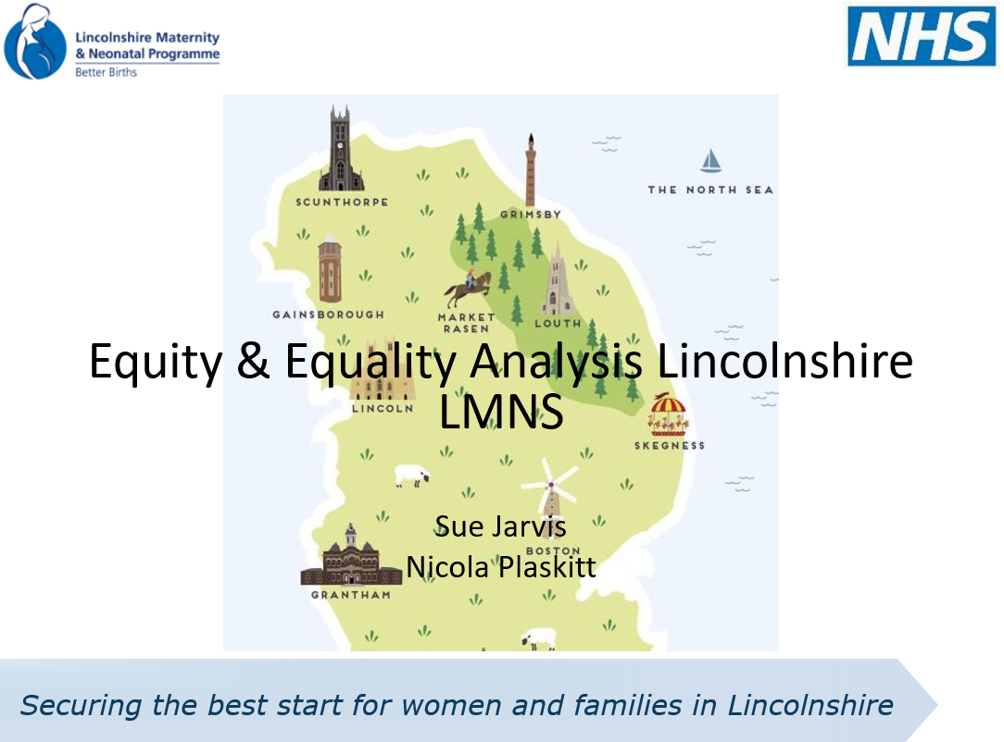
Step One: Understanding the Lincolnshire Population
A full maternity and neonatal population analysis has been produced looking at health outcomes, community assets and staff experience. This was compiled utilising the data available to us at the time, and it should be noted that there were some differences in the depth of information available.
This analysis, along with the identified gaps, has been utilised to inform the action plan. A summary of the population analysis is covered on slide 6-15.

Slide 6
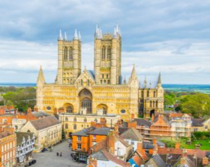

Introduction to Lincolnshire
Lincolnshire is the fourth largest county in England covering 6,959 km² with the fourth most dispersed population and 80km of North Sea coastline
Lincolnshire is predominantly rural with poorly developed road networks, no motorways and comprising mainly of single carriageway A and B roads with less than 30 miles of dual carriageway in the whole county, which impacts on the ability of the population to access services including healthcare
There are around 200 caravan sites, the largest being in Skegness, this inevitable leads to seasonal variation in population density and diversity. In addition, there are nearly 25,000 static caravans on the Lincolnshire coast (the largest concentration in Europe) with a permanent population of over 6,000 people. Access to care is particularly problem for these communities who may also be at financial disadvantage
Large areas of land in the county are used for agriculture, and the main employers in the county are in agricultural, food processing, road haulage, logistics industries and the NHS
Seasonal work contributes to population changes and instability in the job market this is likely to affect younger groups too.

Slide 7
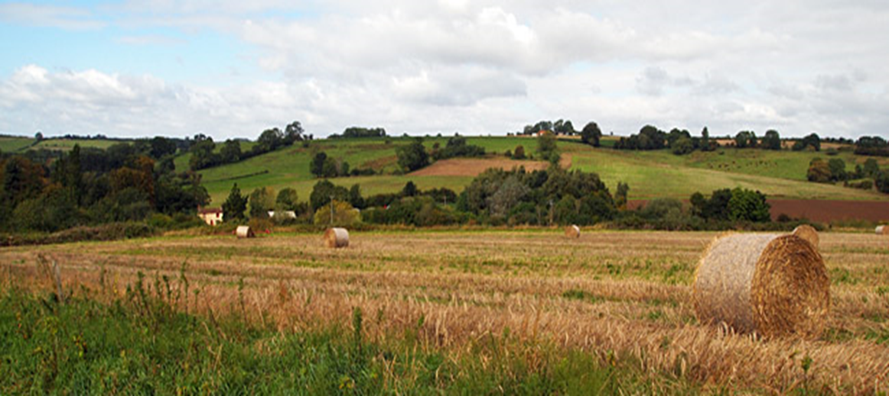
Challenges to Lincolnshire
‘As a rural and coastal county, Lincolnshire faces a series of interlinked challenges, including sparsity, poor transport and digital infrastructure compared to urban counterparts contributing to social isolation. People have to travel further to access services and many communities have limited or no mobile phone and broadband coverage.’
Professor Christopher Whitty – Chief Medical Officer for England
Chief Medical Officer’s Annual Report 2021 - Health in Coastal Communities (publishing.service.gov.uk)

Slide 8
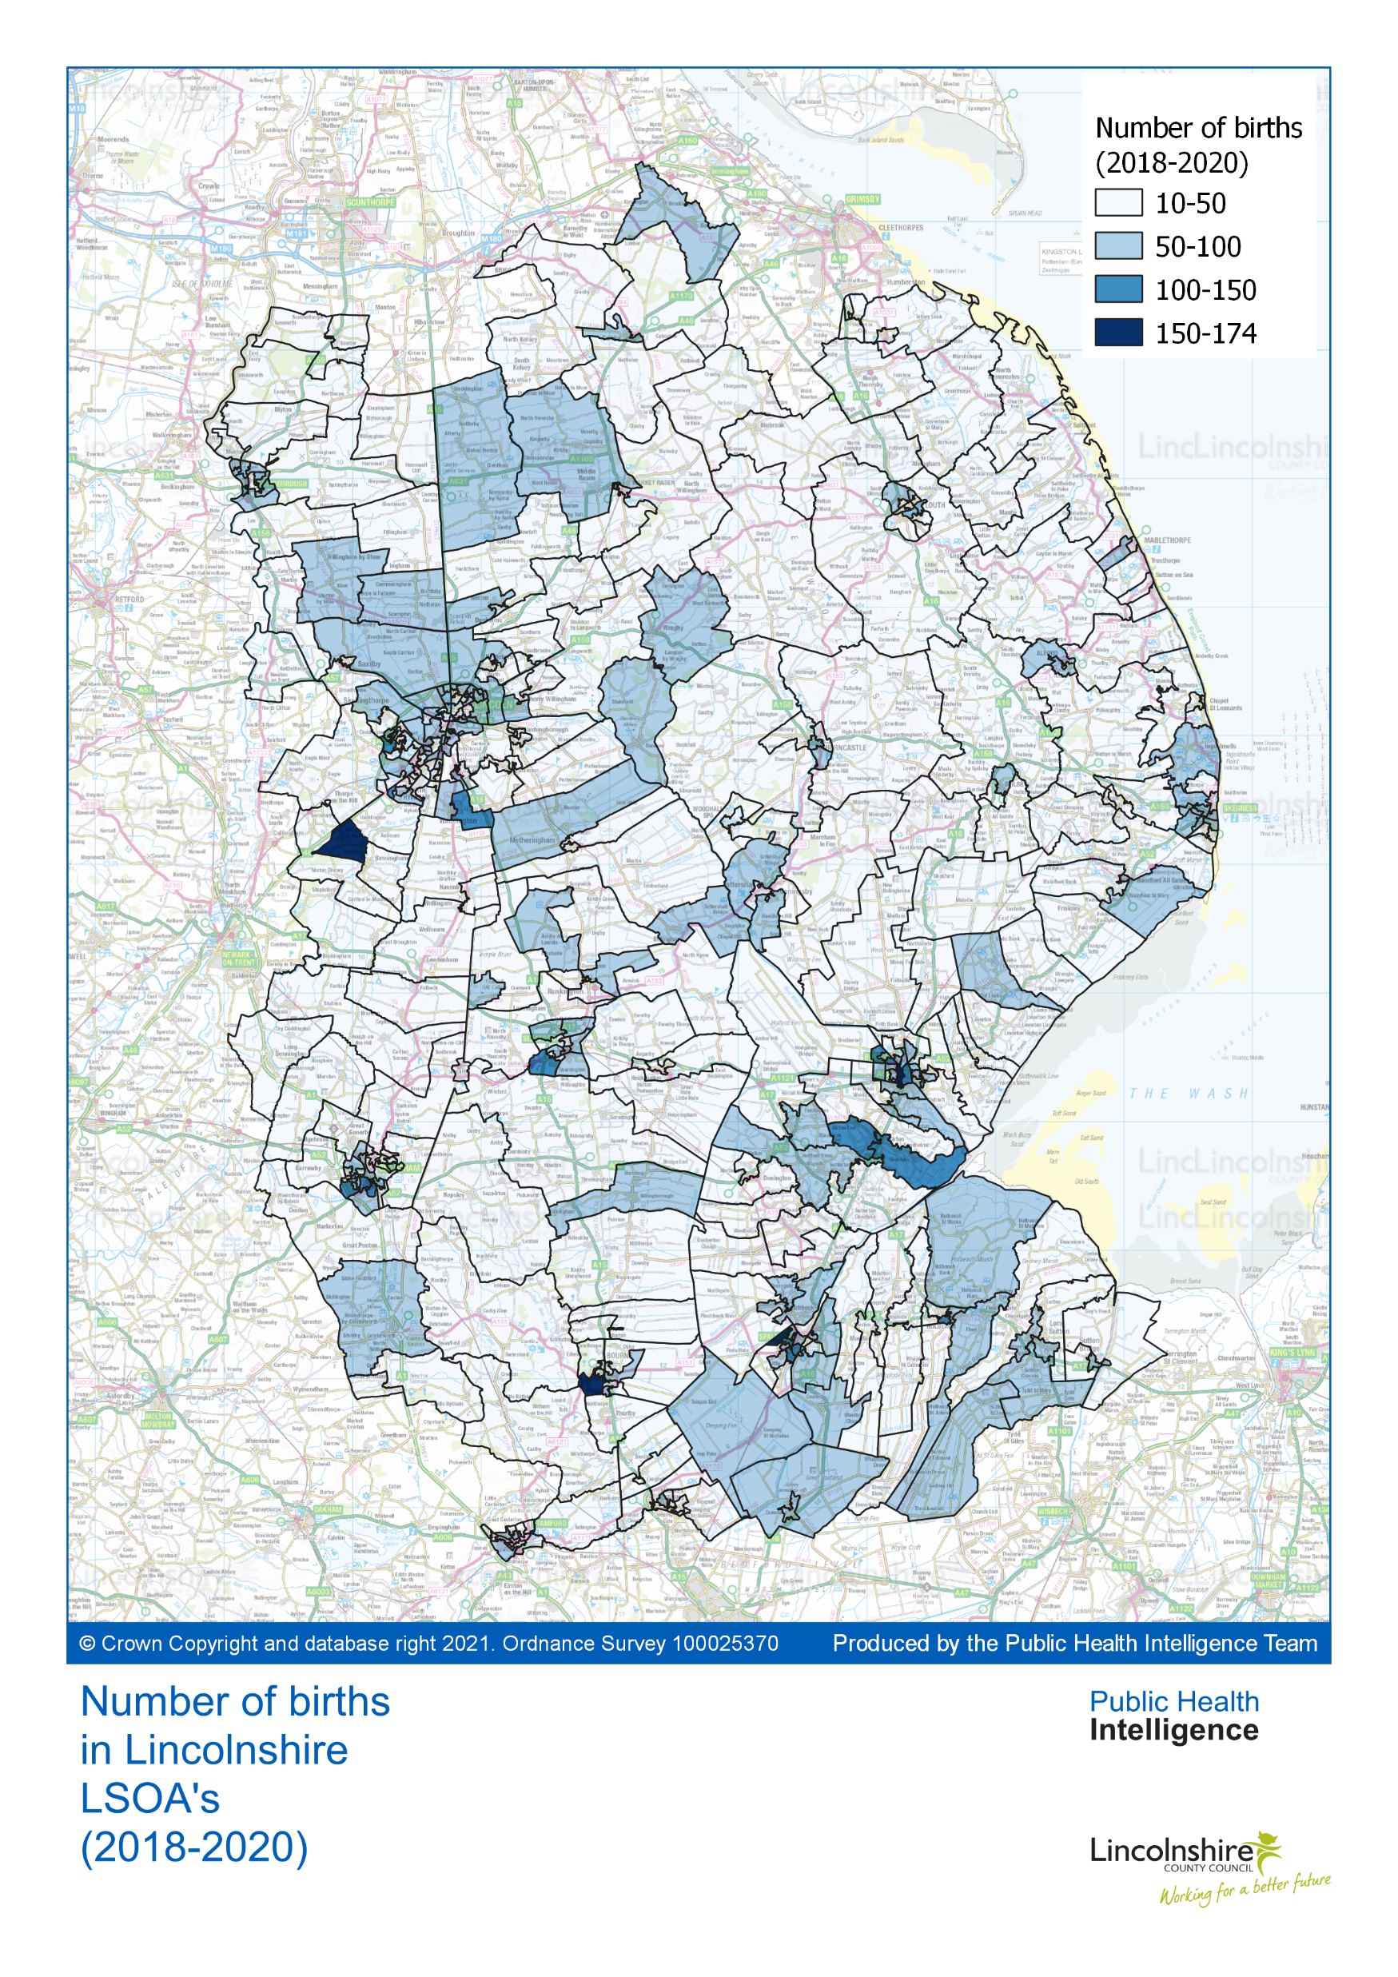
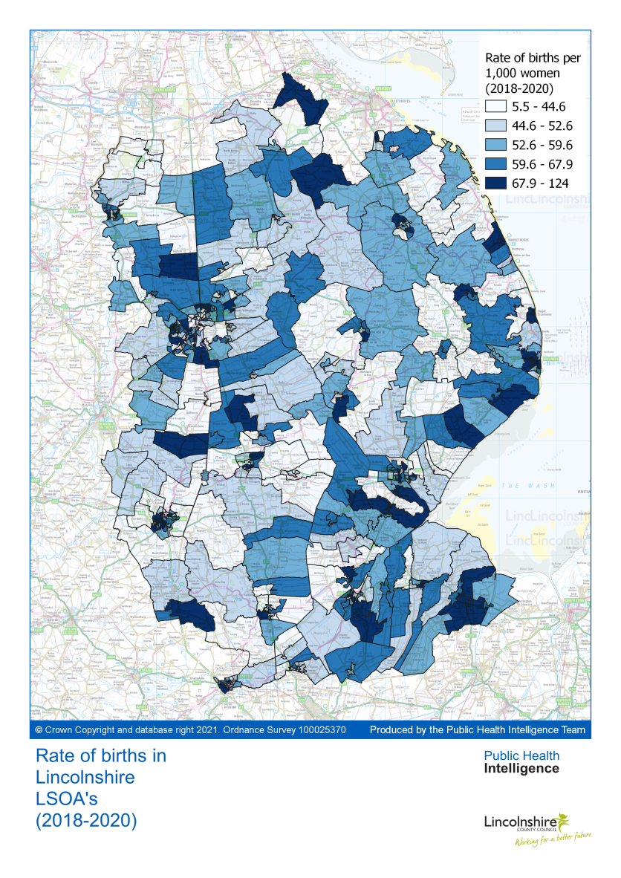
Lincolnshire Births
These maps represent births across Lincolnshire.
This shows the Lincolnshire Integrated Care System (ICS) footprint. It should be noted that some women birth out of the county and the Local Maternity and Neonatal System (LMNS) footprint.
Source: ONS Public Health Intelligence Profiles

Slide 9
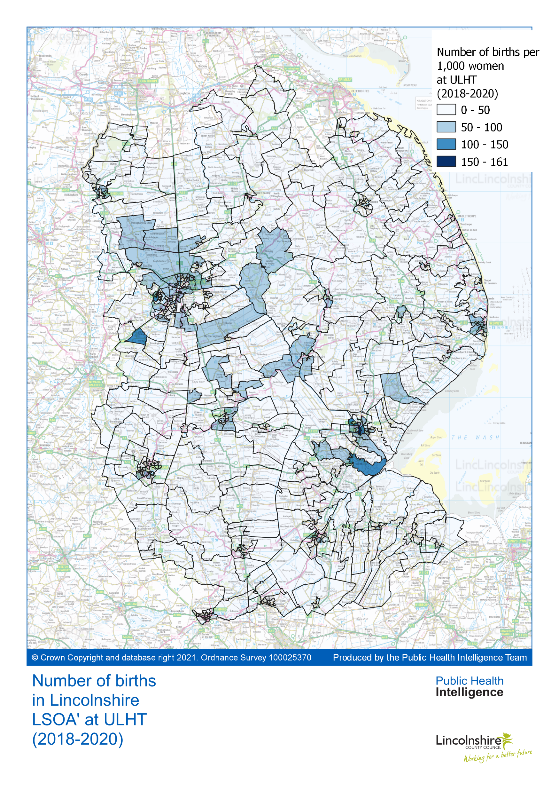
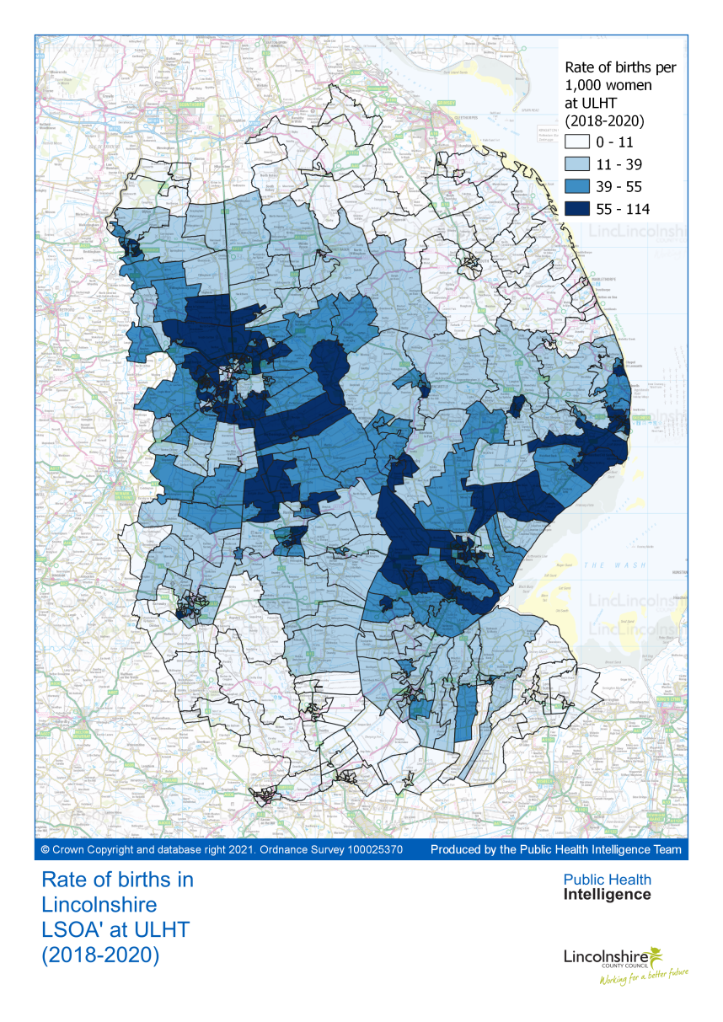
Lincolnshire Maternity & Neonatal System (LMNS) Births
These maps represent our LMNS (United Lincolnshire Hospital Trust) births across Lincolnshire.
Source: ONS Public Health Intelligence Profiles

Slide 10
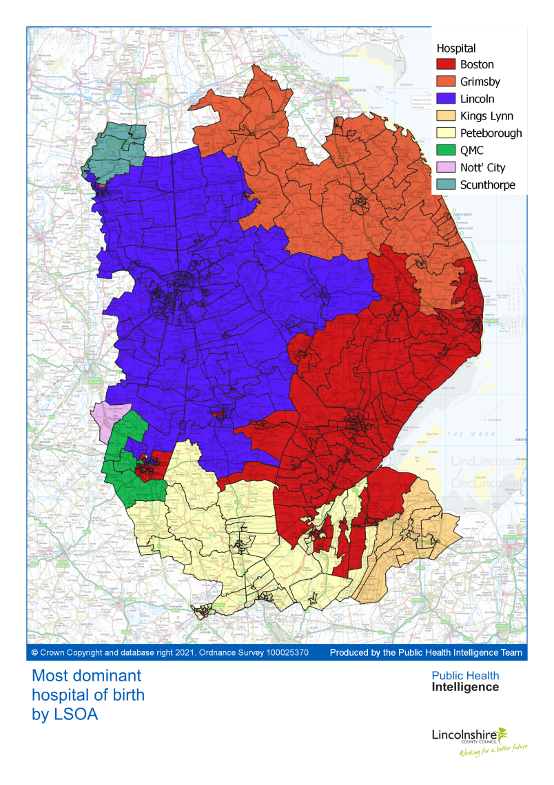
Birthing Destinations
This map demonstrates the number of hospitals used by women with a Lincolnshire postcode.
In 2021/22 there were 6,287 births to women with a Lincolnshire postcode, 4,289 (68.1%) of these were delivered in hospitals within United Lincolnshire Hospitals Trust (ULHT)
Whilst women birth outside of the county some of these women will receive antenatal and postnatal care from ULHT. However, all women will receive care from our Lincolnshire Children’s Health 0-19 (SEND 25) service, Early Years Providers and our Mental Health Trust.
High risk women and babies are predominantly cared for out of Lincolnshire; mainly at the Nottingham sites.
Source: ONS Public Health Intelligence Profiles

Slide 11
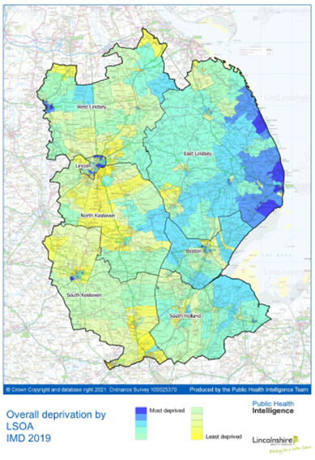
Deprivation
Indices of Multiple Deprivation (IMD) is an overall measure of deprivation experienced by people living in an area based on seven main types of deprivation (income, employment, education, health, crime, access to housing & services, and living environment).
48% of people in Lincolnshire live in rural areas compared to the national average of 18%.
Levels of deprivation show that the rural, coastal areas of the Boston and East Lindsey Local Authorities are amongst the most deprived areas of the county. This is particularly seen around the coastal towns of Mablethorpe and Skegness which are in the top 10% most deprived areas in the country and consequently, a notable proportion of women in these areas are reliant on public transport. This presents specific issues for some women accessing maternity care in rural Lincolnshire. Away from the coastal areas, there are areas of high deprivation in and around Lincoln and Gainsborough.
Source: ONS Public Health Intelligence Profiles

Slide 12
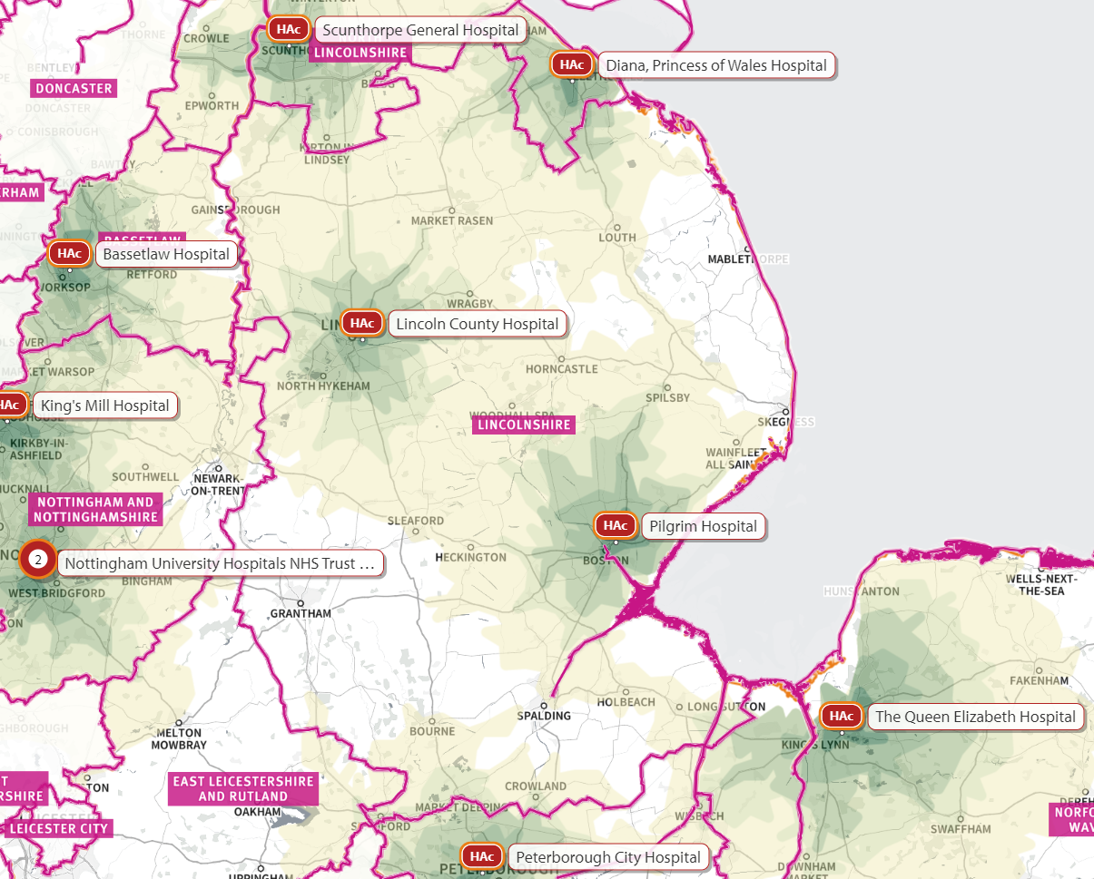
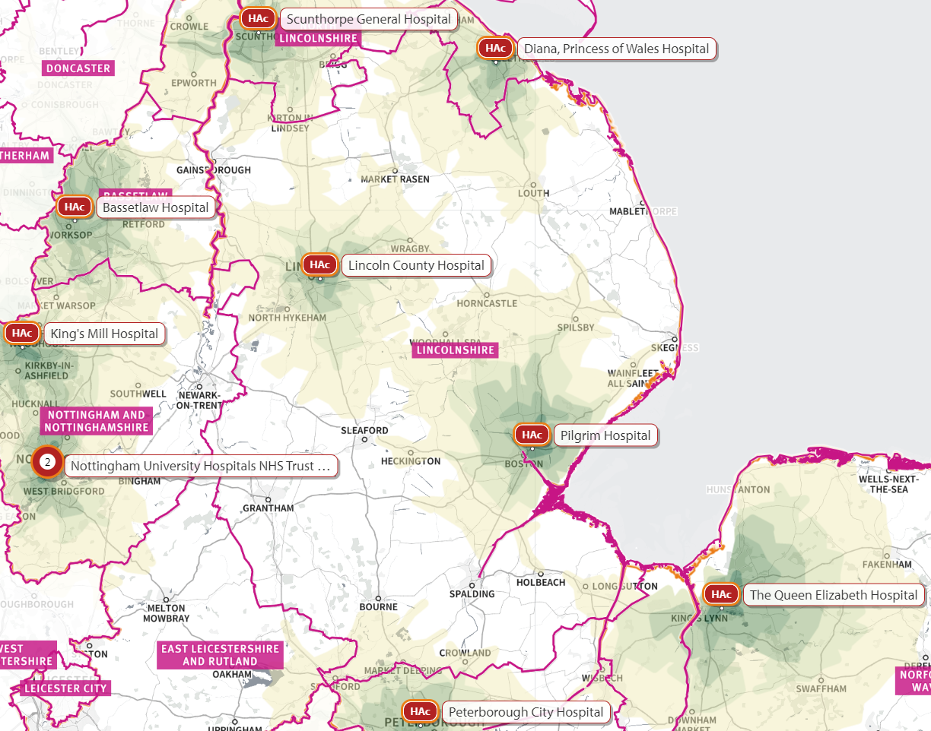
Access to Hospital Privately Owned
Transport
Coloured areas show area within 30 minutes travel time by car to main hospitals utilised by Lincolnshire women during off-peak hours
Coloured areas show area within 30 minutes travel time by car to main hospitals utilised by Lincolnshire women during rush hour
Source: SHAPE: Strategic Health Asset Planning and Evaluation

Slide 13
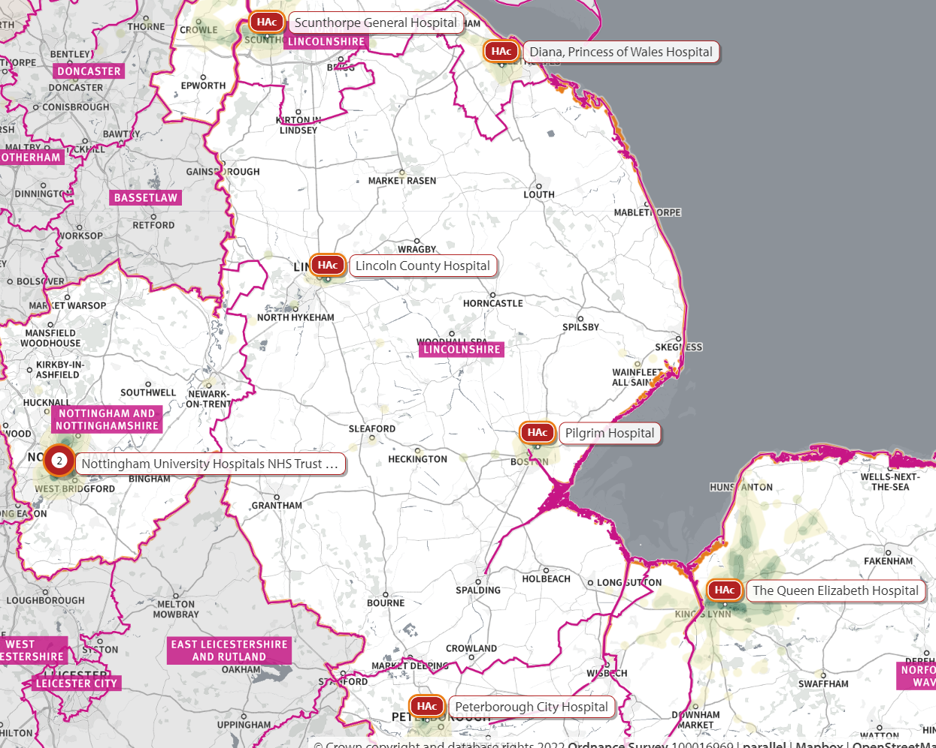
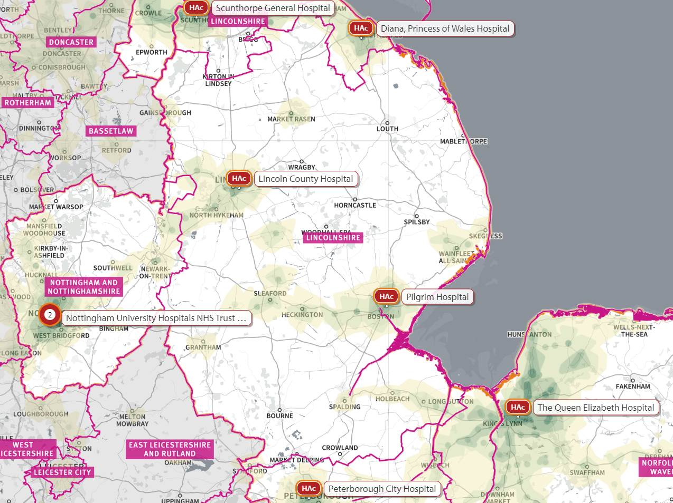
Access to Hospital - Public Transport
Areas in white are more than 60 minutes travel time by public transport to the nearest hospital with maternity services used by Lincolnshire based women
Areas in white are more than 120 minutes travel time by public transport to the nearest hospital with maternity services used by Lincolnshire based women
These maps highlight the challenges to women and families accessing hospital based maternity services via public transport due to the rurality of many parts of the county
Source: SHAPE: Strategic Health Asset Planning and Evaluation

Slide 14
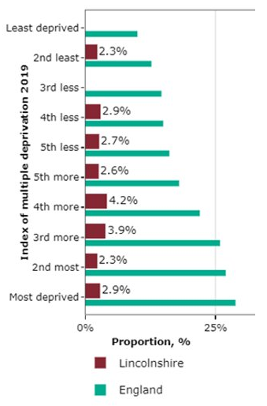
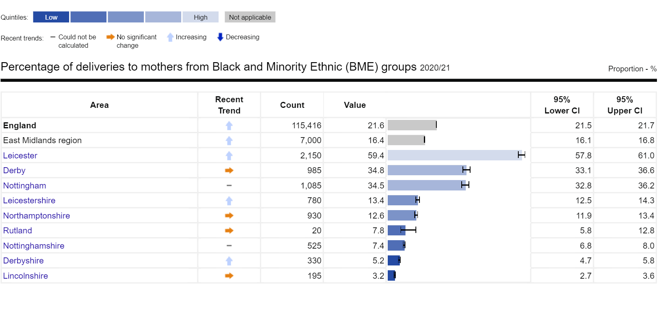
Percentage of deliveries to mothers from
Black and Minority Ethnic (BME) groups and by IMD
Demographic information on ethnicity of mothers illustrates that the percentage of deliveries to mother from Black and Minority Ethnic (BME) Groups is significantly lower than the average for England and East Midlands region.
This graph demonstrates that Lincolnshire’s percentage of deliveries to mothers from Black and Minority Ethnic (BME) groups does not mirror the national IMD trend. No significant differences are seen in the proportion of deliveries to mothers from BME groups by IMD in Lincolnshire. ​
Source: PHE Fingertips
Source: Hospital Episode Statistics (HES) 2019/20

Slide 15
Summary – the Lincolnshire Picture
The county has high levels of deprivation with areas, including the East Coast, being in the top 10% most deprived;
Poor road systems, especially to the most deprived areas in the rural, coastal east of the county, making access to care an issue;
Poor connectivity to mobile systems especially in the more remote areas of the county;
Availability of language translation services can be a challenge with some migrant populations;
Communication with hard-to-reach population groups, such as travellers and people staying long-term on caravan sites, make it difficult to ensure that best options for care are explored and made available;
Except for abortions in women aged under 25 having abortions after previous births, Lincolnshire has a significantly lower rate of abortions than the vast majority of all the upper tier local authorities (UTLA/UAs) in England. However, there is a far higher proportion of abortions taking place 10 weeks after conception;
Higher under 18 conception rate compared to national average;
High levels of women continuing to smoke throughout pregnancy;
Increasing levels of Obesity and Diabetes;
Increasing number of women experiencing Mental Health issues;
Lower than average breastfeeding rates.
Moving forward we acknowledge collaboration will be required to ensure we get a full picture of the Lincolnshire maternity population, our staff and their experience and outcomes: this is reflected in our equity and equality action plan.

Slide 16
Step Two: Production of the Equity and Equality Action Plan
Our plan has been informed by a detailed review of the available data alongside feedback from our service users and professionals.
This has allowed the LMNS to understand the population, their access to care and develop a detailed action plan to address the 5 key priorities outlined to the system by NHS England and make Lincolnshire's maternity and neonatal care equal and equitable for all.
The on-going process of collecting patient feedback, hearing from professionals working with families and reviewing the data is a theme demonstrated in the action plan and will be key to inform the comprehensive equity and equality strategy. A summary of some of the engagement and co-production work is shown on slide 17 – 20.
Patient Feedback
Review Data
Partner Feedback
Review Service Requirements

Slide 17

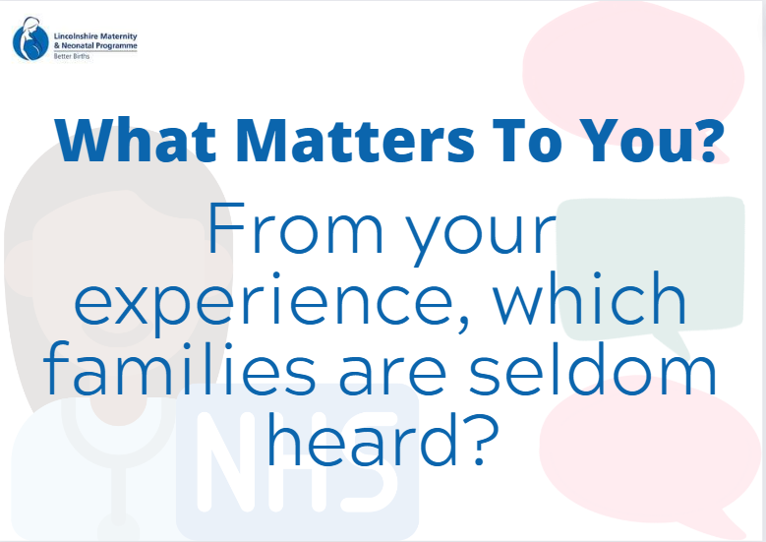
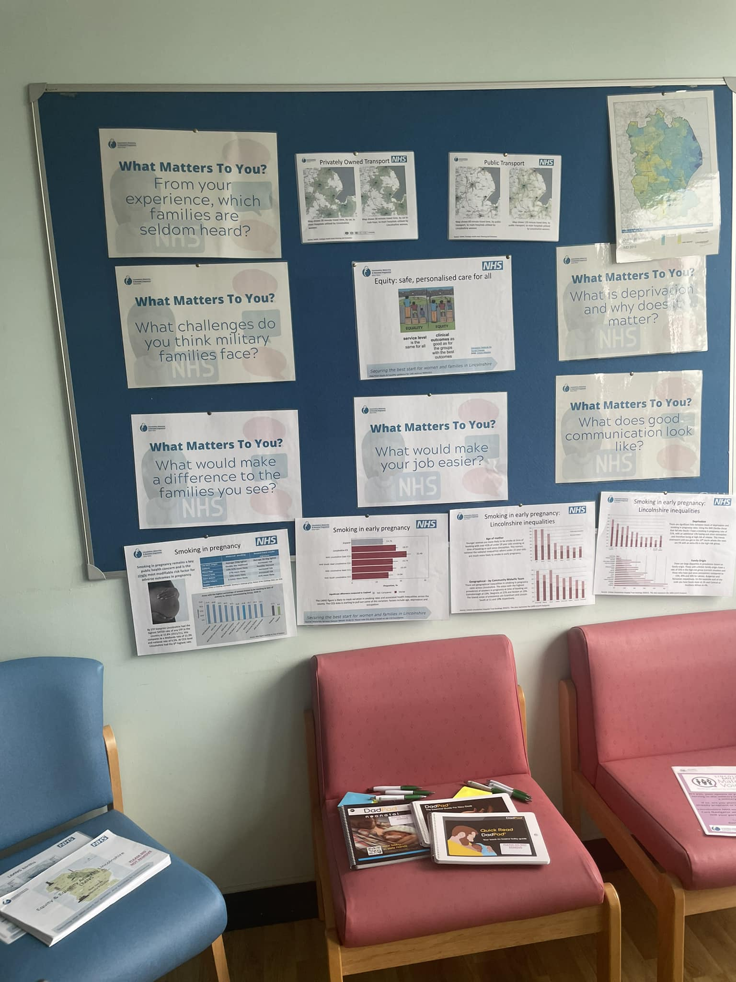
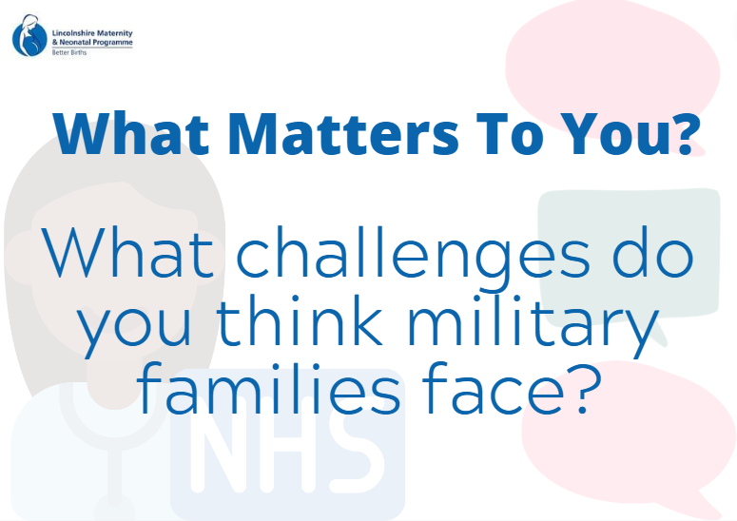
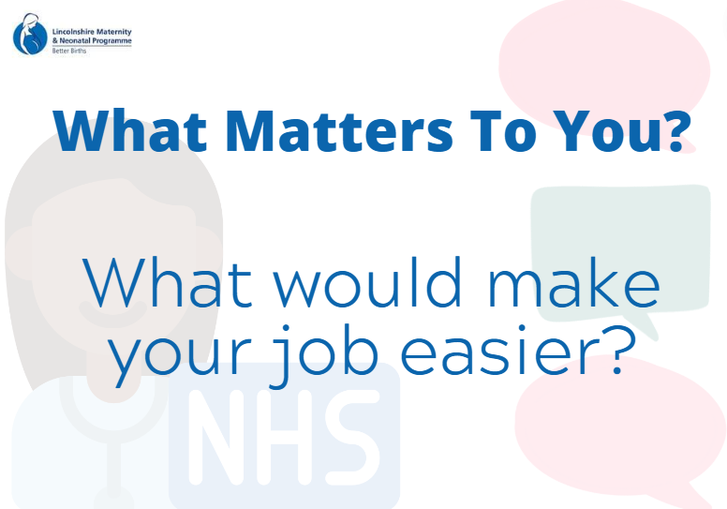
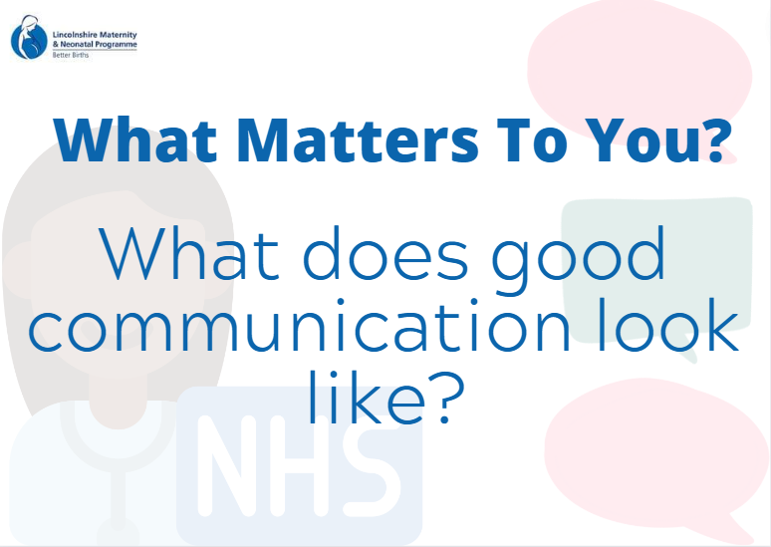
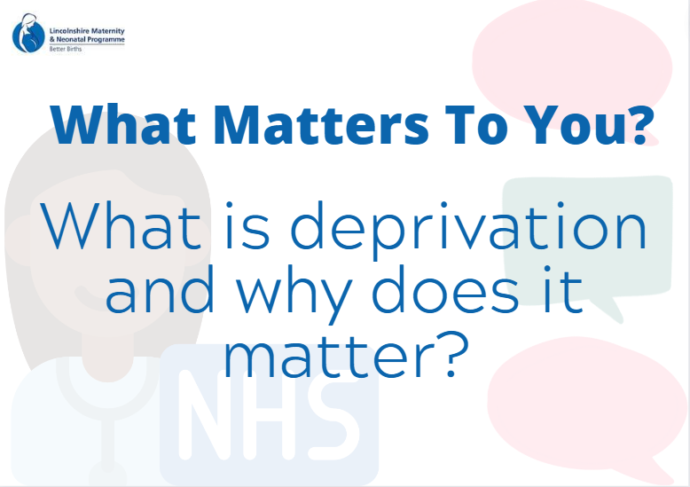
System Wide 'What Matters To You'
Staff Engagement
Staff engagement events held
Lincoln County Hospital, 15th & 16th August
Boston Pilgrim Hospital, 23rd & 24th August
Online engagement events hosted 17th & 25th August
Further staff engagement events to be held for staff across the system
Perinatal Mental Health
Children’s Centre Staff
0-19 Service staff

Slide 18
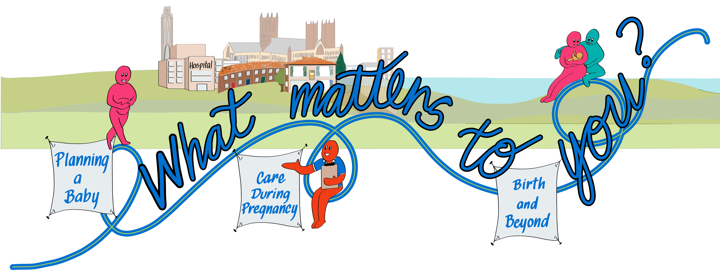
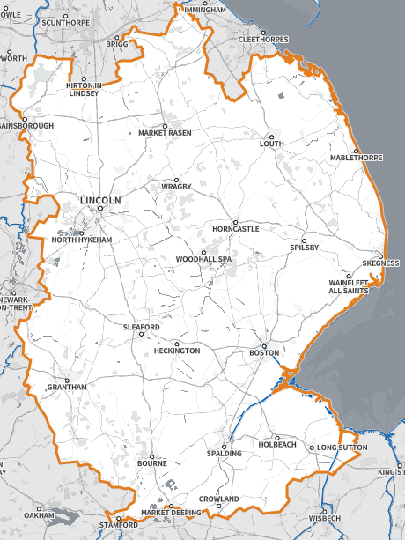
'What Matters To You' Public
Roadshow Events
Skegness – 11th October 2022
Boston/Spalding – Est. February 2023
Gainsborough – Est. May 2023
Sleaford/Grantham – Est. August 2023
Lincoln – Est. November 2023
May
2023
November
2023
October 2022 sees the launch of the ‘What Matters To You’ roadshow events. These events, which are planned to take place across the county, will invite families and professionals to share their thoughts and views about all aspects of care before, during and after pregnancy.
We want to hear what matters to Lincolnshire communities and the professionals working with them while also giving them the opportunity to tour the pregnancy journey and meet with the services who might support them along the way.
In addition to these roadshow events, the LMNS and the Maternity Voice Partnership attend other events; for example, Primary Care Network (PCN) led events.
11th Oct 2022
August
2023
February
2023

Slide 19
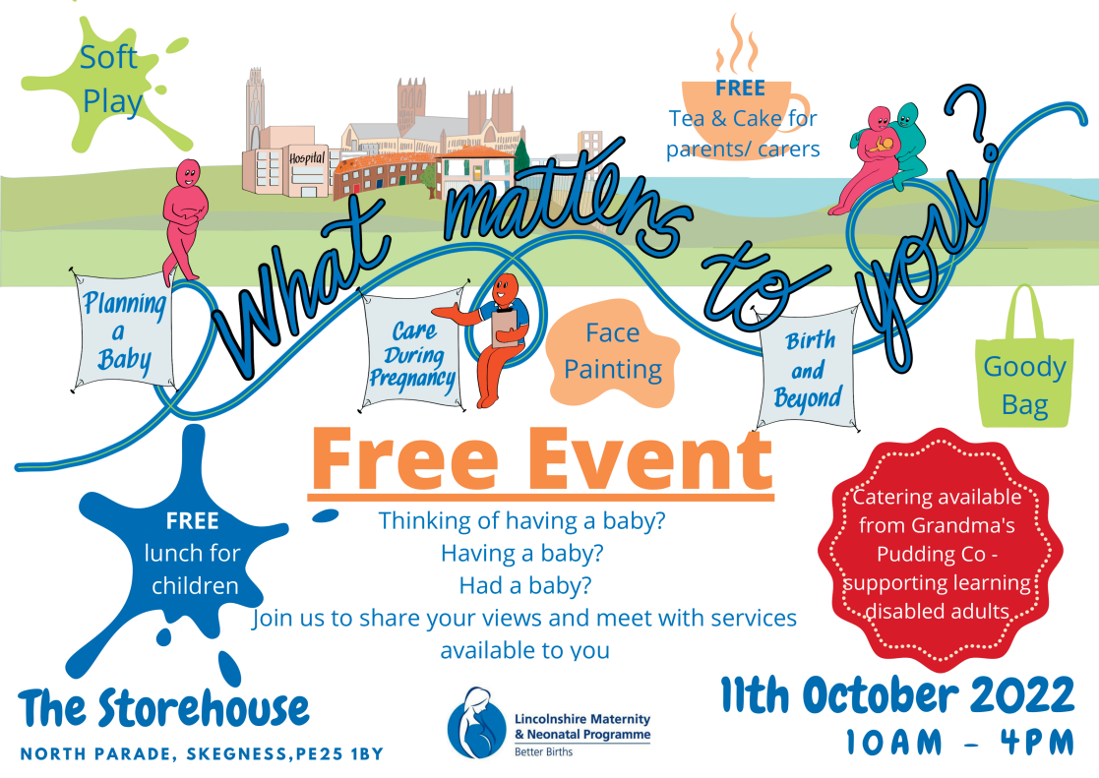
Skegness Roadshow Event

Slide 20
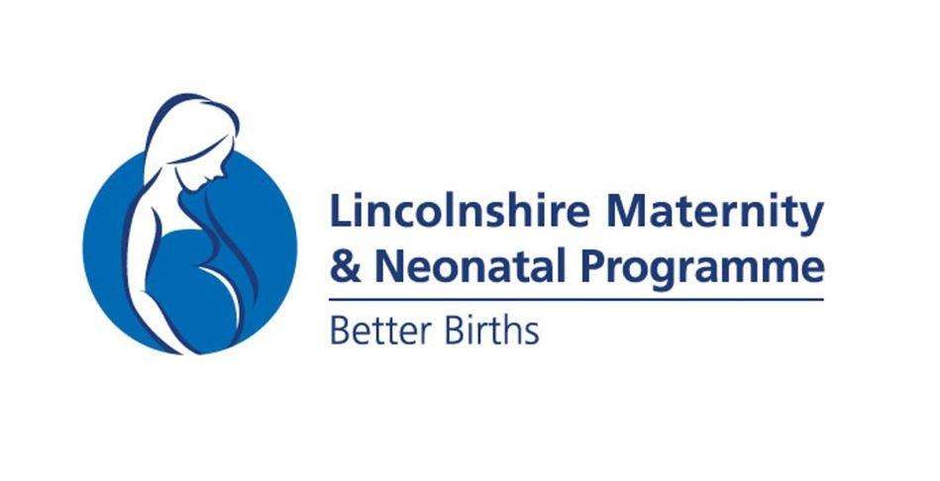



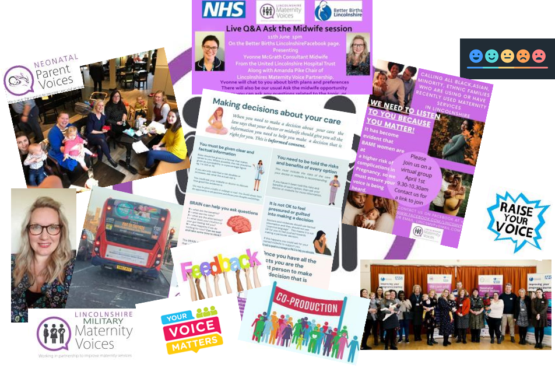




Lincolnshire Maternity
Voice Partnership (MVP)
Co-production is embedded into every element of the Maternity and Neonatal Programme in Lincolnshire. We will continue to follow the same model to engage with families across Lincolnshire, with a further focus on the areas now highlighted throughout this report and our population analysis.
This includes:
Seldom heard voices
East Coast engagement
Access to services
Transient families – military, travellers and seasonal workers
Women who continue to smoke during pregnancy
Women experiencing Diabetes in pregnancy
Families with babies in Neonatal Intensive Care (Neonatal Voices)
Women accessing Perinatal Mental Health Services
Access to contraception, sexual health and abortion
Teenage/young parent voice
Supporting the Latch on Lincolnshire campaign
Example of co-produced intervention:
Military Maternity Voices
Lincolnshires Maternity & Neonatal Military Care Programme.
- YouTube

Slide 21
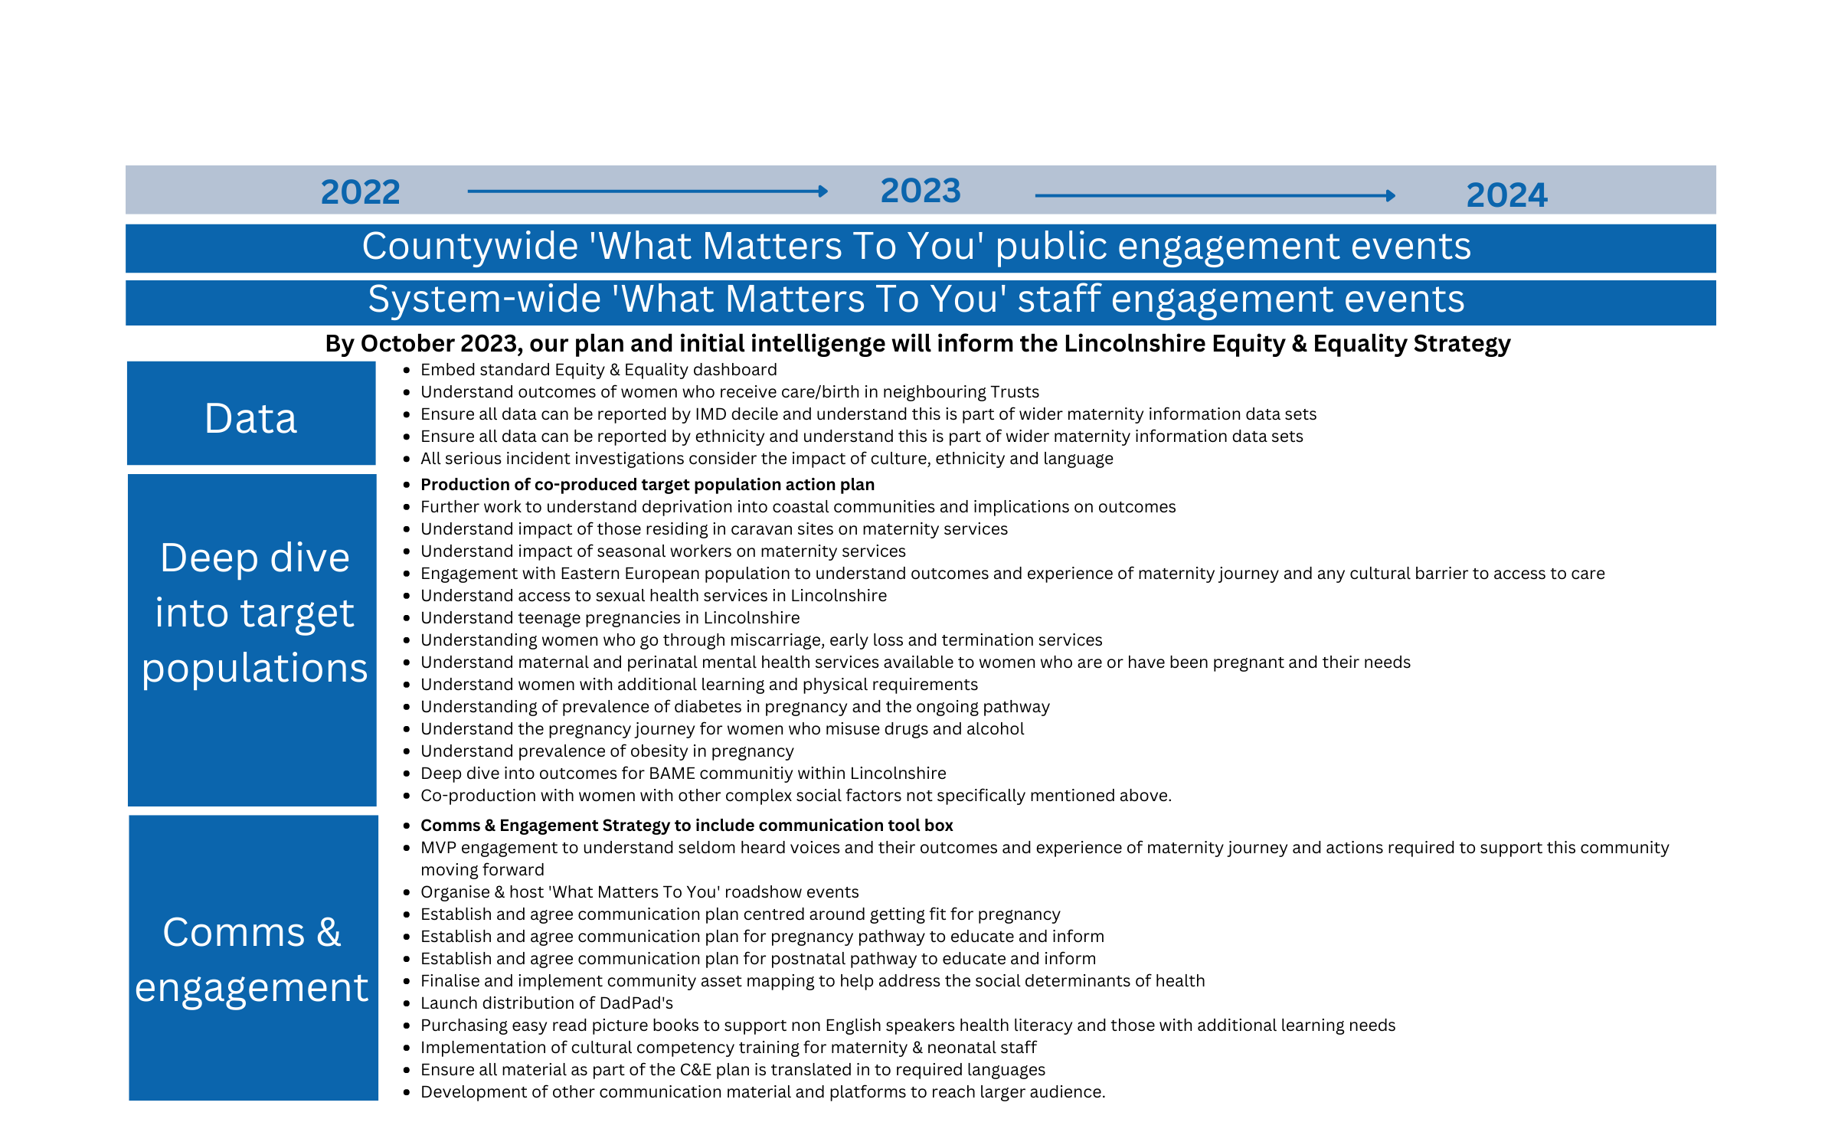
Our Plan

Slide 22
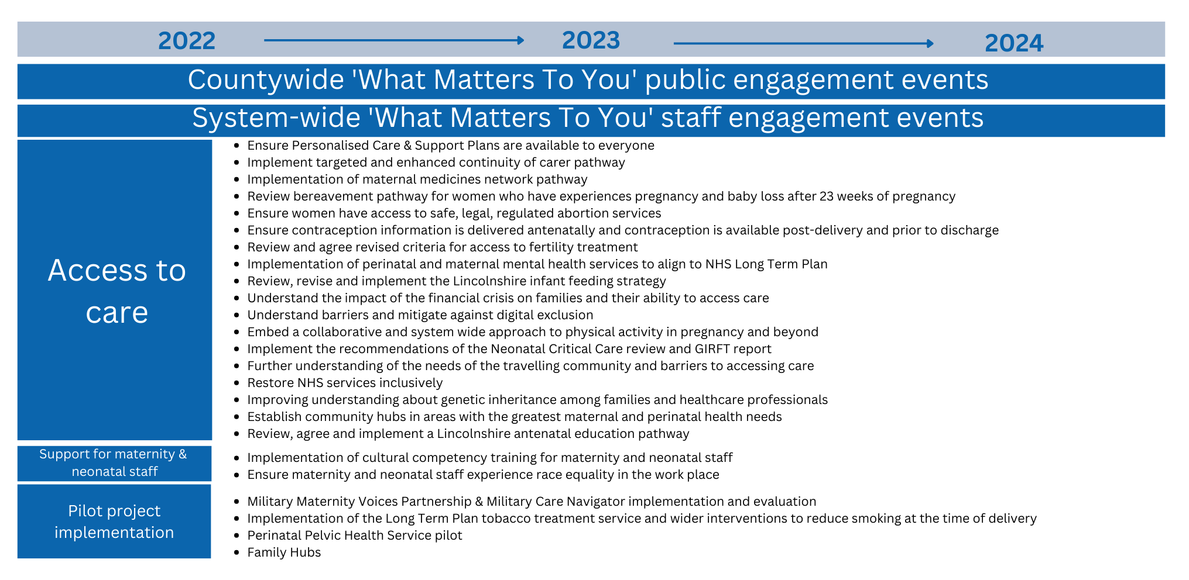
Our Plan continued..
To request a copy of the full, detailed, action plan please email LICB.BetterBirths@nhs.net

Slide 23
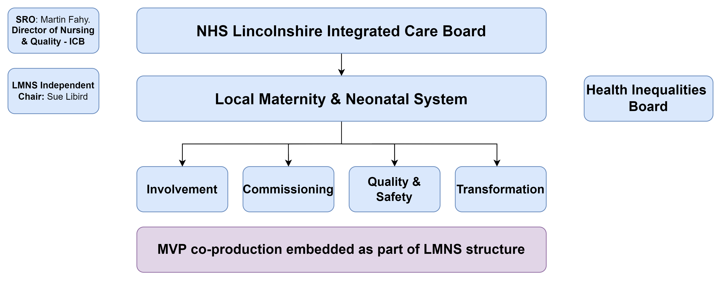
Step Three: Monitoring
Lincolnshire Maternity and Neonatal System will monitor governance and implementation of the E&E action plan to ensure continuous quality improvement. Updates will be provided, where necessary, to relevant ICS workstreams e.g. health inequalities board, to ensure system working and collaboration to reduce health inequalities

Slide 24


Step Four: Get Involved
If you’d like to get involved in the equity & equality work you can do so by either providing your feedback or becoming a volunteer with the Lincolnshire MVP.
Email: lincsmvp@gmail.com.
Facebook: LincsMVP
Twitter: @MVPLincs
If you have any questions or wish to provide comment on the document, please contact the Lincolnshire Maternity and Neonatal Programme Team .
Email: LICB.BetterBirths@nhs.net
Facebook: Better Births Lincolnshire
Twitter: @betterbirthlinc

