Slide 1




PHM Reporting Suite:
Evaluation Module
Developed in partnership with Optum UK

Slide 2
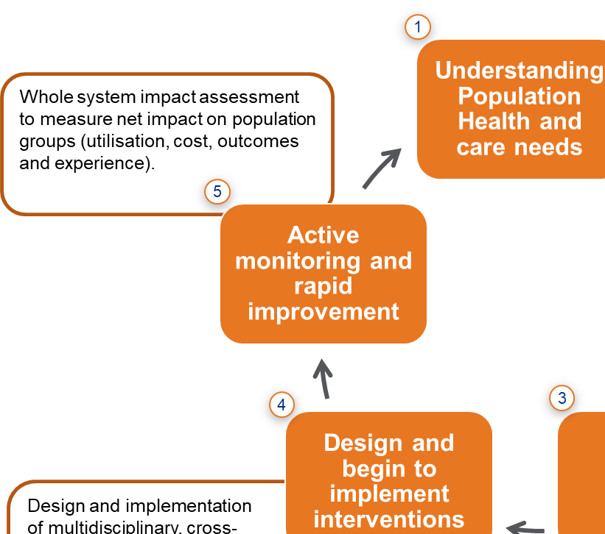
PHM Cycle: Evaluation – why evaluate?
Evaluation closes the loop
How will you know?
Evaluation in the real world
How will you know… if you are having a positive impact on your population?
How will you know… whether you should continue with your intervention, or if other PCNs should consider adopting it?
How will you know… that we are providing good value for the time it has taken to deliver?
How will you know… what to do differently next time?
Best practice
Qualitative and quantitative data available
12+ months of baseline data, participants inducted at same time
Experience & outcomes data as well as activity / economic measures
Control groups available
Real world
Limited data availability
Baseline data unavailable
Participants inducted based on clinical or impactability criteria rather than using a sampling approach
Participants inducted when available rather than at same time
Many other limitations and considerations

Slide 3

Purpose of the Evaluation Module
What…
This is the Evaluation Module, an analytics toolkit within the Optum PHM Reporting Suite
How…
The module allows users to select a cohort that has been subject to an intervention
Users can then select an appropriate control group to compare outcomes against
Users are able to view the trends and differences in activity levels before and after interventions for the selected cohort group compared to the control group
Users are also able to view the trends and differences in patient outcomes before and after interventions for the selected cohort group compared to the control group
New outcomes can be added based on the linked data model and retrospectively analysed; we can also support with the recording of new outcomes data
Why?
The goal is to evidence changes that have occurred in patient utilisation and outcomes before and after interventions have been put in place – what impact has our intervention had?
The Goal…

Slide 4
Evaluation: step by step
Cohort selection
Person-centric interventions using rules-based cohorts means you have a defined group of individuals whose outcomes to evaluate
Intervention design using logic model
A logic model enables evaluation by identifying every activity that needs to take place, as well as the specific outcomes that the intervention aims to change
Intervention Synthesis
Assigning data points to activities & outcomes
Although this step comes later in the process, setting this up for success by guiding the logic model towards being SMART is a crucial role for analysts supporting PCNs and Places
Primary vs Secondary data
Move into active monitoring & rapid improvement
Supporting PCNs and Places to rapidly understand the state and effects of their interventions is a crucial part of PHM, and supports understanding of ROI and further business cases

Slide 5




Hypothesis testing
Hypothesis (H₁)
Null hypothesis (H₀)
A hypothesis, in a scientific context, is a testable statement about the relationship between two or more variables or a proposed explanation for some observed phenomenon
A null hypothesis is a type of statistical hypothesis that proposes that no statistical significance exists in a set of given observations. It is true until you disprove it
Testing your hypothesis
Conclusion – reject or fail to reject the null hypothesis
Apply an appropriate statistical model to your analysis. Compare cohorts, or possibly time periods, and use significance testing to see if your outcome measures have changed
In your summary, state whether or not you rejected your null hypothesis. This is a binary measure of the effectiveness of your intervention (or one aspect of it)

Slide 6
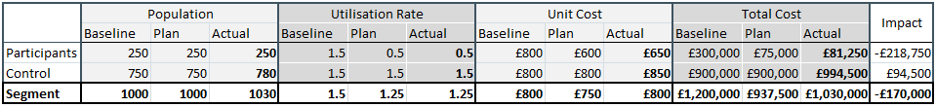
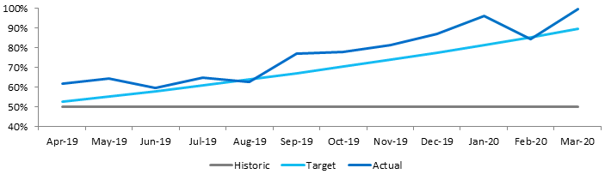
Evaluation: reporting examples
Economic activity
Outputs or outcome measures
Output/process measure examples Blood sugar monitoring for diabetics Number of MDT meetings for intervention participants Number of attendances at practice coffee mornings % serious mental illness population received follow-up following emergency admission Steroid inhaler medicines adherence for COPD population | Outcomes measure examples Patient satisfaction survey results Achieved preferred place of dying Increased PAM (Patient Activation Measure) value Reduced % of 4 hour waits in ED Improved PROMs or EQ-5D results, i.e. improved quality of life | Primary Data vs Secondary Data Primary Data: Where a survey or set of measures are administered locally and new data is collected for analysis. Difficulties with baselining primary data Potentially difficult to do for control group Secondary Data: Where it is possible to make use of data that is already routinely collected e.g. national data returns or patient/staff satisfaction surveys. Often has existing baseline Enables control group approaches

Slide 7
Choosing control groups (observational)
People in the segment, but in other PCNs
People in adjacent segments
PCN 1
PCN 2
PCN 3
PCN 1
PCN 2
PCN 3
Segment 1
Participants
Participants
Segment 2
Control
Control
Control
Segment 3
Cohort
Control
Control
Cohort
Control
Segment 4
Potential challenges and opportunities:
Not viable with whole-ICS intervention
Relies on having data for non-participating PCNs
Potential variance between Control & Case groups
Can explore propensity scores to create better matched control groups

Slide 8
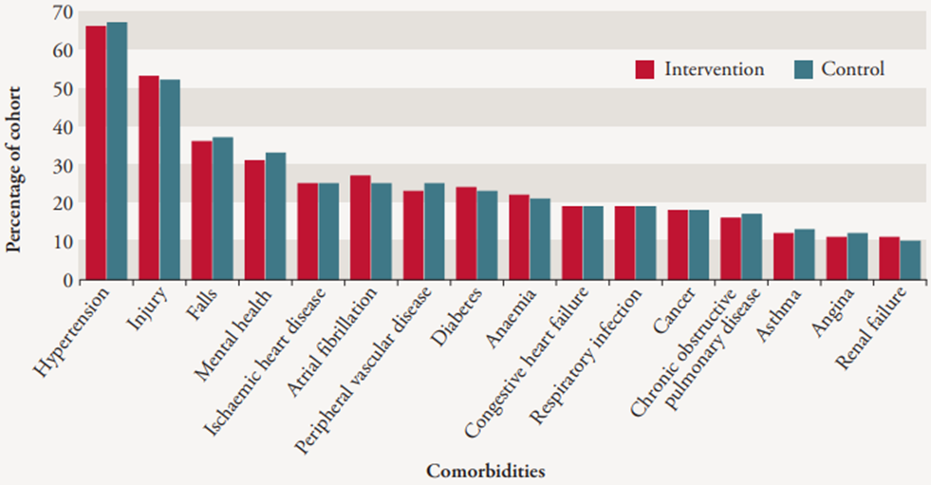
Generating matched cohorts
Potential challenges and opportunities:
Technically difficult- skillset required to run matched cohort models
Relies on having high quality whole- ICS data
This technique is repeatable- once it has been done
Image source: https://www.nuffieldtrust.org.uk/research/evaluation-of-complex-health-and-care-interventions-using-retrospective-matched-control-methods

Slide 9
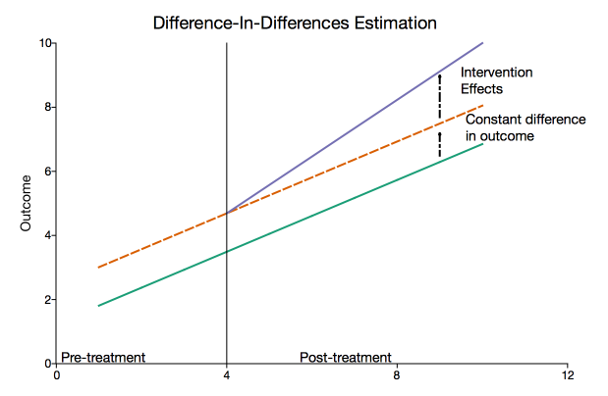
How to compare?
Difference in Differences approach
  The difference-in-differences method is a quasi-experimental approach that compares the changes in outcomes over time between a population enrolled in a program (the treatment group) and a population that is not (the comparison group).
  In our Fuel Poverty Cohort, we would compare the activity changes in the trajectory and volumes of the Intervention Cohort to the trajectory and volumes of the Control Group after the intervention.
Barr B, Zhang X, Green M, Buchan I. A blueprint for synthetic control methodology: a causal inference tool for evaluating natural experiments in population health BMJ 2022; 379 :o2712 doi:10.1136/bmj.o2712
https://www.bmj.com/content/379/bmj.o2712

Slide 10
End

