Slide 1




Evaluation Module
Developed in partnership with Optum UK

Slide 2
The PHM cycle — making things stick through continuous learning and doing
Understanding Population Health and care needs
Descriptive analytics to understand the specific needs of the local population, the impact of wider determinants and to explore gaps in care and unwarranted variation.
Active monitoring and rapid improvement
Whole system impact assessment to measure net impact on population groups (utilisation, cost, outcomes and experience).
1
Opportunity analysis and targeting
Risk stratification and segmentation models to identify risk factors and the groups challenged by them, using advanced data mining techniques.
5
2
Design and begin to implement interventions
Design and implementation of multidisciplinary, cross-organisational interventions that are targeted at high-risk population segments through a bio-psycho-social approach.
4
3
Predictive system modelling
Future-facing financial modelling of unmitigated and mitigated system financial risk using person level costing data and mitigated scenarios.
© 2024 Optum, Inc. All rights reserved. Confidential property of Optum. Do not distribute or reproduce without express permission from Optum.

Slide 3
ICS aims supported by Optum’s PHM analytics
Improving outcomes in population health and health care
Tackling inequalities in outcomes, experience and access
Find at-risk segments in the PHM Dashboard and compare their outcomes to detect unwarranted variation
Incentivise and track improvements to outcomes over time using the Evaluation module
Explore the impact of health inequalities in the PHM Dashboard, both in the focus Inequalities domain but also as a theme throughout the entire dashboard
Use insights from the Elective Recovery module to assess the impact of health inequalities on waiting lists
Enhancing productivity and value for money
Helping the NHS to support broader social and economic development
Explore the total cost of care for specific population segments in the PHM Dashboard
Incentivise outcomes and new ways of integrated working in the Evaluation module
Use the PHM-Led Projections module to understand system financial forecasts, including do-nothing and mitigated scenario analysis
Throughout the PHM Reporting Suite, we take a holistic, bio-psycho-social approach to understanding populations. This incorporates insights based on social and economic factors in the population.
This approach enables wider ICS stakeholders, including community wellbeing services and social prescribers, to all come around the table to use a shared source of the truth to support decision making, from ICS to person level.
© 2024 Optum, Inc. All rights reserved. Confidential property of Optum. Do not distribute or reproduce without express permission from Optum.

Slide 4

Purpose of the tool
What…
This is the Evaluation Module, an analytics toolkit within the Optum PHM Reporting Suite
How…
The module allows users to select a cohort that has been subject to an intervention
Users can then select an appropriate control group to compare outcomes against
Users are able to view the trends and differences in activity levels before and after interventions for the selected cohort group compared to the control group
Users are also able to view the trends and differences in patient outcomes before and after interventions for the selected cohort group compared to the control group
New outcomes can be added based on the linked data model and retrospectively analysed; we can also support with the recording of new outcomes data
Why?
The goal is to evidence changes that have occurred in patient utilisation and outcomes before and after interventions have been put in place – what impact has our intervention had?
The Goal…
© 2024 Optum, Inc. All rights reserved. Confidential property of Optum. Do not distribute or reproduce without express permission from Optum.

Slide 5
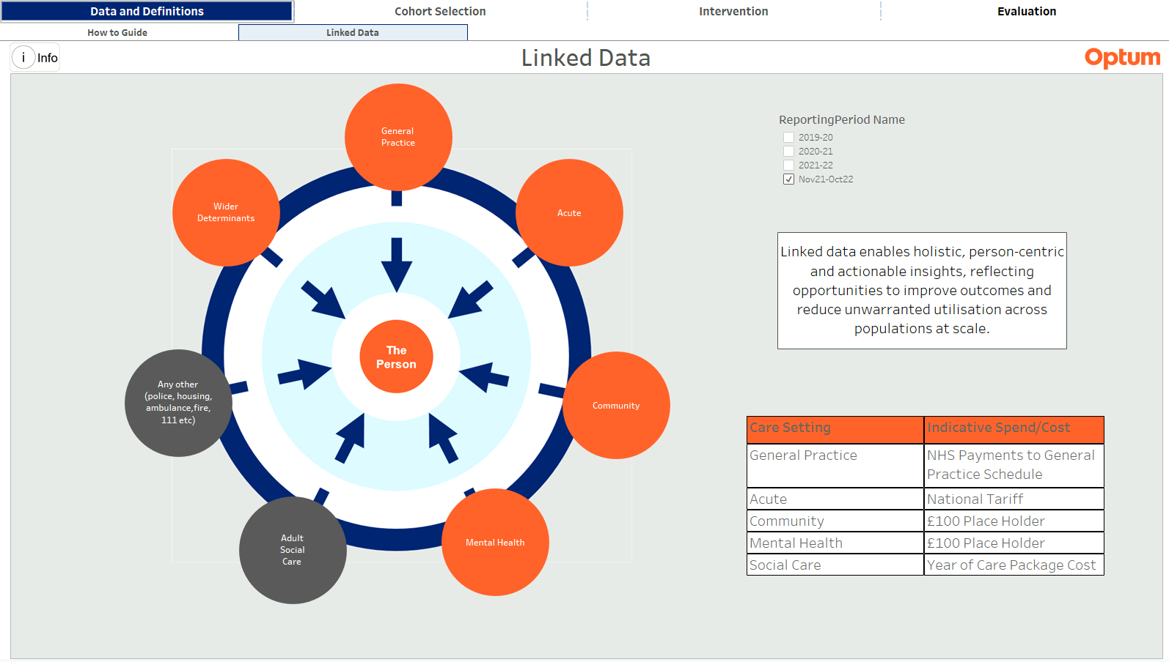
Linked Data
© 2024 Optum, Inc. All rights reserved. Confidential property of Optum. Do not distribute or reproduce without express permission from Optum.

Slide 6
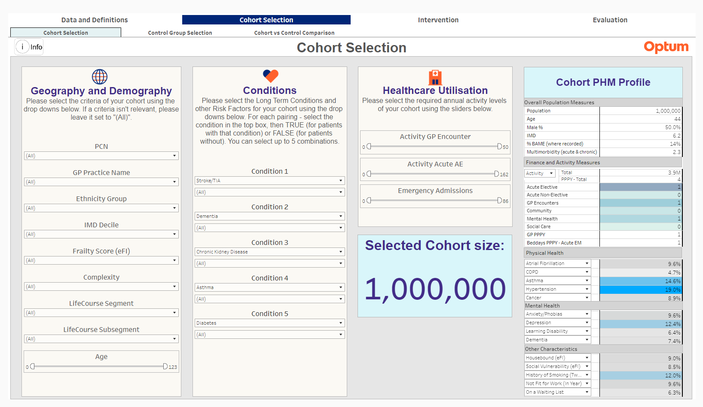
Cohort Group Selection (no filters selected)
© 2024 Optum, Inc. All rights reserved. Confidential property of Optum. Do not distribute or reproduce without express permission from Optum.

Slide 7
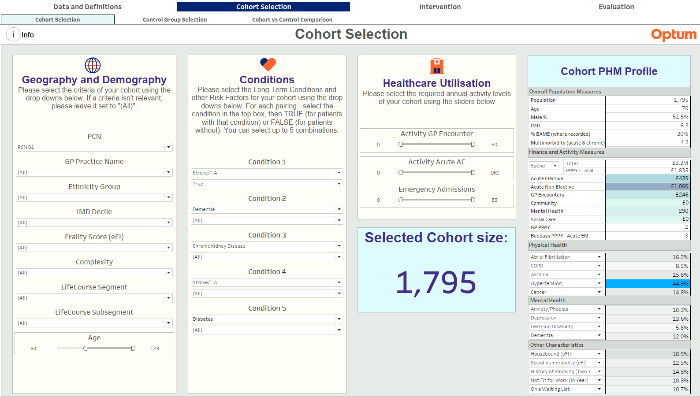
Cohort Group Selection (filters selected)
44
© 2024 Optum, Inc. All rights reserved. Confidential property of Optum. Do not distribute or reproduce without express permission from Optum.

Slide 8
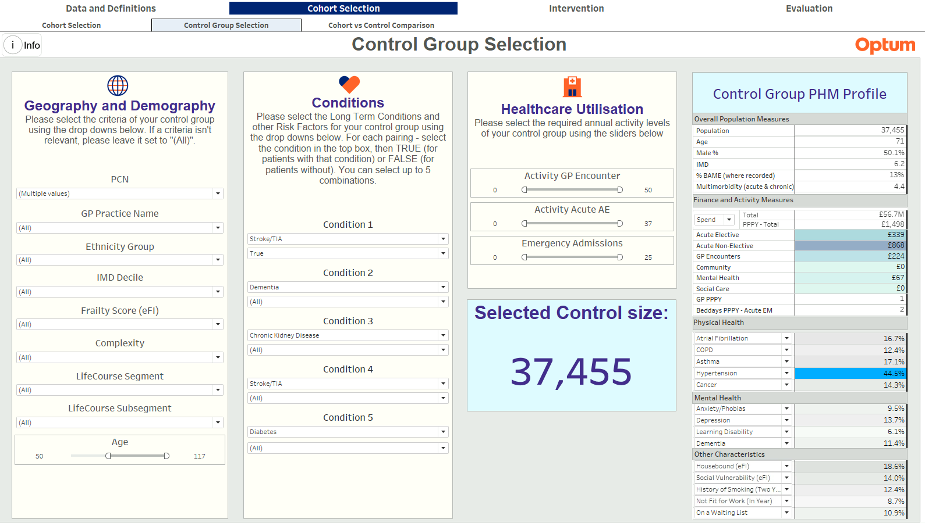
Control Group Selection
© 2024 Optum, Inc. All rights reserved. Confidential property of Optum. Do not distribute or reproduce without express permission from Optum.

Slide 9
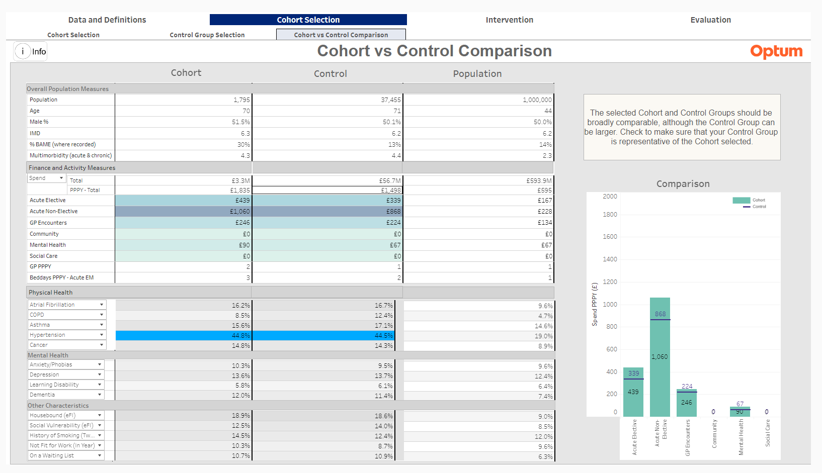
Comparison
© 2024 Optum, Inc. All rights reserved. Confidential property of Optum. Do not distribute or reproduce without express permission from Optum.

Slide 10
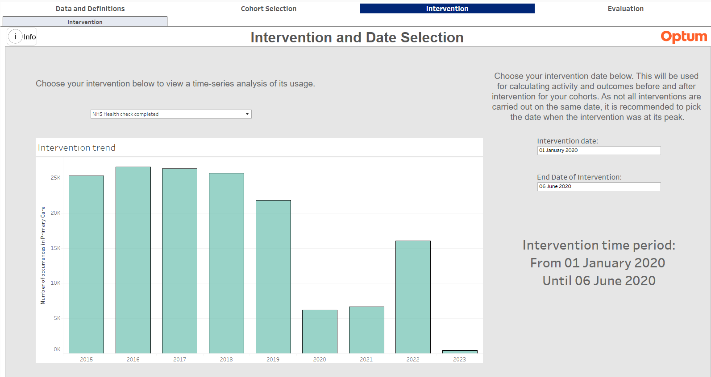
Intervention and Date Selection
© 2024 Optum, Inc. All rights reserved. Confidential property of Optum. Do not distribute or reproduce without express permission from Optum.

Slide 11
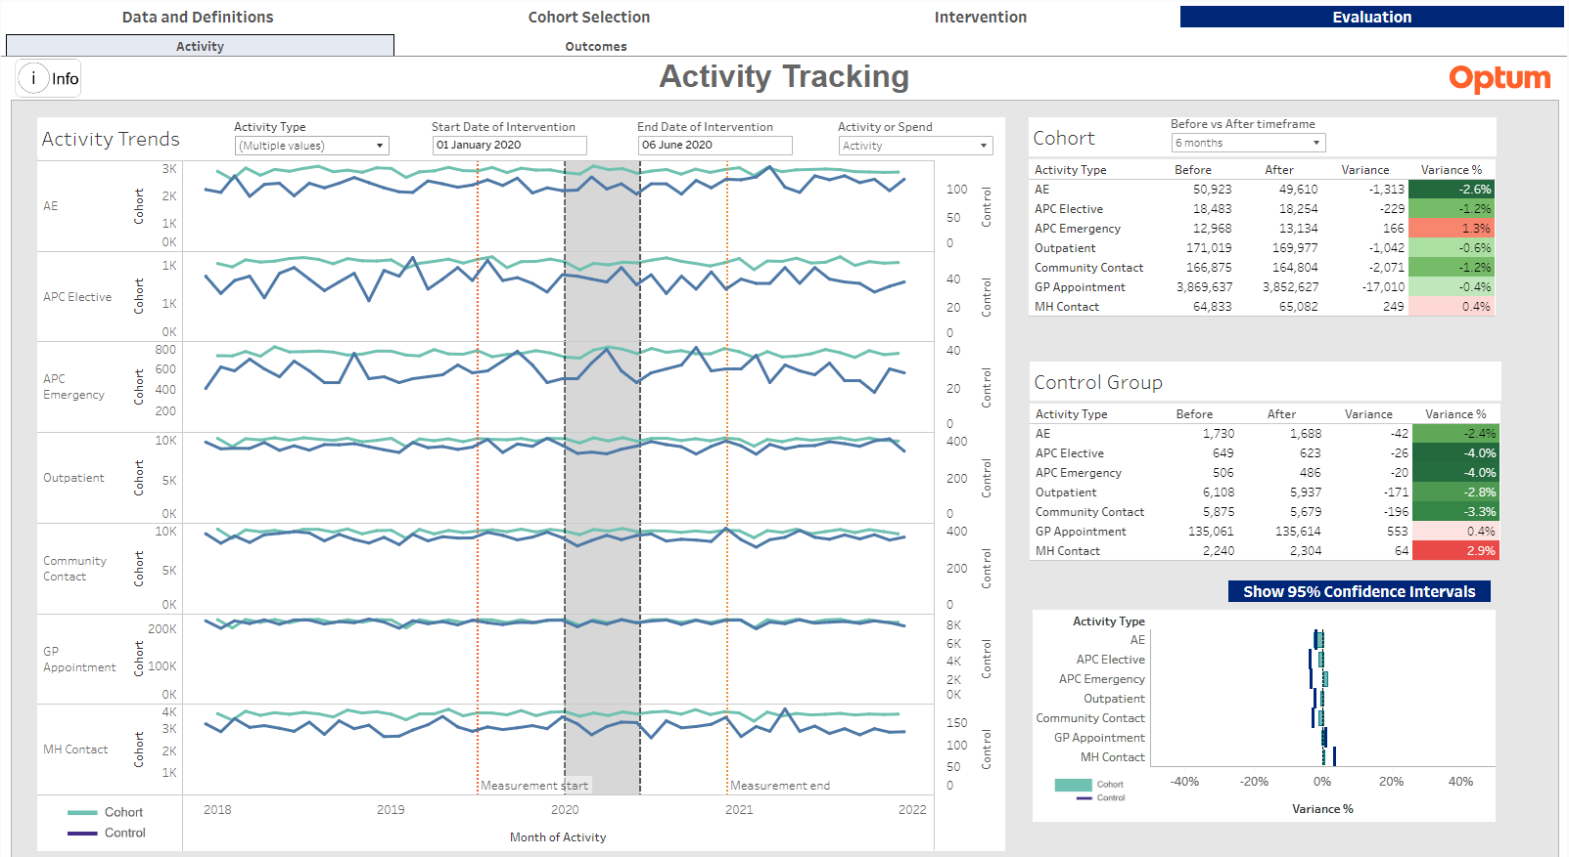
Activity tracking
© 2024 Optum, Inc. All rights reserved. Confidential property of Optum. Do not distribute or reproduce without express permission from Optum.

Slide 12
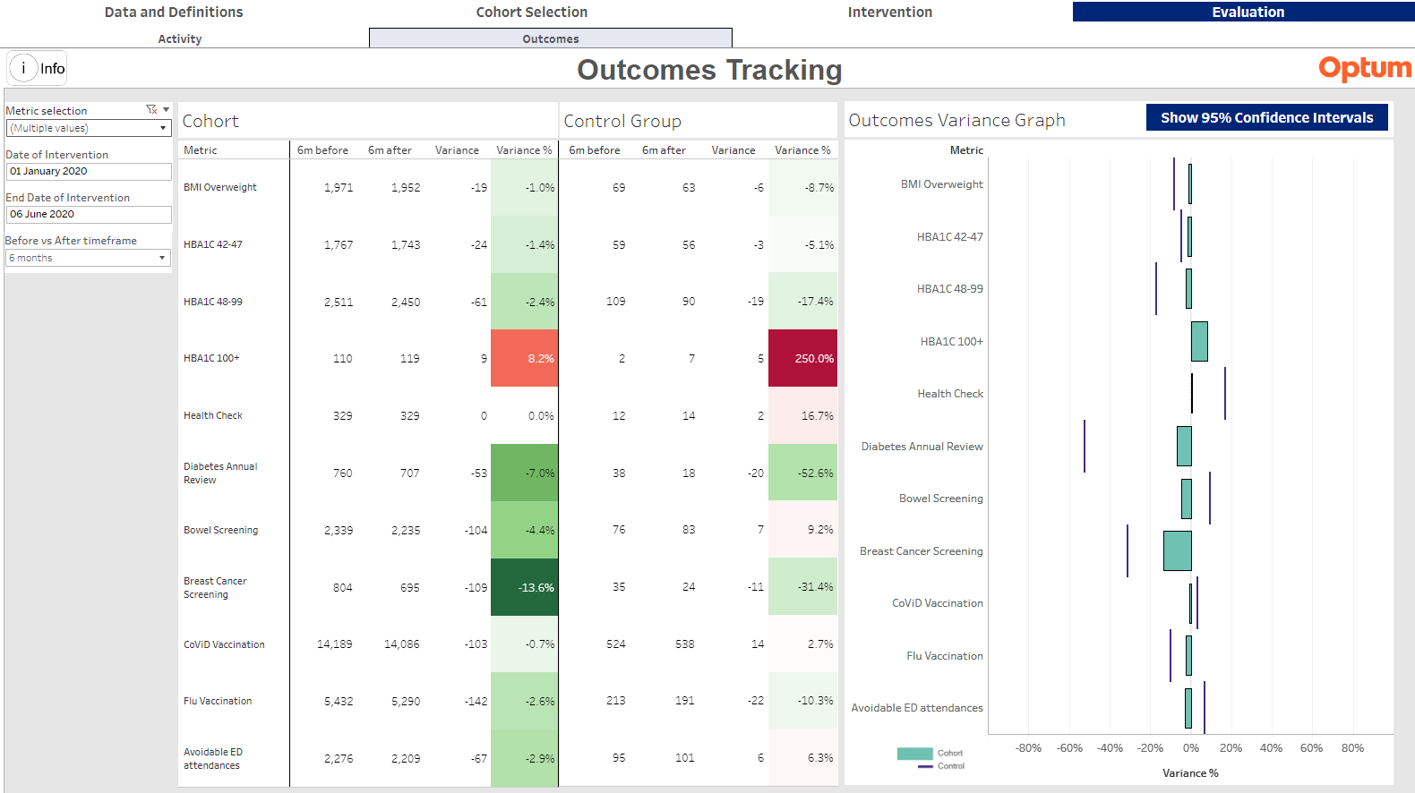
Outcomes Tracking
© 2024 Optum, Inc. All rights reserved. Confidential property of Optum. Do not distribute or reproduce without express permission from Optum.

Slide 13



Summary
By using a customisable approach, the Evaluation Module allows users to evidence changes that have occurred in person-level utilisation and outcomes before and after interventions have been put in place
The “difference of the differences” approach allows users to see the difference between changes in the cohort and control groups. This difference can be at least partly attributed to the intervention that the cohort have undergone
Population health interventions can take many months or years to take full effect. As more data becomes available, it will be possible to track interventions for many years, which will give additional confidence in the findings.
© 2024 Optum, Inc. All rights reserved. Confidential property of Optum. Do not distribute or reproduce without express permission from Optum.

Slide 14
14

