Slide 1


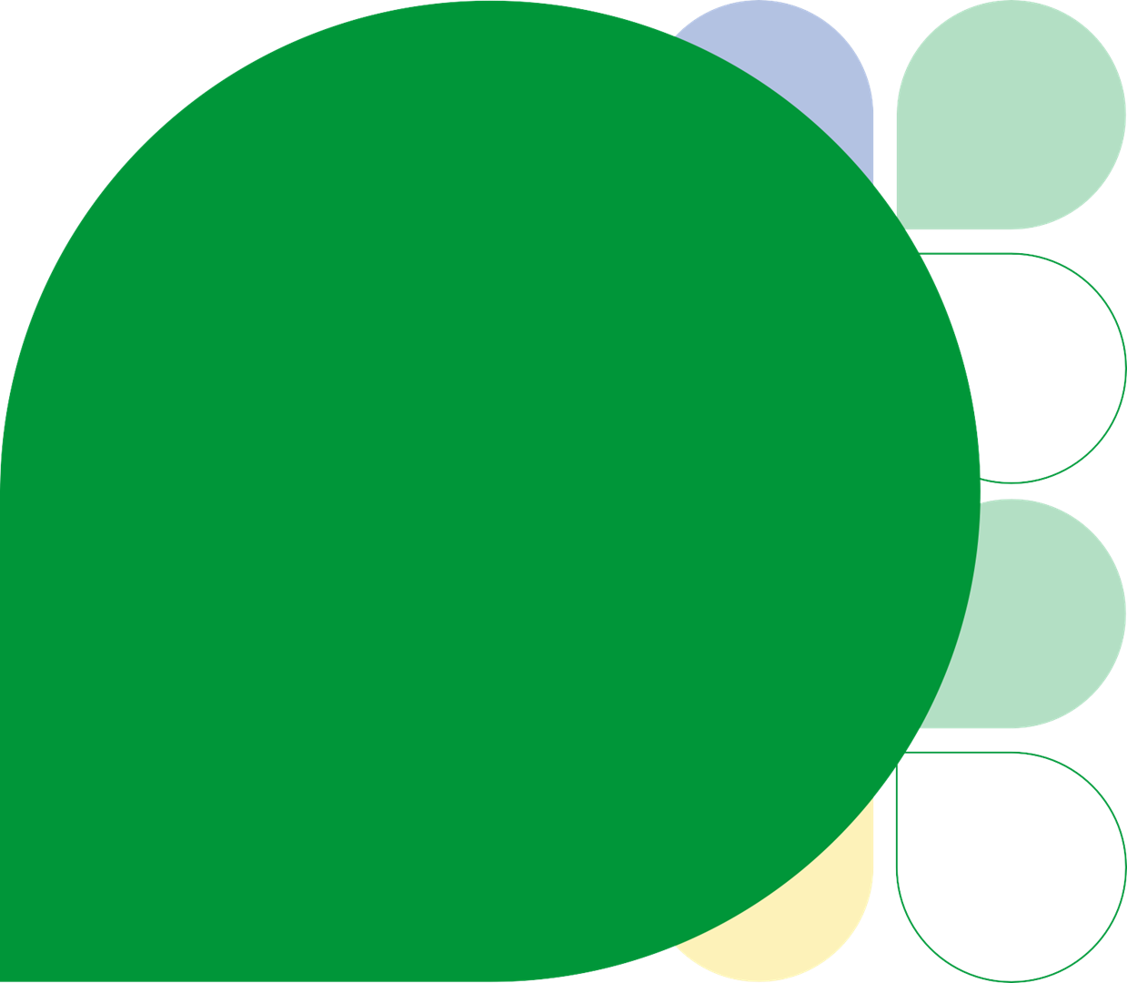

Lincolnshire PHM Led Projections Module Guide
Developed in partnership with Optum UK

Slide 2
Contents
1
Overview
Change cycle and data sources
2
Dashboard reports
How to use each PHM LP report
3
Use cases
Examples with Lincolnshire data

Slide 3
Overview

Slide 4
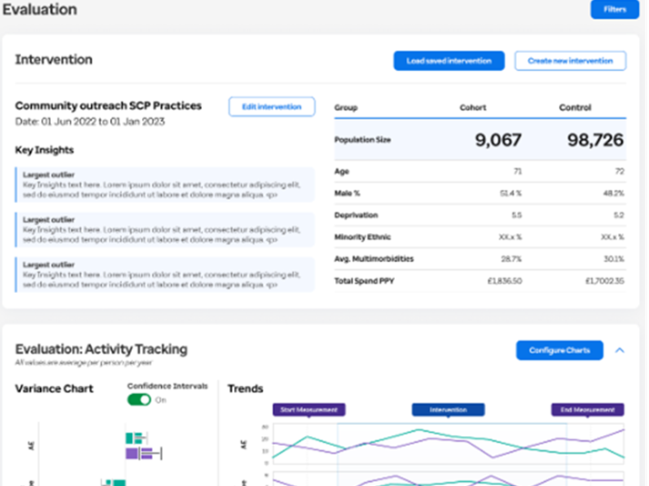
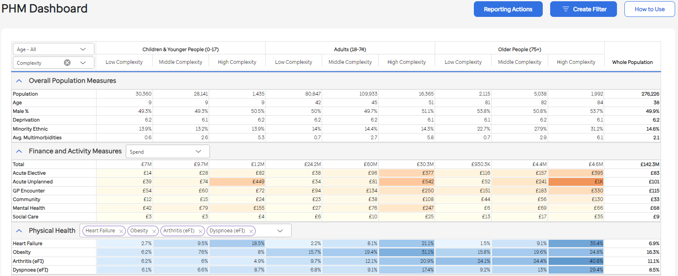
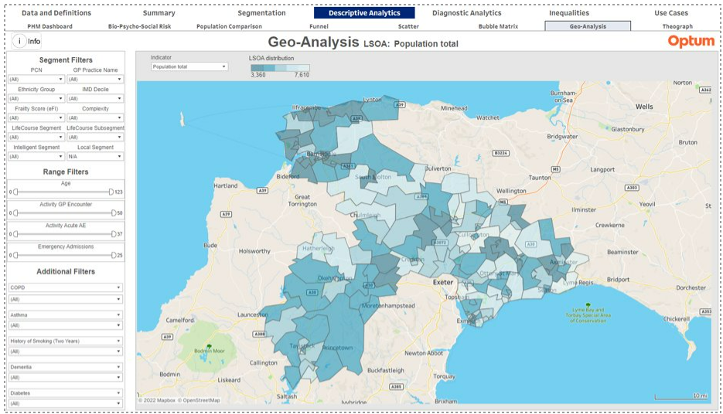
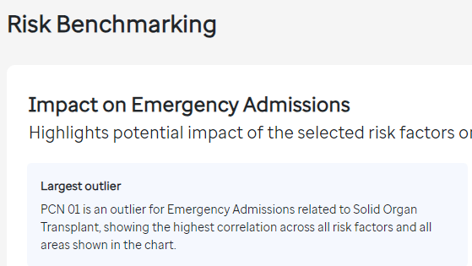
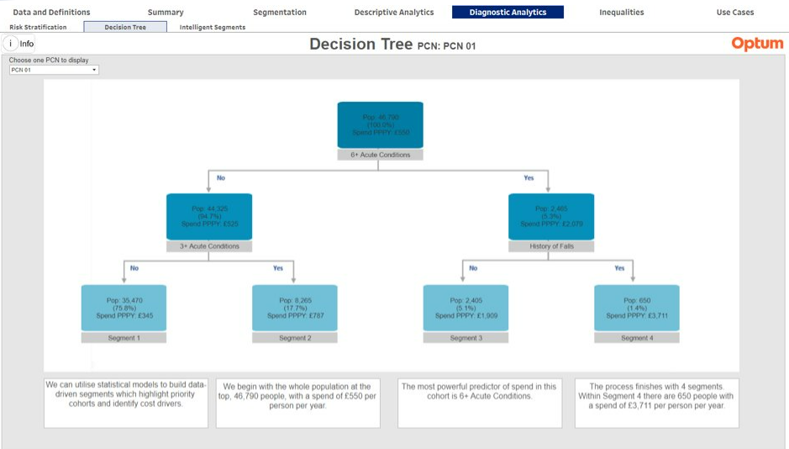
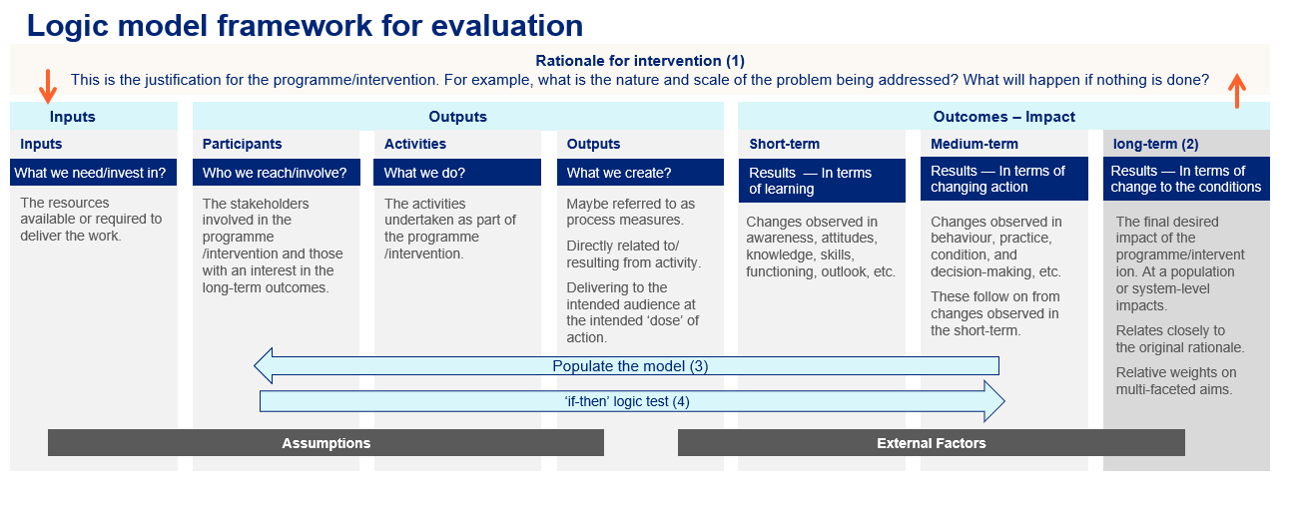
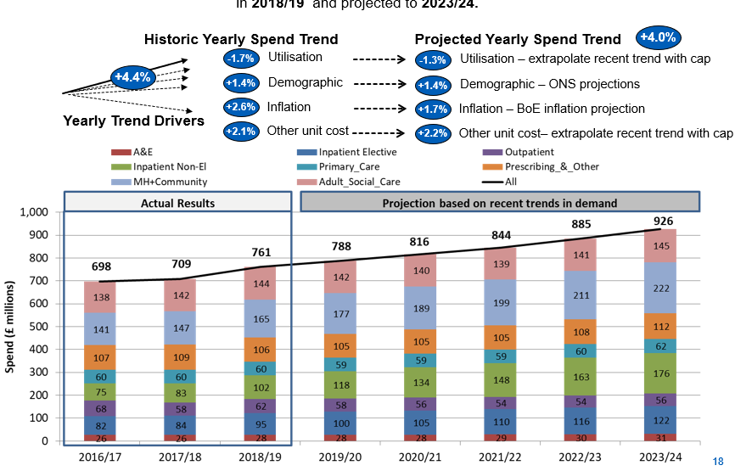

The Change Cycle: Insight, to action, to impact assessment…
Evaluation
Descriptive analytics
1
Diagnostic analytics
5
2
Intervention Design & Delivery
4
3
PHM-Led Projections
The PHM Led Projections module is part of the PHM Reporting Suite. Population Health Management is an iterative cycle. Use the PHM Dashboard to seek opportunity, a population of interest, and then PHM-Led Projections will facilitate the forward view, firstly with no change and then, using the Mitigation Tool, enables you to model your intervention, visualise the resource impact and build your business case.

Slide 5
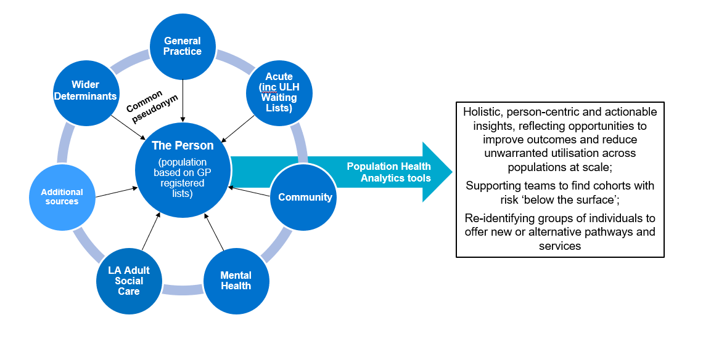
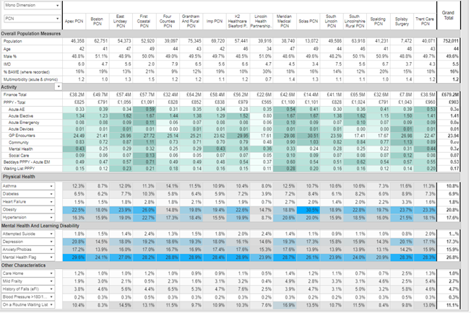
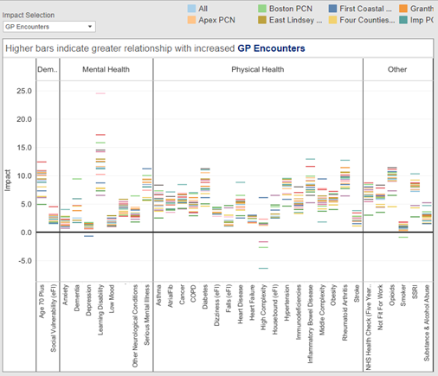
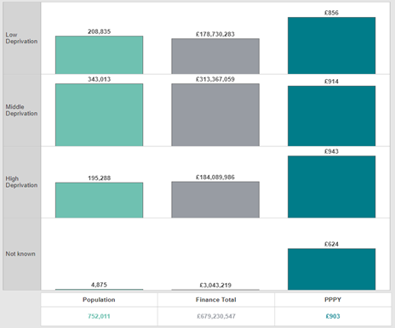
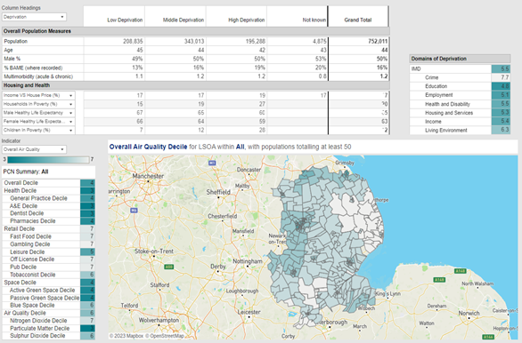
The Lincolnshire Joined Intelligence Dataset
We have created one of the most comprehensive, person-level, linked datasets in the country.
This allows whole person, whole cohort, whole population, whole system understanding, supporting opportunity identification, evaluation, options appraisal, personalisation, health equity & equality, major system change.
Includes indicative, average cost data for certain types of care to provide comparative intelligence on whole system activity, implications and opportunities.
Governance mechanisms established to allow access and use across ICS partners and GP practices.
Cornerstone of Population Health Management, with evidence-informed decision-making underpinning the approach.
Source: Lincolnshire ICS Joined Intelligence Dataset, NHS Lincolnshire ICB, 2023. Optum Reporting Suite

Slide 6
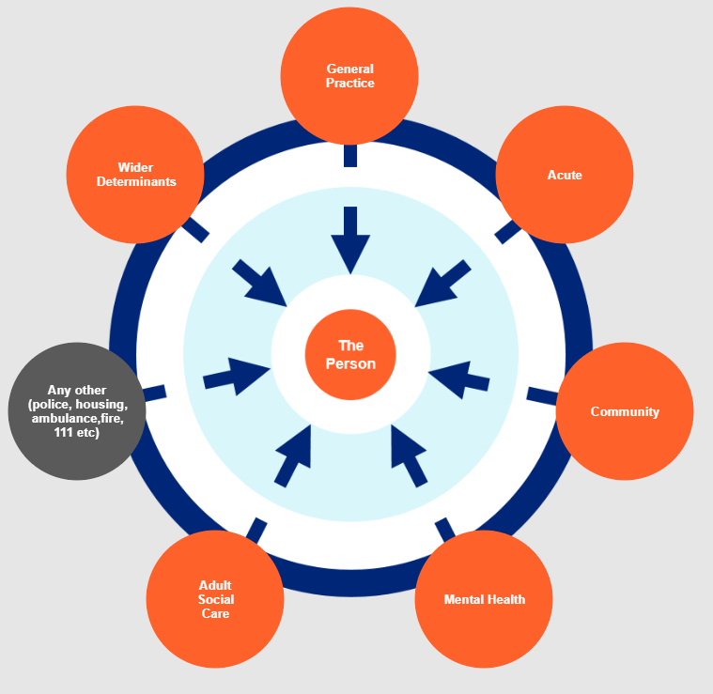
Linked Data Finance - Lincolnshire
Finance is calculated for each activity and totalled at patient level in the Linked Data Model for a reporting period of one year
General Practice
For each event (GP Events dataset) an average cost per event is assigned
(GP National Payments to GP Practice/number of events)
Acute Finance – locally agreed
For each activity (e.g. attendance, appointment, inpatient stay) (SUS national dataset) the following finance fields are referenced in order, where available, to establish a cost:-
ULHT reference file detailing average cost at POD/TFC/HRG (aggregated PLICs) (ULHT sites only)
PLCM data (patient level)
National Tariff (patient level)
N.B. includes additional data from PLCM: High Cost Drugs & Devices, Acute Other (Pathways, Critical Care, Unbundled Diagnostics)
GP Prescribing
For each prescription (Prescribing dataset) the cost has been calculated using the quantity prescribed and the unit cost from the NHS dictionary of medicines and devices (dm+d) preferred pack size
Community – locally agreed
For each Community contact (CSDS dataset), utilising aggregated PLICs data, a locally agreed average cost is assigned (LCHS)
Adult Social Care
For each contact (Adult Social Care dataset) finance is calculated from unit cost and number of units received per week
Mental Health – locally agreed
For each Mental Health contact / inpatient stay (MHDS dataset), utilising aggregated PLICs data, a locally agreed average cost is assigned (LPFT)

Slide 7
The Reports
https://phm.optum.co.uk

Slide 8

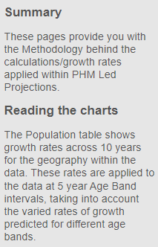

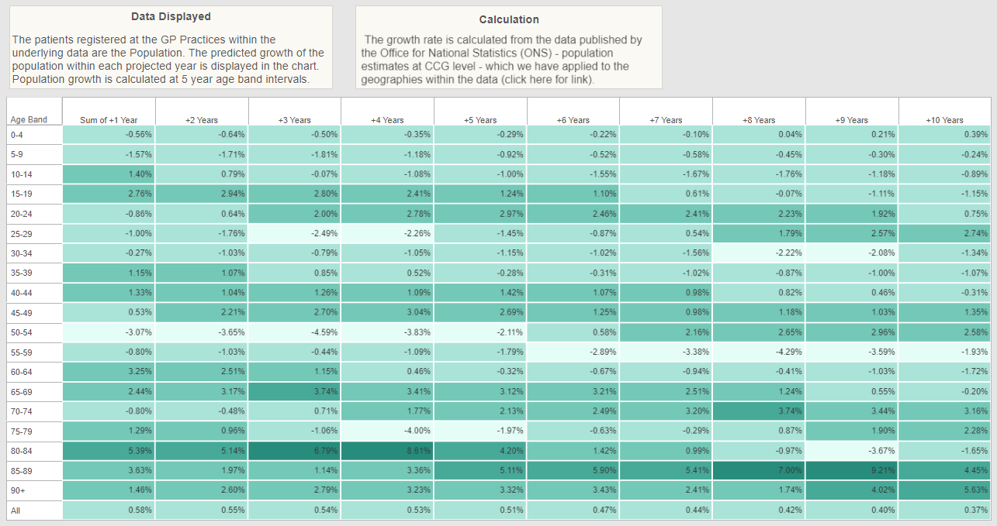
Population

Slide 9
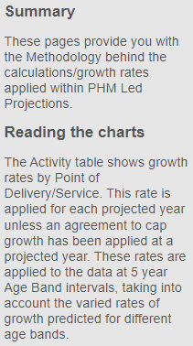
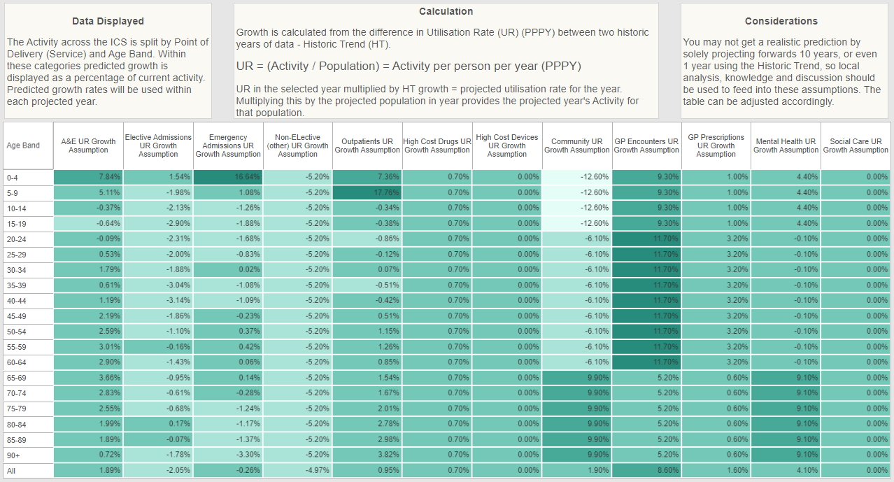
Activity

Slide 10
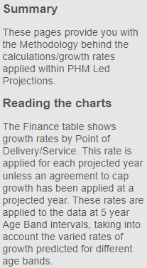
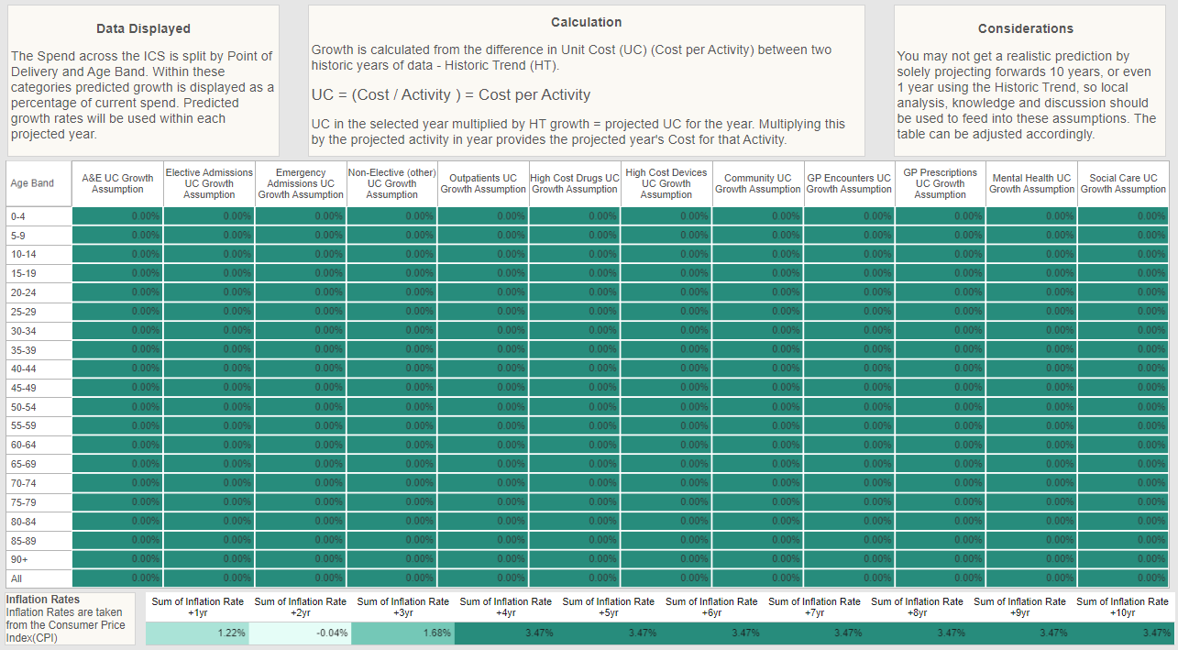
Spend (in Lincolnshire Unit Cost Growth is not applied)

Slide 11
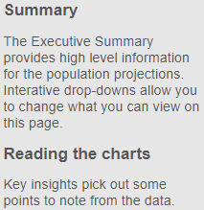
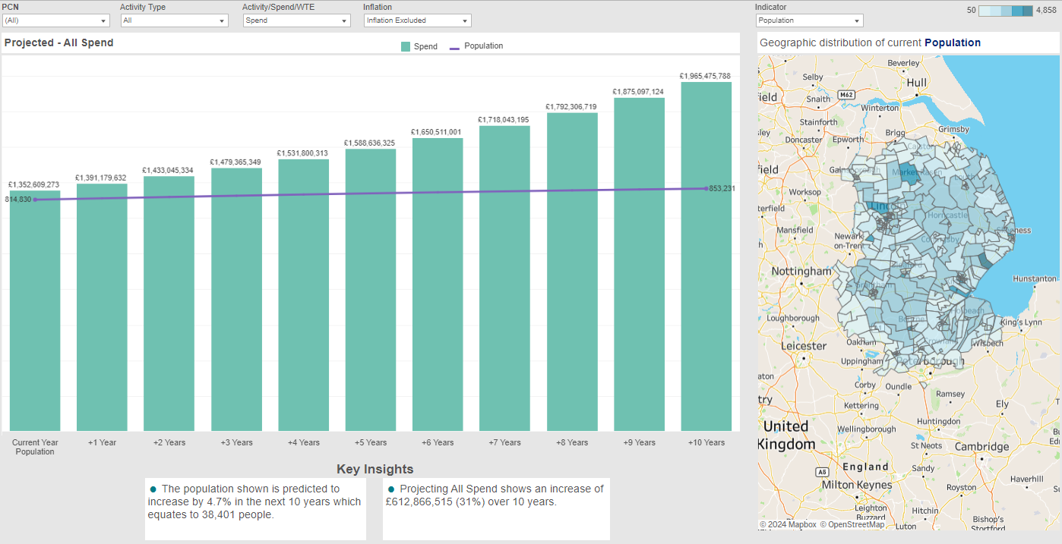
Executive Summary
Throughout most of the reports you have the option to display “All” Activity Types or pick one Activity Type of interest.
There is an option to add inflation to the Spend, by default this is excluded.

Slide 12
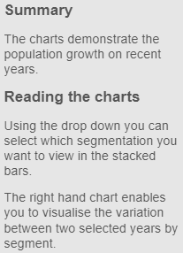
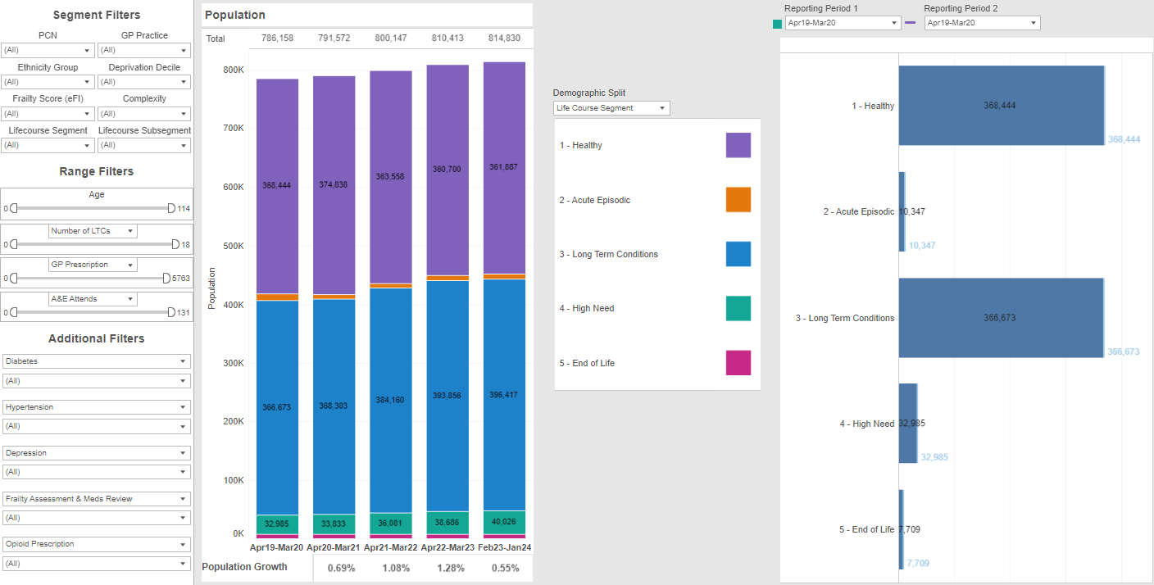
Historic Demographics
You can apply filters to select a cohort/population of interest. Filters applied on this report persist to other reports (apart from Resource by Activity Type which is driven by a different data source).

Slide 13
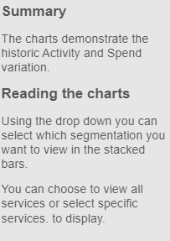
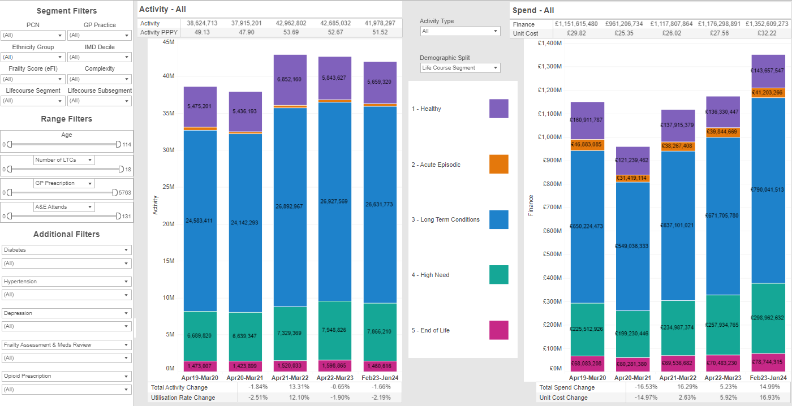
Historic Resource

Slide 14
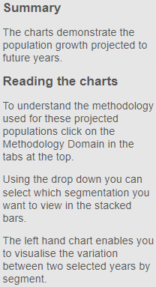
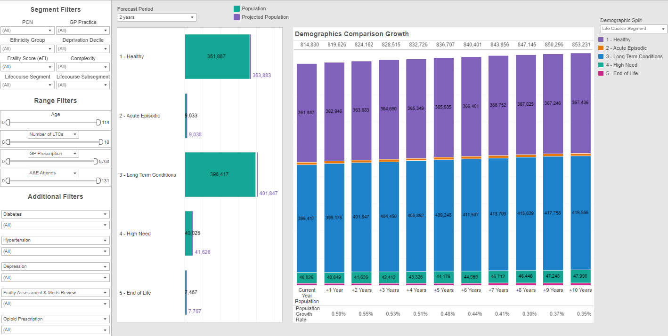
Demographics

Slide 15
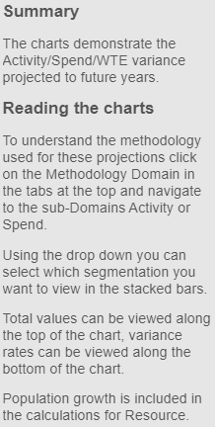
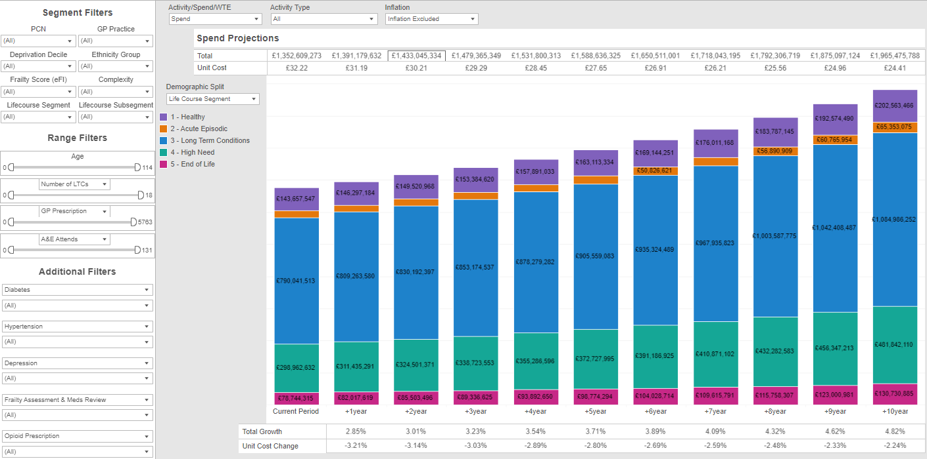
Resource by Segment

Slide 16
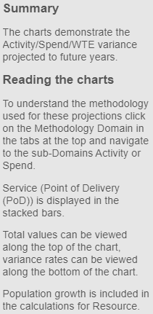
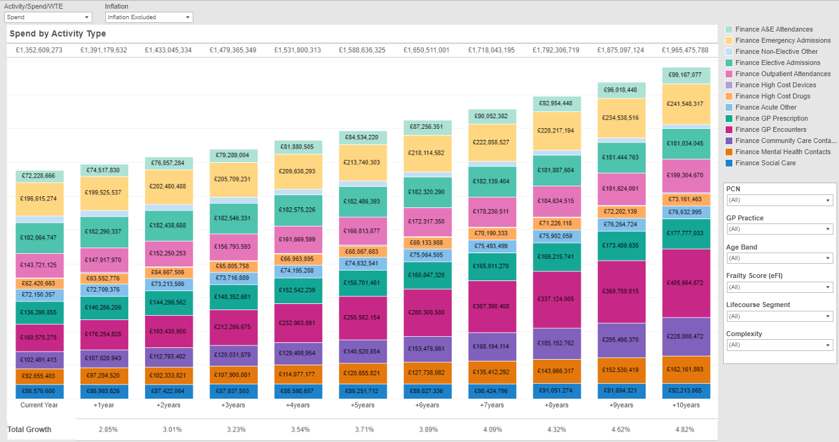
Resource by Activity Type
N.B Filters applied on this report work independently to other reports

Slide 17

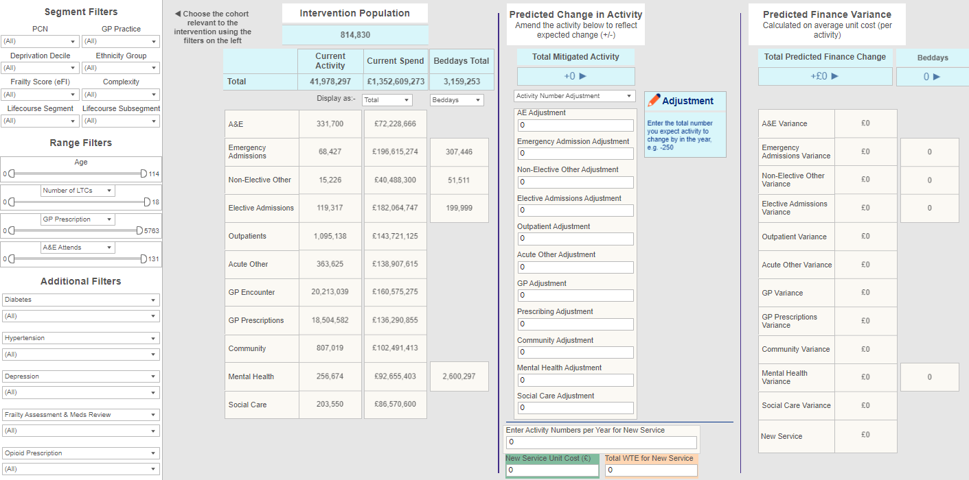
Mitigation Tool
See the following pages for details on how to use the Mitigation Tool

Slide 18
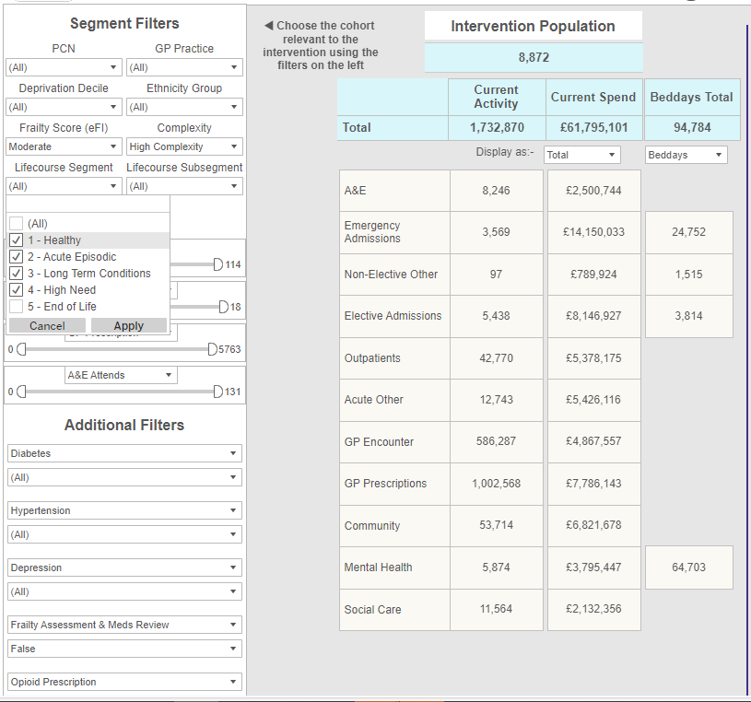
Using the Mitigation Tool – Part 1: Current Resource
Use the filters on the left to select a cohort/population of interest, these filters persist across reports (remember to click “Apply” in the dropdowns).
You can select to view Beddays or Whole Time Equivalent (WTE). Beddays only displays next to a service which delivers inpatient care. WTE refers to the WTE required to deliver the service to the cohort selected in the reporting period (shown at the top of the report).
The current Activity, Spend and Population in the tables will adjust accordingly for the cohort. This is important because, for example, the spend PPPY will be higher for more complex people and this will be reflected in the model. Choose to display as "Total" or "PPPY".
For a specific population you can view the total activity & spend for each point of delivery in this one table. The advantage of this is that you can easily see where the highest and lowest resource occurs. This is helpful when you come to mitigate the activity.

Slide 19
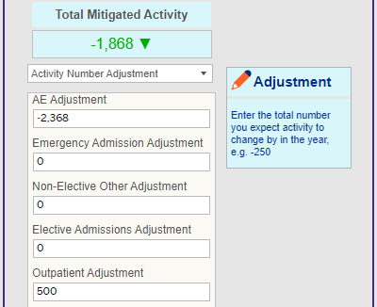
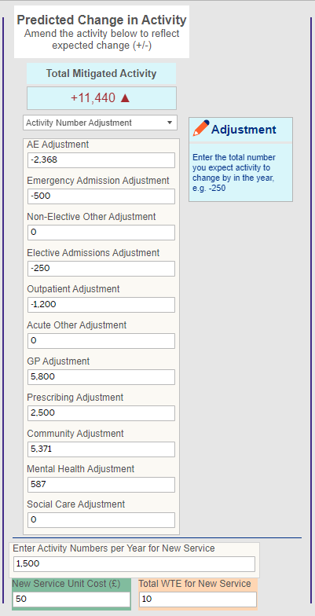
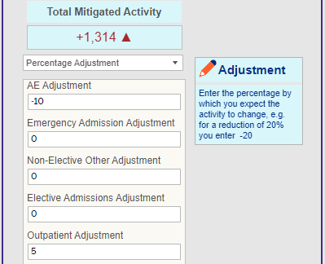
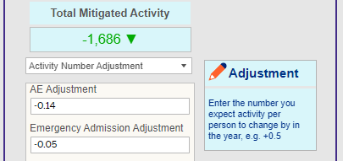
Mitigation Tool – Part 2: Mitigation
Example 1: should you design an intervention which will reduce A&E Activity by 2,368 attendances & increase Outpatient Attendances by 500 then:-
select Display As "Total“
select "Activity Number Adjustment"
type -2,368 in the box for A&E Adjustment
type 500 in Outpatient Adjustment
The adjustment boxes in the centre section of the Mitigation Tool report allow you to type in an Activity or Percentage adjustment, either as a total activity adjustment or PPPY adjustment.
Example 2: should you design an intervention which will reduce A&E Activity by 10% attendances & increase Outpatient Attendances by 15% then:-
select Display As "Total“
select “Percentage Adjustment"
type -10 in the box for A&E Adjustment
type 15 in Outpatient Adjustment
Example 3: should you design an intervention which will reduce A&E Activity by 0.14 attendances per person per year (PPPY) & decrease Emergency Admissions by 0.05 PPPY then:-
select Display As “PPPY“
select "Activity Number Adjustment"
type -0.14 in the box for A&E Adjustment
type -0.05 in Emergency Admission Adjustment
If a new service is being commissioned type the estimated annual Activity, Unit Cost (and WTE) for the new service in the relevant boxes towards the bottom centre of the screen.

Slide 20
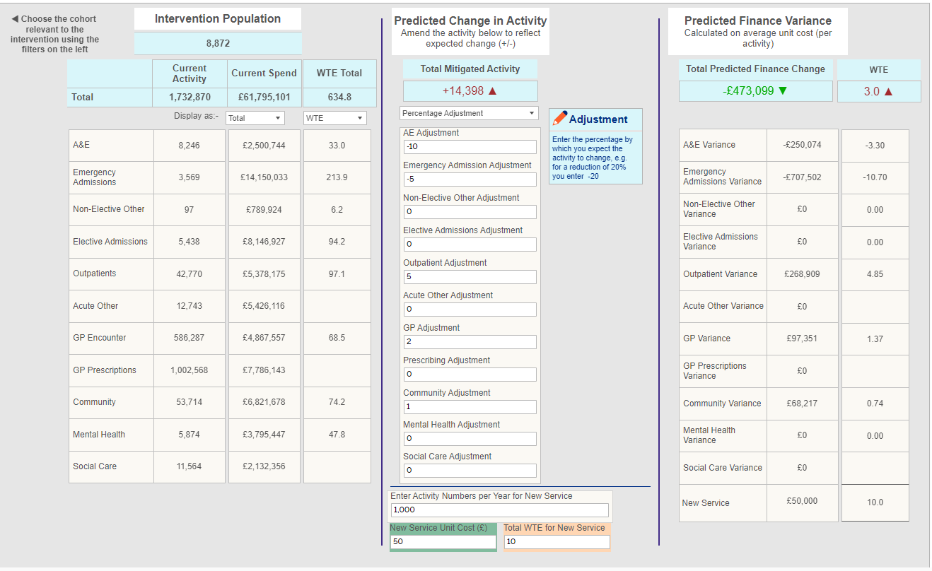
Mitigation Tool – Part 2: Mitigation
The Spend by Service and WTE/Beddays will adjust accordingly in the section to the right of the Mitigation Tool detailing the impact of the adjustments you have entered. The total impact is calculated and displayed at the top right.

Slide 21
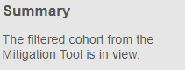
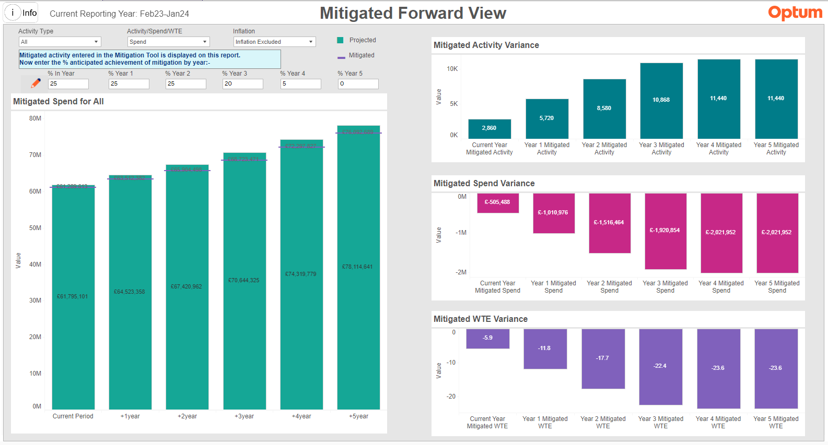
Mitigation Forward View
Example: If you expect to achieve 25% of the projected outcome in the current year and a further 25% in years 1 and 2, followed by 20% in year 3 and a further 5% in year 4 then adjust the percentage boxes above the left-hand chart to display these values (as shown).
On the right you can see the projected variance for Activity, Spend and WTE by year.

Slide 22
Use cases: Lincolnshire data
https://phm.optum.co.uk

Slide 23


Use cases information
Use the Historic Trends reports for your population of interest to see what has happened in the past
Use the “Projections – Do Nothing” reports to understand what could happen if there is no change and use this to support the case for change
Find evidence to support the proposed change (page 31)
Create several models for change in the “Mitigation Tool”, e.g. best case/worst case scenario, to present in your Business Case
Build evaluation methods into the design to track the impact following the intervention
Guidance
The following Case Studies are intended to help you understand how best to utilise the PHM Led Projections module and wider PHM Reporting Suite to create mitigated views for a population.
Insert quote? PHM data quote? Or quote from John D?
Quoter

Slide 24
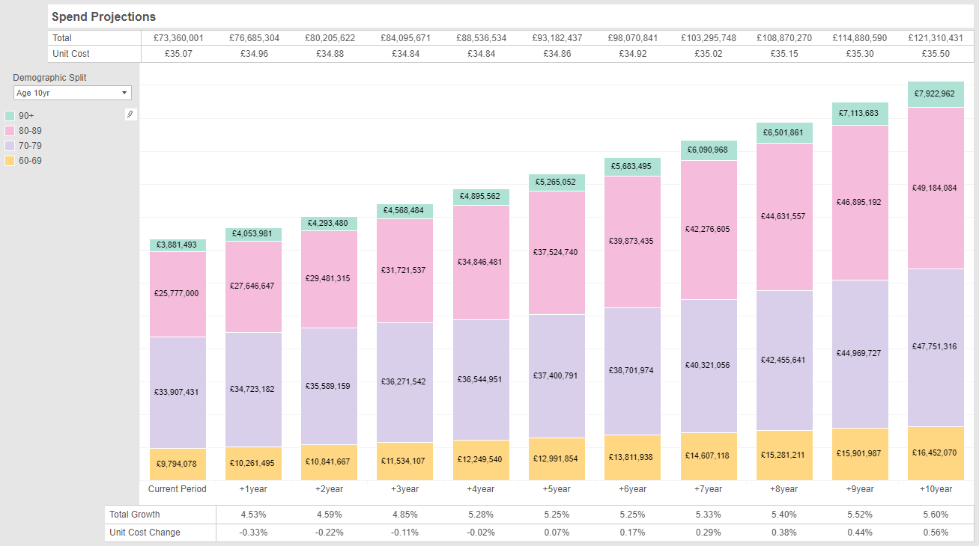
Example 1: Frailty
Cohort is Moderately Frail people (aged 65+) with High Complexity (4 or more complex conditions)

Slide 25
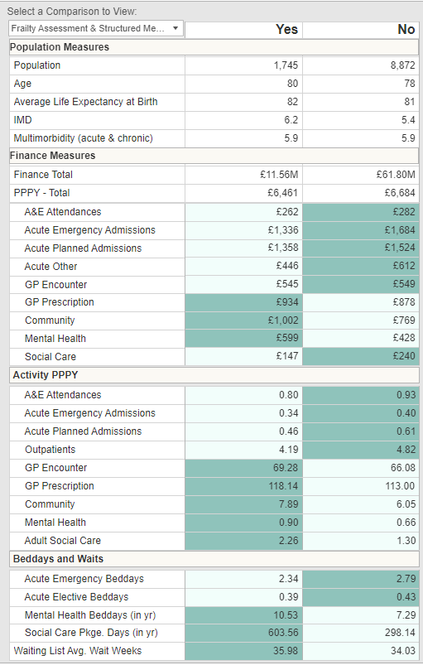
1. Frailty (continued)
Have had a Frailty Assessment or Medication Review
Have NOT had a Frailty Assessment or Medication Review
Cohort is Moderately Frail people (aged 65+) with High Complexity (4 or more complex conditions)
This is the Comparison Detail report available in the PHM Dashboard module, where you can interrogate and segment the linked data to understand your population in further detail.
For example: in the Comparison Detail Report for this cohort the variance in activity per person per year is evident for people who have had a Frailty Assessment or Structured Medication Review versus those who haven’t.
Variance
-0.13
-0.06
-0.15
-0.63
3.2
5.14
1.84
0.24

Slide 26
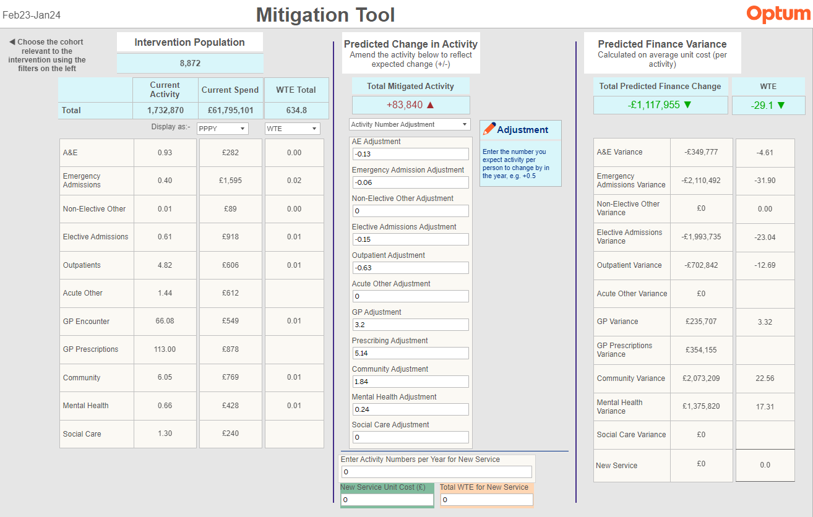
1. Frailty (Continued)
Cohort is Moderately Frail people (aged 65+) with High Complexity (4 or more complex conditions) who have not had either a Frailty Assessment or Structured Medication Review.
The adjustments entered are taken directly from the variance found in the Comparison Detail report (previous page).
Potential saving if they meet the same outcomes as the cohort who have had these Reviews.

Slide 27
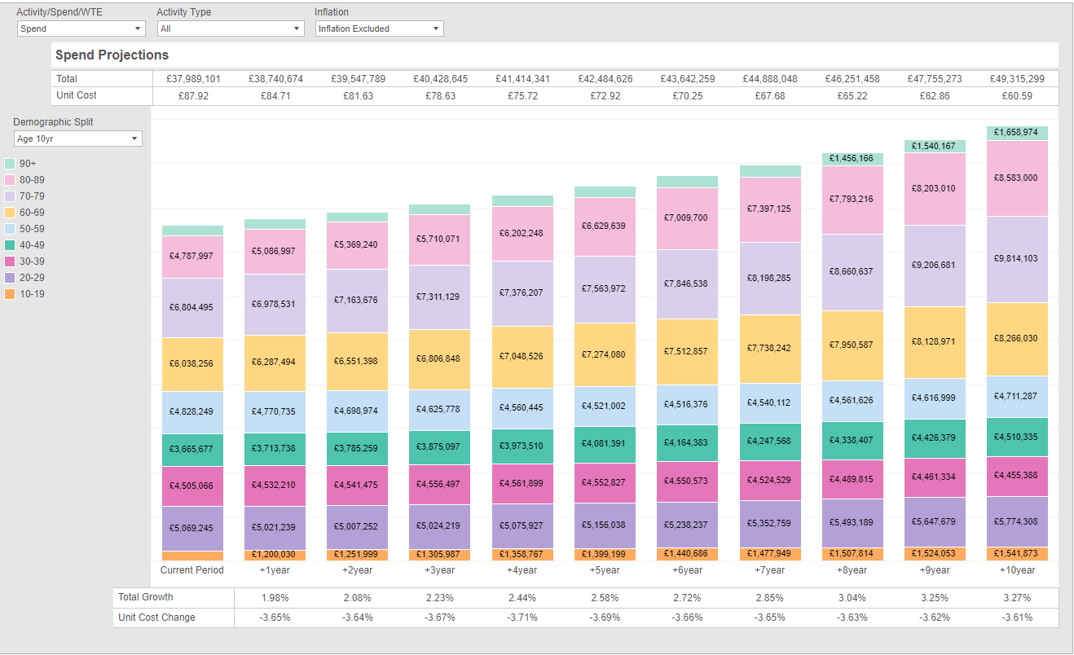
Example 2: High Intensity Users
Cohort = 7 or more A&E attendances (all types) in year, aged 18+, not end of life

Slide 28
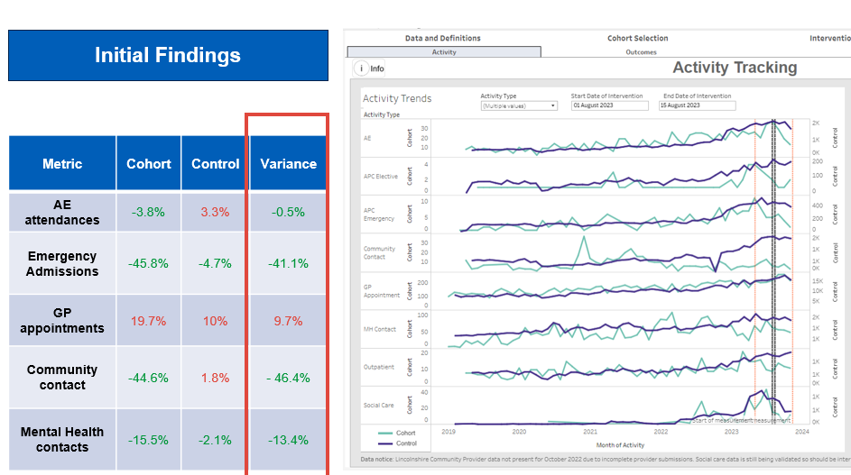
High Intensity Users (Continued)
Cohort – 28 people identified as HIU in Trent PCN, aged 18+ and have had > 7 ED attendances in the past 12 months
Control – 2,139 people from all PCNs across Lincolnshire, aged 18+ and have had >7 ED attendances in the past 12 months
-7.1%

Slide 29
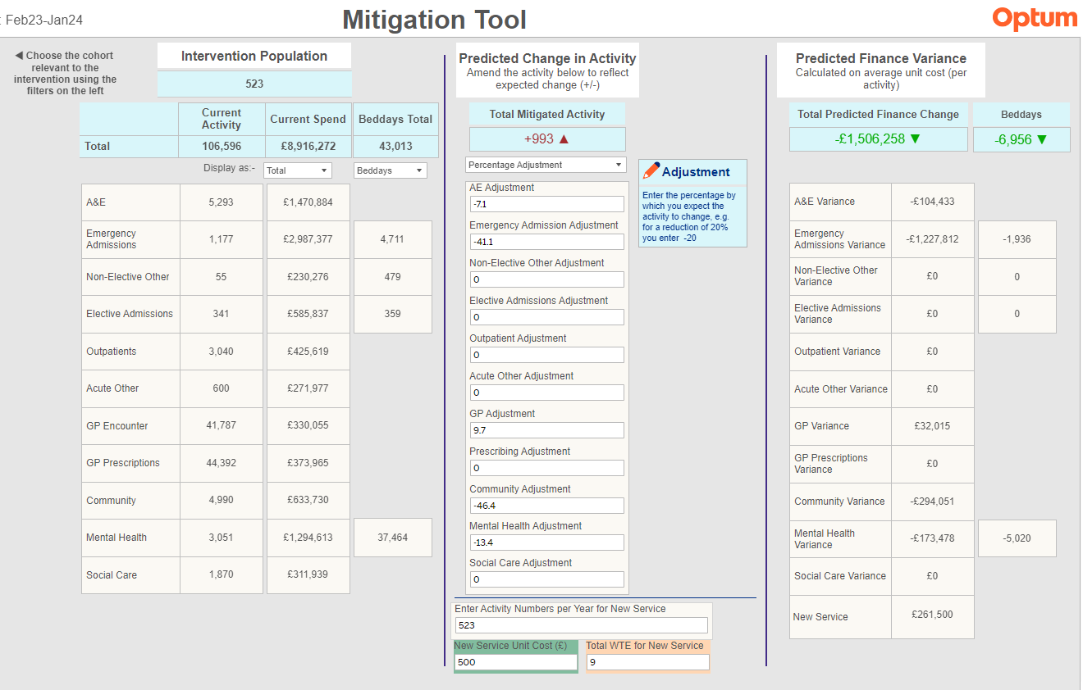
High Intensity Users (Continued)
Cohort = First Coastal and Boston PCN, 7 or more A&E attendances (all types) in year, aged 18+, not end of life.
The adjustments entered are equivalent to those seen after the 3 month evaluation for 28 patients in Trent PCN (caveat: this cohort is small, you may want to wait to evaluate when more patients have been through the intervention or err on the side of caution when making the adjustments for future populations).
Investment = 1 Band 5 per 60 patients per year.

Slide 30
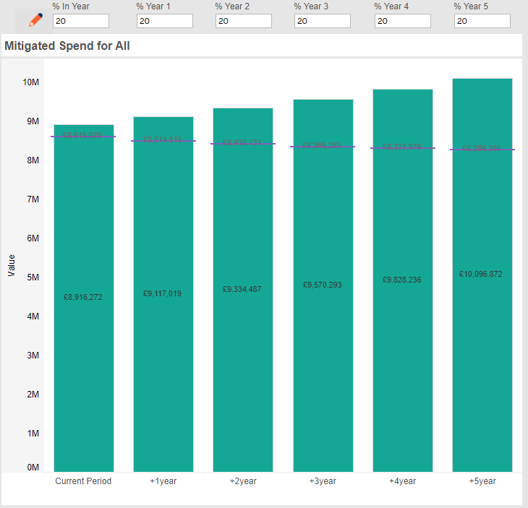
High Intensity Users (Continued)
Cohort = First Coastal and Boston PCN, 7 or more A&E attendances (all types) in year, aged 18+, not end of life.
Example: Anticipated achievement is 20% of rolling cohort per year.

Slide 31

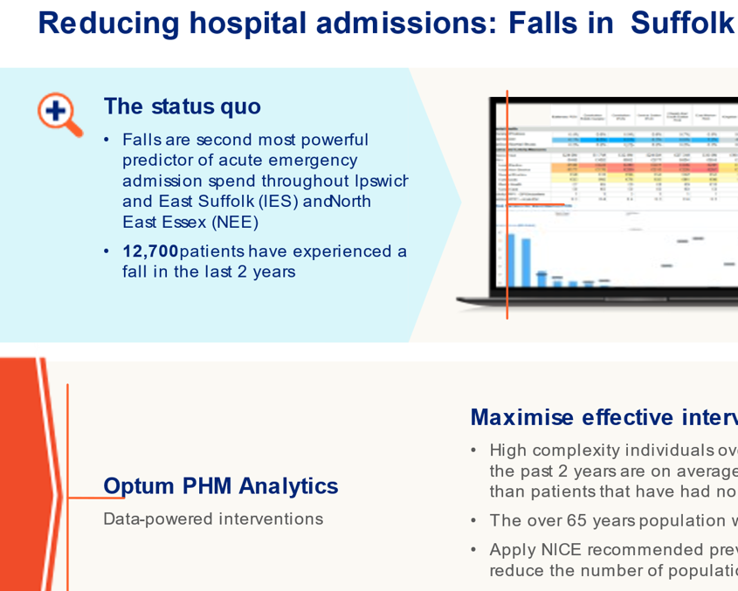
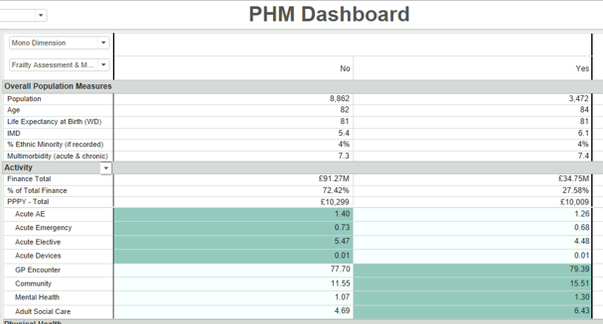








Some suggestions on how to calculate the impact of an intervention
Mitigation Tool Adjustments
Data Analysis
Case Studies
Pilot Project
Design and Adapt
National Evidence
Delphi Process
Plan and Research
Measure and Monitor

