Slide 1




Pathfinder Walkthrough
Developed in partnership with Optum UK

Slide 2

Partnering across health and care supported by PHM analytics
National NHS England & Improvement
Population Health Management
Development Programme partner
36
33
132
16m
ICSs participated in Population Health Management Development Programme
Place-based partnerships completed the programme
Primary Care Networks completed the programme
People included in linked data, analytics and insight
We have supported every tier of an integrated health and care system to:
Link local data
Build analytical skills to find rising risk cohorts grappling with social inequality⁴
Design and deliver new models of integrated care focusing on outcomes
Risk stratify elective care backlog
Explore alternative out-of-hospital models
Evaluate potential return on investment of these shifts in care
4. NHS England » 2022/23 priorities and operational planning guidance

Slide 3
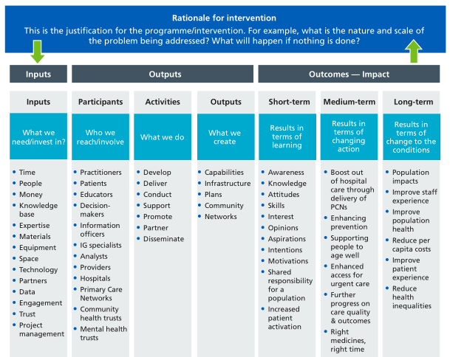
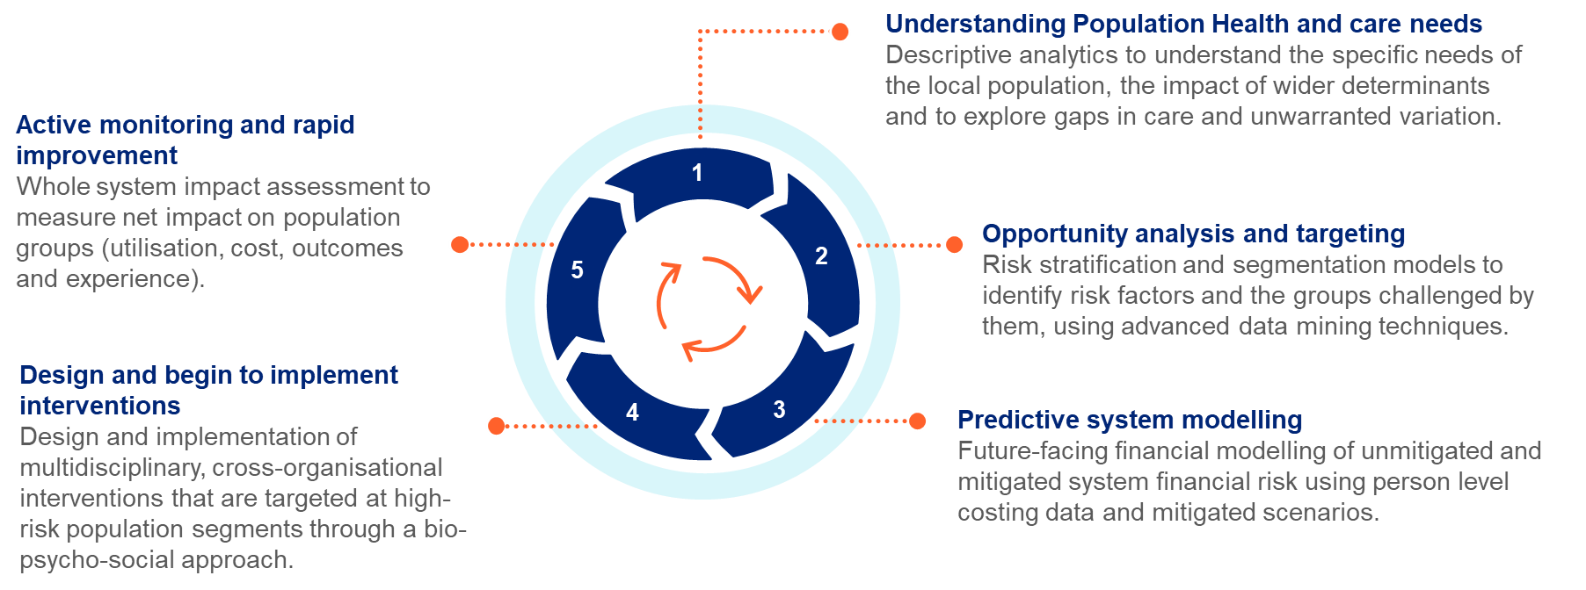
Here’s a hypothetical example
The Place leadership team want to find people who are using A&E frequently (they define as 5+ A&E attends in a year) to put in place evidence based, targeted preventative care aimed at addressing the root cause of their service use. This includes addressing social issues, improving activation & engagement and medicines adherence. Evidence shows significant reductions in unplanned care are possible alongside improvements to patient experience and outcomes.
STEP 1: Understand risk factors in the population and segment to find high intensity users
STEP 2: Apply filters to frequent attenders to find manageable cohorts and design targeted interventions (for example, age, sex, ethnicity)
STEP 3: Agree outcomes & link to activities or interventions
STEP 4: Monitor and adapt process to improve outcomes
STEP 5: Consolidate learning to spread, scale and improve service widely
STEP 6: Repeat

Slide 4
The PHM cycle — making things stick through continuous learning and doing
Understanding Population Health and care needs
Descriptive analytics to understand the specific needs of the local population, the impact of wider determinants and to explore gaps in care and unwarranted variation.
Active monitoring and rapid improvement
Whole system impact assessment to measure net impact on population groups (utilisation, cost, outcomes and experience).
1
Opportunity analysis and targeting
Risk stratification and segmentation models to identify risk factors and the groups challenged by them, using advanced data mining techniques.
5
2
Design and begin to implement interventions
Design and implementation of multidisciplinary, cross-organisational interventions that are targeted at high-risk population segments through a bio-psycho-social approach.
4
3
Predictive system modelling
Future-facing financial modelling of unmitigated and mitigated system financial risk using person level costing data and mitigated scenarios.
© 2024 Optum, inc. All rights reserved. Confidential property of Optum. Do not distribute or reproduce without express permission from Optum.

Slide 5
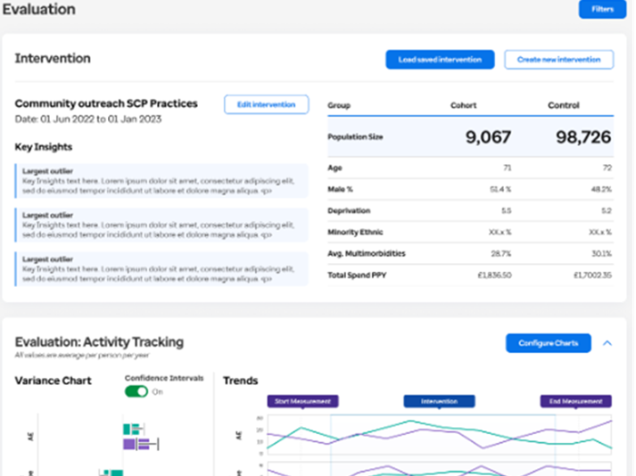
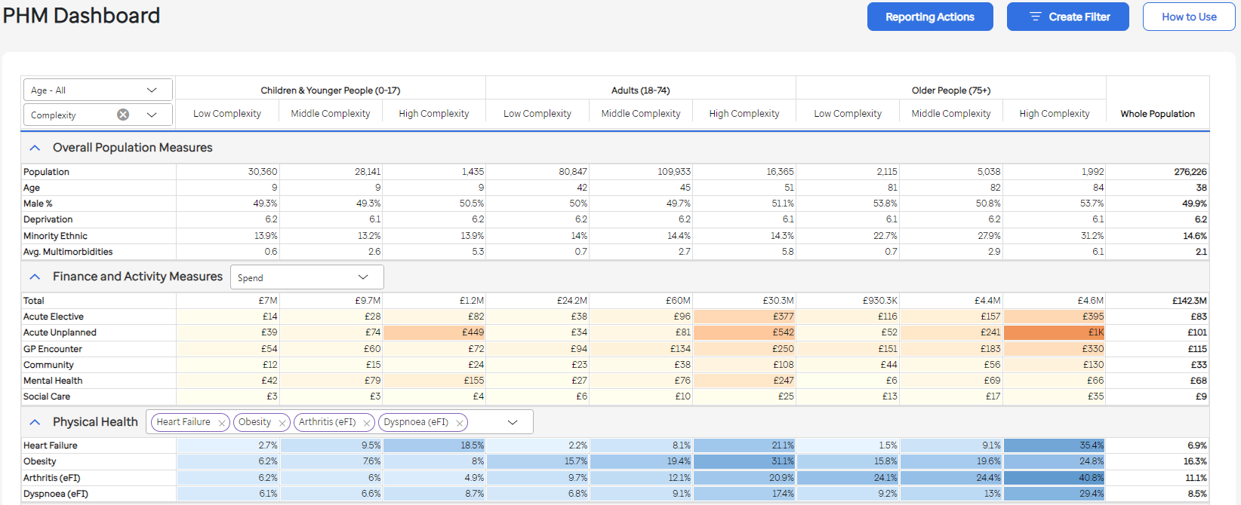
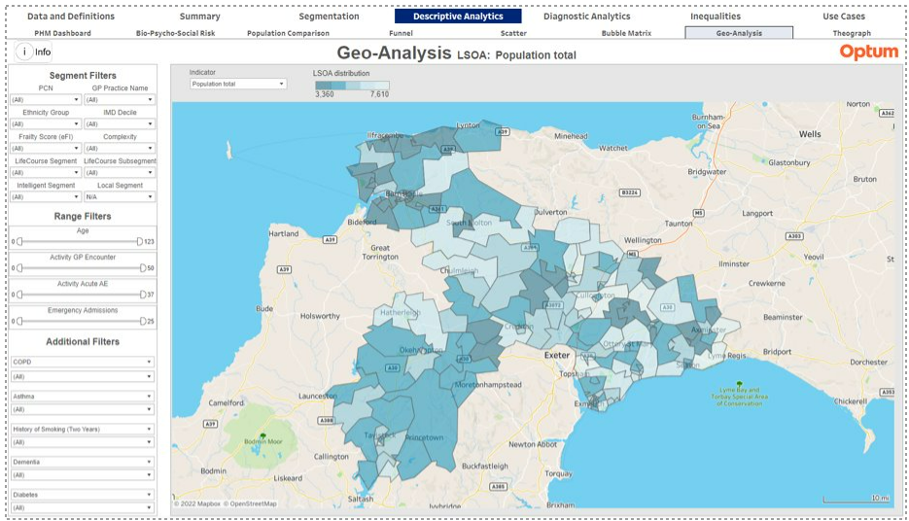
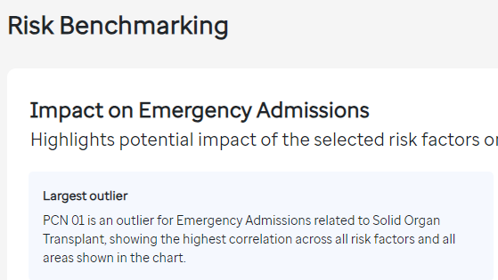
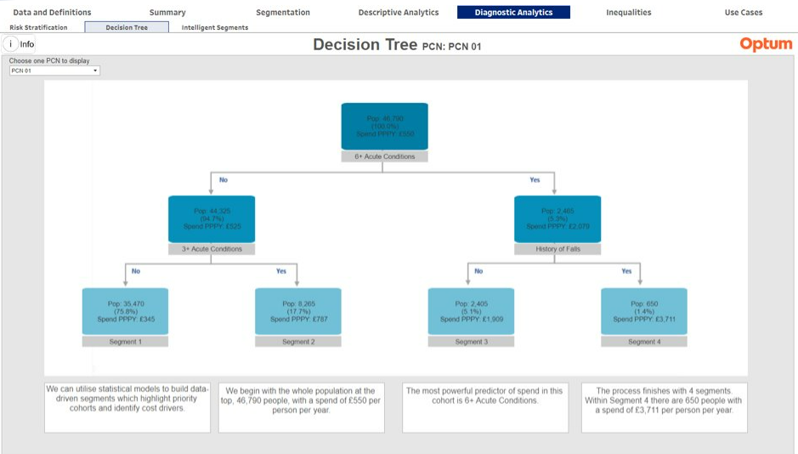
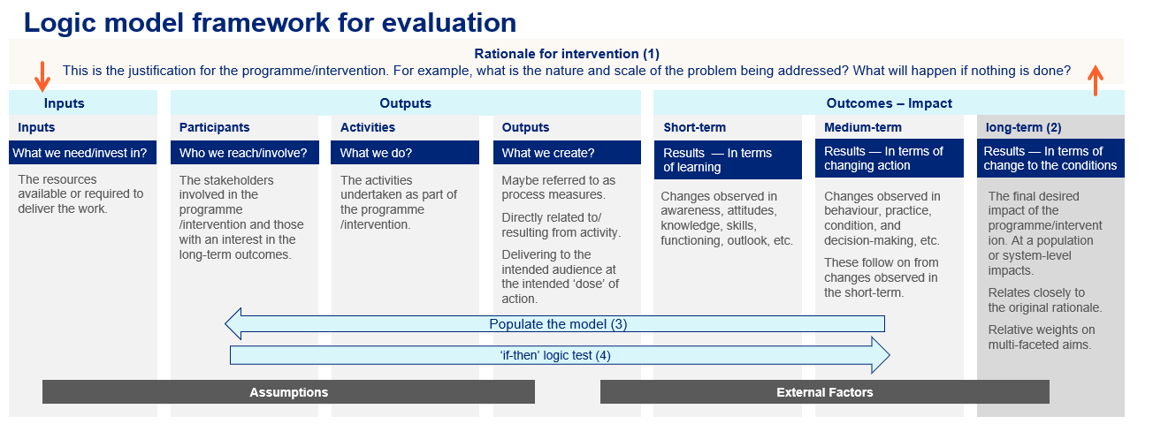
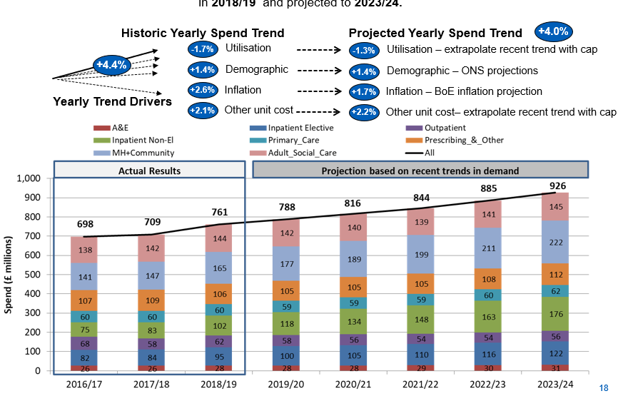
The PHM cycle — making things stick through continuous learning and doing
Evaluation
Descriptive analytics
1
Diagnostic analytics
5
2
Intervention Design & Delivery
4
3
PHM-Led Projections
© 2024 Optum, inc. All rights reserved. Confidential property of Optum. Do not distribute or reproduce without express permission from Optum.

Slide 6
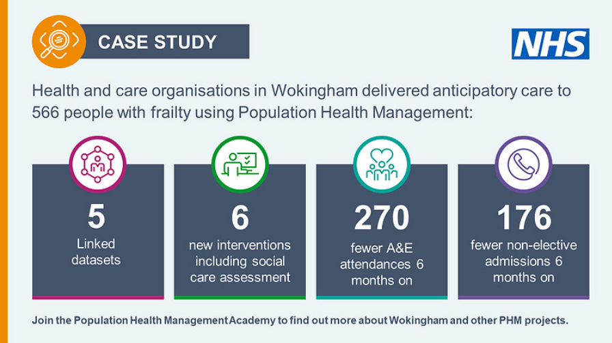
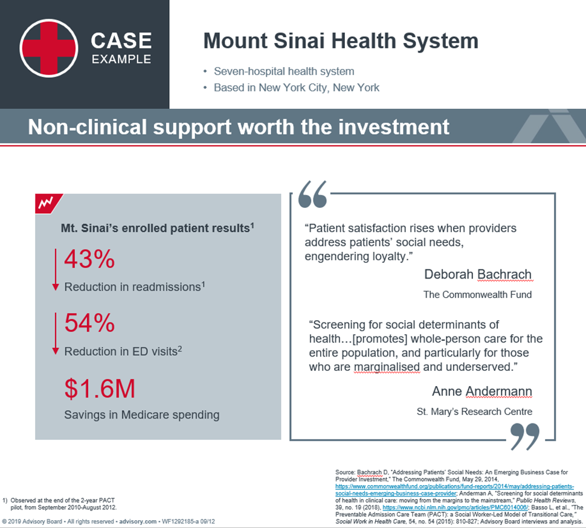
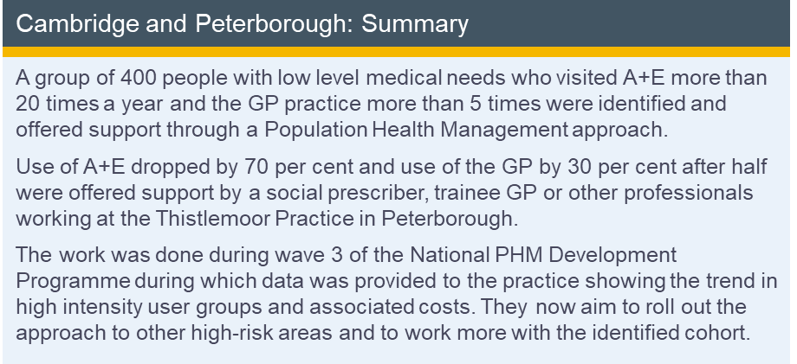
Evidence base from Optum’s clinical interventions library
Cohort criteria
5+ A&E attendances in a twelve month period
© 2024 Optum, inc. All rights reserved. Confidential property of Optum. Do not distribute or reproduce without express permission from Optum.

Slide 7
Shift to walkthrough in Pathfinder
Linked data
Segmentation -> filter to 5+ AE
Risk benchmarking
Segmentation -> add filter for diabetes
PHM-LP projections
PHM D
Next slide
© 2024 Optum, inc. All rights reserved. Confidential property of Optum. Do not distribute or reproduce without express permission from Optum.

Slide 8
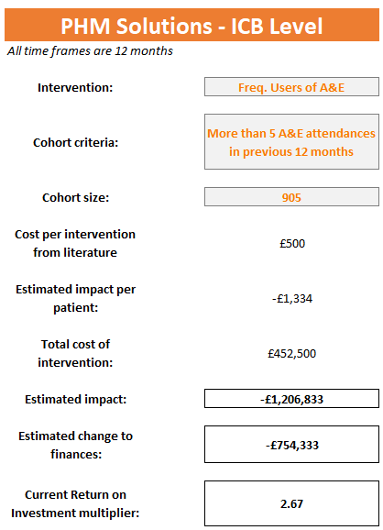
PHM Solutions – opportunity identification, to intervention, to evaluation
Cohort with 5+ A&E attendances
Calculating potential ROI supports evidence-based decision-making for the prioritisation and implementation of interventions for impactable cohorts.
© 2024 Optum, inc. All rights reserved. Confidential property of Optum. Do not distribute or reproduce without express permission from Optum.

Slide 9
Intervention design
© 2024 Optum, inc. All rights reserved. Confidential property of Optum. Do not distribute or reproduce without express permission from Optum.

Slide 10
Shift to walkthrough in Pathfinder
Mitigations tool in PHM-LP
Evaluation
© 2024 Optum, inc. All rights reserved. Confidential property of Optum. Do not distribute or reproduce without express permission from Optum.

Slide 11
Pathfinder PHM Analytics – technical requirements for local hosting
Azure* Cloud Environment
Databricks subscription
Web app container
ODIN
Data Process
PHASE
Data Science Engine
SQL Instance
Pathfinder
PHM Analytics
SQL DB
SQL & Python
R & Python
People
Analytics team + superuser
Data engineer/DBA
Cloud engineer/sysadmin
Security team
Technology
Terraform to deploy infrastructure
Octopus or Jenkins for deployment
Service bus & function apps
© 2024 Optum, inc. All rights reserved. Confidential property of Optum. Do not distribute or reproduce without express permission from Optum.

Slide 12
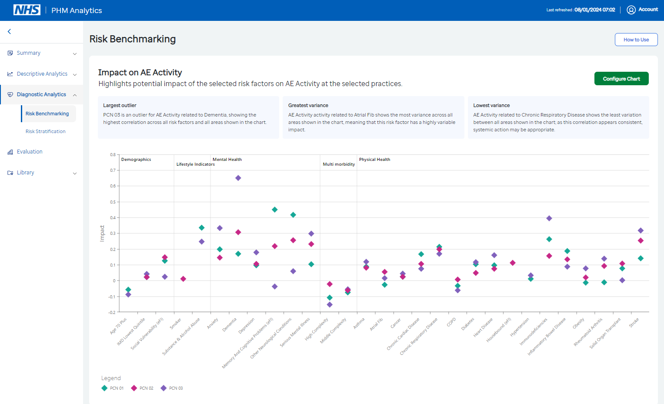
PHM Solutions – opportunity identification, to intervention, to evaluation
Opportunity identification
Different groups may start in different places to find a cohort to work with. This method quickly identifies PCN outliers for A&E attendances and the risk factors that explain this – which could be one place to start
© 2024 Optum, inc. All rights reserved. Confidential property of Optum. Do not distribute or reproduce without express permission from Optum.

Slide 13


PHM Solutions – opportunity identification, to intervention, to evaluation
Opportunity identification
Section: Working example
© 2024 Optum, inc. All rights reserved. Confidential property of Optum. Do not distribute or reproduce without express permission from Optum.

Slide 14
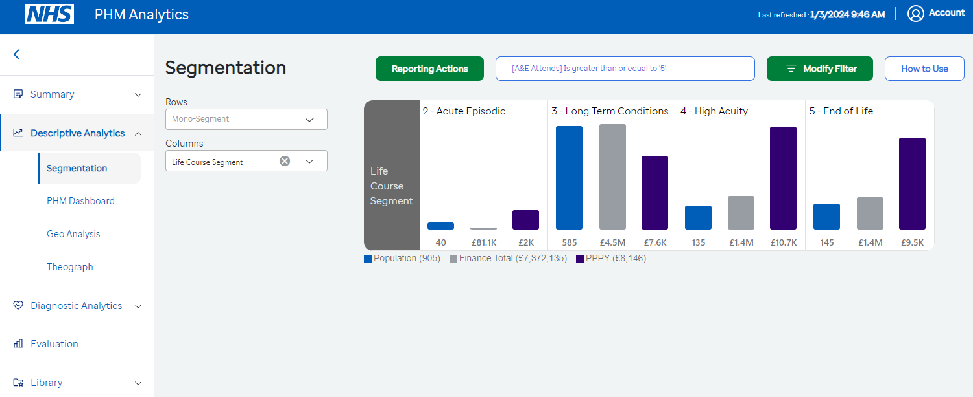
PHM Solutions – opportunity identification, to intervention, to evaluation
HIUs – Bridges to Health segmentation for cohort with 5+ A&E attendances
Not all people who use A&E frequently are the same, and segmentation allows us to tailor our care offer further. What differential support do people who use A&E frequently need if they have a long-term conditions need, versus those who multiple long-term conditions and complex care needs (High Acuity) or are End of Life?
Section: Working example
© 2024 Optum, inc. All rights reserved. Confidential property of Optum. Do not distribute or reproduce without express permission from Optum.

Slide 15
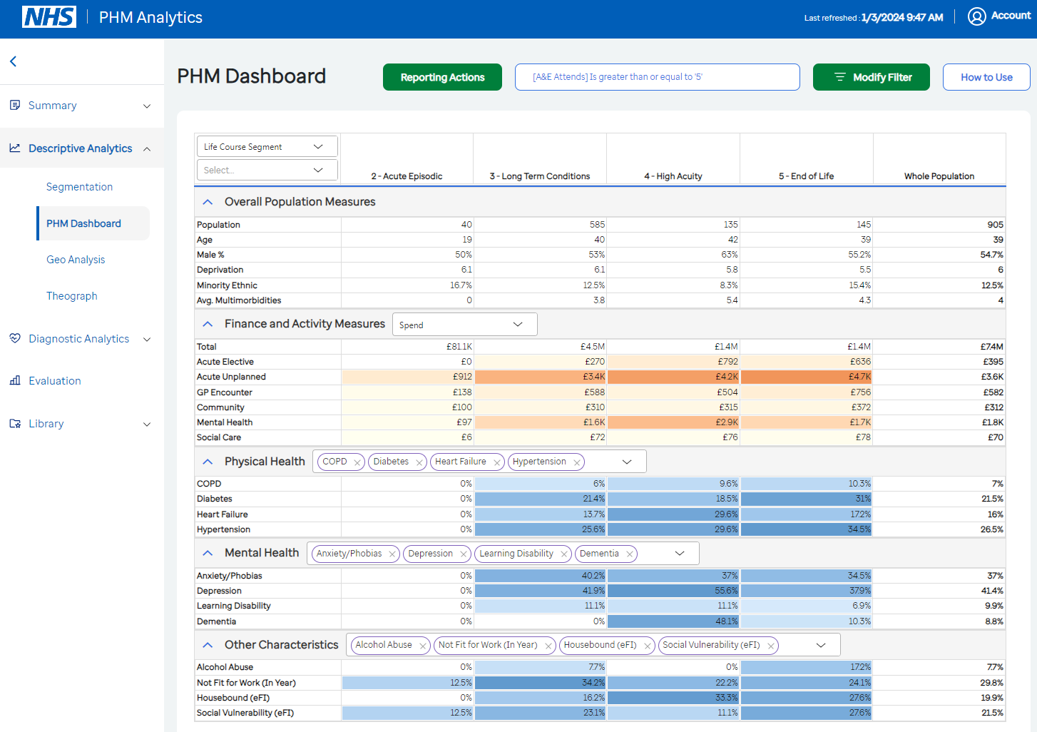
PHM Solutions – opportunity identification, to intervention, to evaluation
Bridges to Health segmentation for cohort with 5+ A&E attendances
The PHM Dashboard gives us further insights on the people in each segment – enabling us to truly understand the people in need of a new intervention.
Section: Working example
© 2024 Optum, inc. All rights reserved. Confidential property of Optum. Do not distribute or reproduce without express permission from Optum.

Slide 16
PHM Solutions – opportunity identification, to intervention, to evaluation
Cohort with 5+ A&E attendances
Calculating potential ROI supports evidence-based decision-making for the prioritisation and implementation of interventions for impactable cohorts.
© 2024 Optum, inc. All rights reserved. Confidential property of Optum. Do not distribute or reproduce without express permission from Optum.
Section: Working example

Slide 17
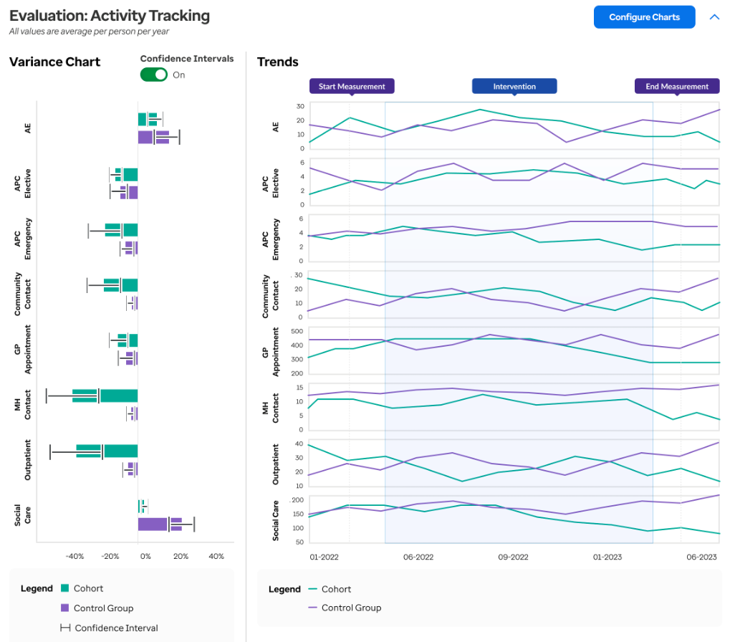
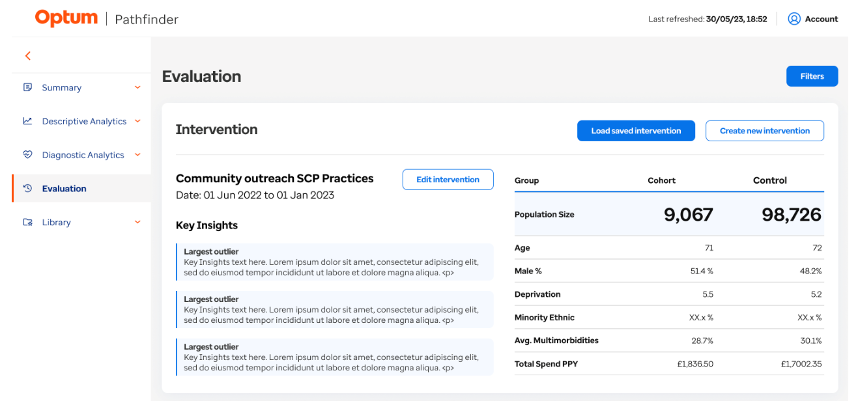
PHM Solutions – opportunity identification, to intervention, to evaluation
Tracking and monitoring impact
The ability to robustly track and monitor the impact of evidence-based interventions, using a retrospective matched control methodology.
Section: Working example
© 2024 Optum, inc. All rights reserved. Confidential property of Optum. Do not distribute or reproduce without express permission from Optum.

Slide 18
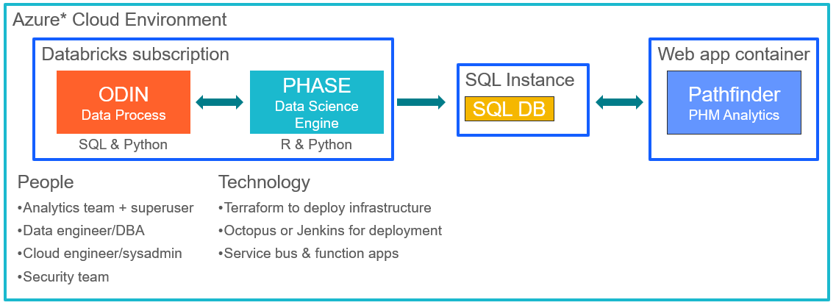
Technical requirements for Optum hosting
Pathfinder PHM Analytics
Technical requirements for local hosting
Architecture
Local hosting of Pathfinder requires an Azure subscription which can host a web app container, a SQL instance, and a Databricks subscription to run the data process & data science models. Deployment is via Terraform and Octopus or Jenkins.
People
In order to run the data process and maintain the Pathfinder application, ICSs should have an analytics team with expertise in SQL and Python, a data engineer, a cloud engineer, and a security team.
Section: Pre-requisites
© 2024 Optum, inc. All rights reserved. Confidential property of Optum. Do not distribute or reproduce without express permission from Optum.

