Slide 1


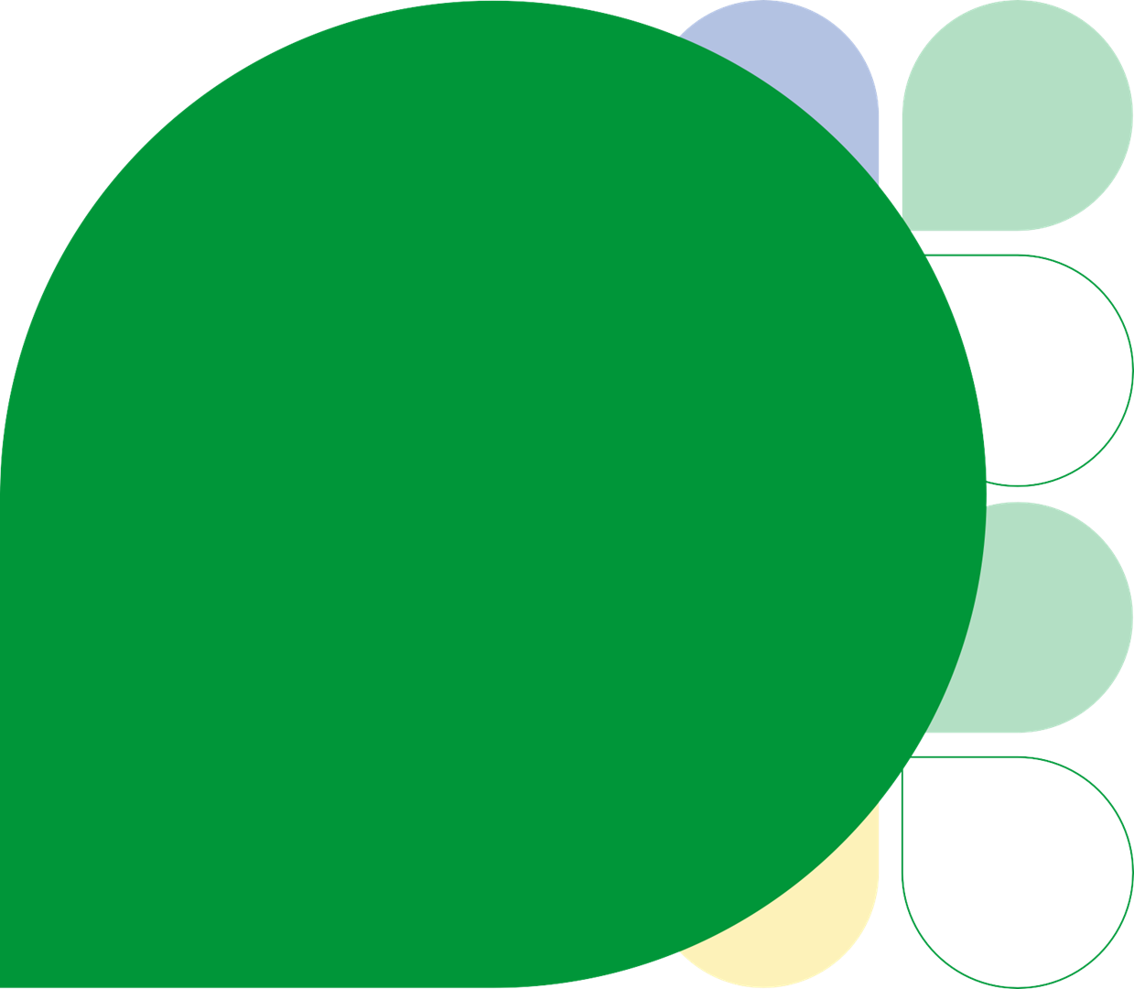

Population Health Management Approach & Application
1 November 2023
Developed in partnership with Optum UK

Slide 2
Population Health Management Approach & Application
1 November 2023

Slide 3
Objectives
Understand the linked data and the opportunities it affords, with a specific view on PHM Support from System-to-Person
Share examples of PHM in action and assess how this can support using whole-system working

Slide 4

Consider Population Health Management in the context of Quality Improvement
Population Health Management
Quality Improvement
Focus: Primarily concerned with the health outcomes of an entire population or community.
Scope: Involves strategies to optimise the health of a defined group, considering factors like demographics, social determinants, and health behaviours.
Approach: Emphasises proactive measures, preventive care, and interventions targeted at improving the health of the overall population.
Tools: Utilises data analytics, care coordination, and community engagement to address health disparities and enhance the well-being of diverse groups.
Focus: Concentrates on improving the processes and outcomes within a specific system, organization, or service delivery.
Scope: Involves targeted efforts to enhance the quality of care, services, or processes, often within a healthcare facility or specific operational context.
Approach: Prioritises continuous assessment, measurement, and refinement of processes to achieve better outcomes, safety, and patient satisfaction.
Tools: Involves the use of various methodologies and tools such as PDSA cycles, Six Sigma, and data-driven approaches to identify and address specific areas for improvement.
Overlap
While distinct, there is overlap between population health management and quality improvement, especially in healthcare. Both aim to enhance health outcomes, and effective quality improvement within an organisation can contribute to better population health.
Conversely, strategies employed in population health management, such as preventive care and addressing social determinants, can positively impact the quality of care and services delivered to individuals within that population.
In summary, population health management has a broader focus on the health of a population, considering various determinants, while quality improvement is more specific, concentrating on refining and optimising processes within a system or organisation to achieve better outcomes.

Slide 5
Really high-level summary for teams to be thinking about

Slide 6
How do we get to a PHM-led service – 10 practical steps
❶ | Adoption, dissemination and planning around the Lincolnshire Strategic Segmentation model
❷ | Build triumvirate of clinicians, analysts and managers at all levels of the System to maximise the opportunity to use the ICS Joined Intelligence Dataset to inform and influence care planning and decision-making
❸ | Undertake neighbourhood-wide stakeholder and capability mapping and alignment of roles, and maximise engagement across all stakeholders
❹ | Allow decisions associated with care to be made as close to, and in conjunction with the population, with the wider PCN, place, system hierarchy supporting and enabling local decision-making and action
❺ | Develop and implement outcomes matrix and incentives for processes and establish automated reporting mechanism against measurement outcomes
❻ | Maximise top-of-license working, with an emphasis on proactively engaging and managing segments of the population to prevent the onset and exacerbation of clinical conditions
❼ | Review and align the Care Navigator, Social Prescriber and Health & Wellbeing Coach roles to best manage the proactive care process and interaction, thus reducing clinician effort
❽ | Identify and implement digital resources and tools to improve engagement between teams and with the population and their care journey/s
❾ | Establish and implement a patient experience feedback mechanism that provides actionable insight on patient access, service use, and health and wellbeing journey
❿ | Evaluate progress using a data-driven evaluation methodology and course correct based on learning

Slide 7
Questions we should be asking ourselves
1
Are we considering wider determinants of health in all planning and interactions?
2
Are patient setting goals and contributing to their personalised journey?
3
Are we effectively managing the coordination of the patients journey?
4
Are patients meeting their goals?
5
Are we following up on patient events?
6
Is the patient experience adding to their journey?
7
Are we defining our service offering based on patients needs?
8
Are patient utilisation patterns changing as a result of proactive care?

Slide 8
Breaking down the PHM cycle to define practical steps for implementing PHM

Slide 9
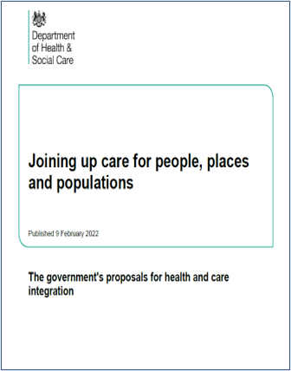
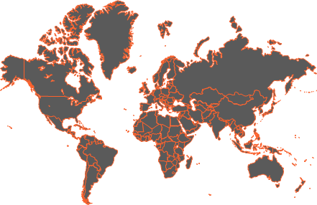
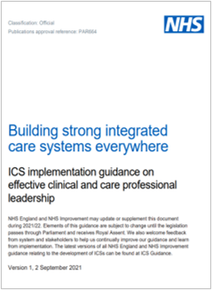
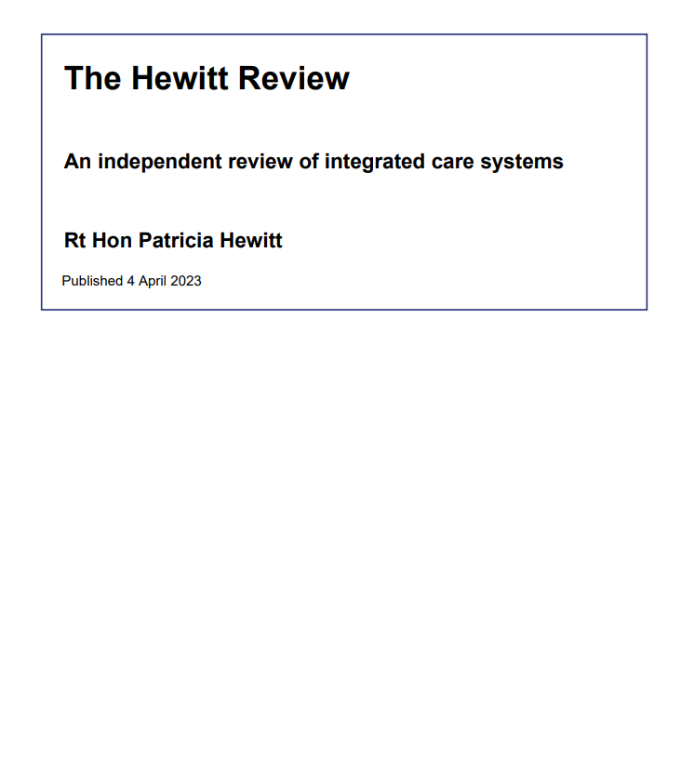
National (Global) Shift to Integrated Care Systems is underway
Canada
Ontario Health Teams will merge all providers and budgets around one patient population
​
Focus on population health management and reducing inequalities in access, experience and outcomes should form 50% of ‘the work’ of an ICS
Saudi Arabia
Building 20 Accountable Care Organisations to manage health and social care under a fixed budget
England
All patches became Integrated Care Systems by mid-2022
Finland
Creating 21 ‘sote’ (health care) regions responsible for health and social care, and rescue services by 2023
Integrated care systems (ICSs) represent the best opportunity in a generation for a transformation in our health and care system. Effective change will require the combination of new structures with changed cultures. Everyone needs to change, and everyone needs to play their part

Slide 10
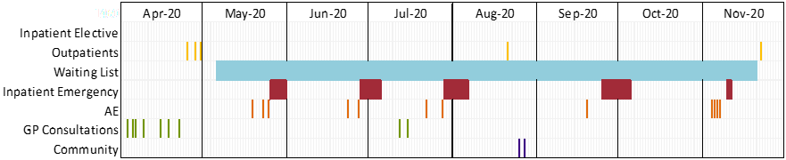






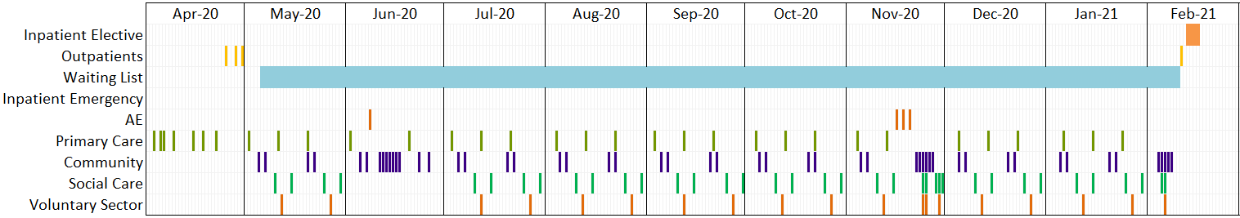






The Why: To collectively manage whole populations well
Example patient journey for a highly complex individual listed for surgery with no integrated PHM approach in place
Inpatient elective
£0
Outpatients
£500
Inpatient emergency
£12,500
A&E
£1,200
Total envelope £14,250
GP Consults
£120
Community
£200
Example patient journey for a highly complex individual listed for surgery, within PHM model. The person’s condition is managed by an integrated community MDT, and despite some A&E attends in year, a rapid response ensures no further deterioration:
Inpatient elective
£1,200
Outpatients
£500
Inpatient emergency
£0
Total envelope £6,500
A&E
£400
Primary Care*
£900
Community & VCSE
£3,500

Slide 11
The How: Use a Cycle of Improvement designed with Intelligence
1
Population segmentation to understand the specific needs of the local population, the impact of wider determinants and to explore gaps in care and unwarranted variation.
Understanding Population Health and care needs
Opportunity analysis and targeting
Predictive system modelling
Design and begin to implement interventions
Active monitoring and rapid improvement
Evaluation: Whole system impact assessment to measure net impact on population groups (utilisation, cost, outcomes and experience).
5
2
Risk Stratification: Model impact to identify high and emerging risk groups most amenable to interventions.
4
3
Intervention: Design and implementation of multidisciplinary, cross-organisational interventions that are targeted at appropriate population segments through a bio-psycho-social approach.
Prediction: Actuarial modelling of unmitigated and mitigated system financial risk using people level costing data and mitigated scenarios.

Slide 12
Intelligence-led Care Design
1
Population segmentation to understand the specific needs of the local population, the impact of wider determinants and to explore gaps in care and unwarranted variation.
Understanding Population Health and care needs
Opportunity analysis and targeting
Predictive system modelling
Design and begin to implement interventions
Active monitoring and rapid improvement
Evaluation: Whole system impact assessment to measure net impact on population groups (utilisation, cost, outcomes and experience).
5
2
Risk Stratification: Model impact to identify high and emerging risk groups most amenable to interventions.
4
3
Intervention: Design and implementation of multidisciplinary, cross-organisational interventions that are targeted at appropriate population segments through a bio-psycho-social approach.
Prediction: Actuarial modelling of unmitigated and mitigated system financial risk using people level costing data and mitigated scenarios.

Slide 13
Understanding Population Health and care needs
Practical steps for implementing |  | PHM PMO Offer
System teams (e.g. primary care, finance, personalization, etc.) disseminate, adopt and show case Lincs strategic segmentation model to align system governance to population segments Combine data and local intelligence to inform decision-making in all projects and programmes, with an emphasis on input from people closest to the population Bring the right stakeholders to the table to decide how to measure success for that population Build a picture of the impact of wider determinants of health, and specific environmental factors that lead to health inequality Continue to add wider data sets to Lincolnshire PHM data set to improve wider view of population |  | Facilitate and coordinate sessions to build knowledge and experience in the use and application of the Lincolnshire Strategic Segmentation Model Linked data orientation sessions for managers and ICB teams to build knowledge and experience in the use and application of the segmentation model and outcomes framework, with an emphasis on wider determinants of health and health inequality impact Analytical and data scientist support for improving Lincolnshire PHM data set, indicators and insights Facilitate the teams to develop stakeholder mapping with further framework design support

Slide 14
Draft segmentation model v4 – high level overview
Generally Healthy
Acute Episodic
Long Term Conditions
High Need
Palliative & End of Life
At Risk
Major
Moderate Frailty
Severe Frailty
Incurable Cancer
Core20
Frequent
Big Six*
High Complexity
Palliative & other EoL
Children & Maternity
Waiting List
Disability
Dementia
Low Risk
Mental Health
Big 6: Cancer, CKD, Diabetes, Heart Failure, Stroke, Chronic Respiratory
At-risk: alcohol/substance abuse, obesity, smoking, not fit for work, care plan, social vulnerable, cognitive decline, low mood, high cholesterol, QRISK, high blood pressure, low mood
MSK: admission, outpatient attendance, or is on a waiting list, for one of the following specialties - Trauma and Orthopaedics, Rheumatology, Physiotherapy Service. We have also looked in the primary care dataset to look for any complaints of musculoskeletal pain, history of MSK issues or and referrals to a MSK Service.
Mental Health: depression, anxiety, serious mental illness (bipolar & schz)
Frailty: as defined by Electronic Frailty Index (eFI), these segments are defined by a high number of frailty deficits
MSK
Based on working group sessions 1-4 we have revised the Lincs Segmentation Model again.
It still follows a MECE model, assigned in order – from right to left in segment, and top to bottom in subsegment.
Living With Illness

Slide 15
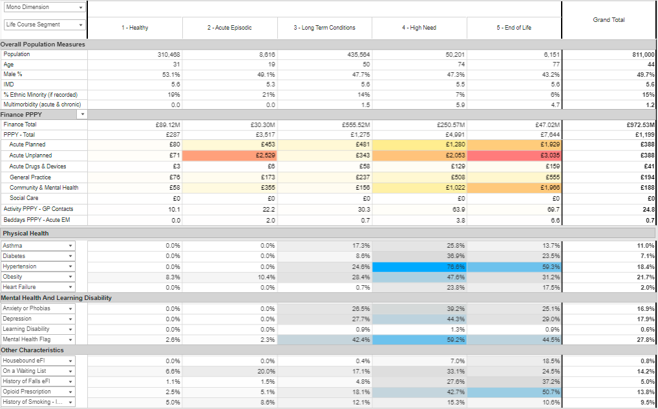
Draft segmentation model

Slide 16
Intelligence-led Care Design
1
Population segmentation to understand the specific needs of the local population, the impact of wider determinants and to explore gaps in care and unwarranted variation.
Understanding Population Health and care needs
Opportunity analysis and targeting
Predictive system modelling
Design and begin to implement interventions
Active monitoring and rapid improvement
Evaluation: Whole system impact assessment to measure net impact on population groups (utilisation, cost, outcomes and experience).
5
2
Risk Stratification: Model impact to identify high and emerging risk groups most amenable to interventions.
4
3
Intervention: Design and implementation of multidisciplinary, cross-organisational interventions that are targeted at appropriate population segments through a bio-psycho-social approach.
Prediction: Actuarial modelling of unmitigated and mitigated system financial risk using people level costing data and mitigated scenarios.

Slide 17
Opportunity analysis and targeting
Practical steps for implementing |  | PHM PMO Offer
Look at variation Determine unwarranted variation and gaps in care across geographies, PCNs, practices and deprivation Identify ‘positive deviants’ Use data to align system priorities underpinned by the Strategic Segmentation Model Focus Discussions towards a holistic approach to person needs rather than the wrap around services Support the further development of Lincs outcomes framework to support the SSM |  | Focus on total risk and complexity for each person in the population – develop a plan on how to build actions around the whole person Seek to remove barriers and identify further relevant resources Interview and understand what actions those outperforming their peers are taking; document, codify, and share Deep dive on opportunities for ARRS roles in the LTC and high acuity population segments Build relationships with frontline workers in priority areas especially with each PCN and together explore opportunities to improve revenue through reducing gaps in care. This sets the foundation for future value-based contracting.

Slide 18
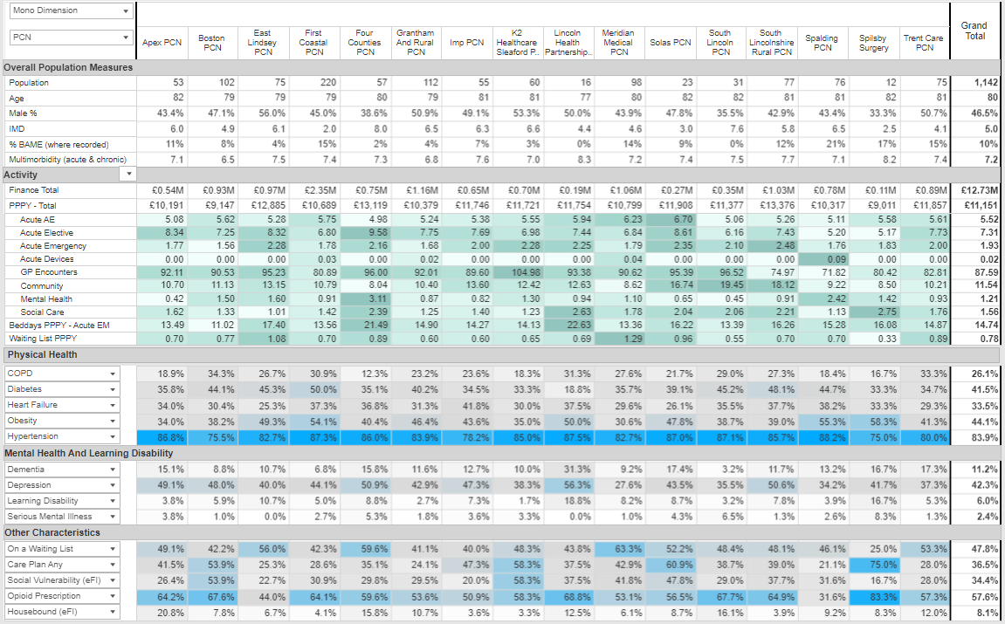
Cohort with 4+ A&E attends last year

Slide 19
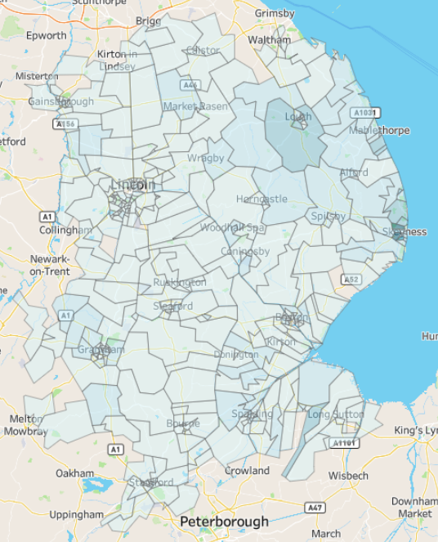
The demographics of the cohort population
 | Apex PCN | Boston PCN | East Linsey PCN | First Coastal PCN | Four Counties PCN | Grantham & Rural PCN | Imp PCN | K2 Healthcare PCN | Lincoln Health Partnership | Meridian Medical PCN | Solas PCN | South Lincoln PCN | South Lincolnshire Rural PCN | Spalding PCN | Spilsby Surgery | Trent Care PCN | Total
Population | 93 | 191 | 161 | 393 | 122 | 242 | 139 | 150 | 32 | 193 | 41 | 82 | 172 | 140 | 27 | 145 | 2,323
Age | 80 | 80 | 81 | 79 | 81 | 79 | 81 | 81 | 77 | 80 | 83 | 82 | 82 | 81 | 82 | 80 | 80
Male % | 37.6% | 46.6% | 50.3% | 44.0% | 43.4% | 50.4% | 48.9% | 47.3% | 53.1% | 42.0% | 46.3% | 42.7% | 40.1% | 44.3% | 29.6% | 47.6% | 45.3%
IMD | 6.1 | 5.1 | .7 | 2.0 | 8.0 | 6.6 | 6.0 | 6.5 | 4.8 | 4.5 | 3.1 | 7.3 | 5.8 | 6.6 | 2.8 | 4.0 | 5.1
% BAME | 10% | 8% | 5% | 15% | 2% | 4% | 6% | 3% | 3% | 11% | 10% | 6% | 8% | 18% | 11% | 14% | 9%
LTC’s | 7.0 | 6.4 | 7.0 | 7.4 | 6.9 | 6.7 | 7.3 | 6.8 | 7.1 | 7.0 | 7.5 | 7.2 | 7.5 | 7.0 | 7.1 | 7.0 | 7.0
Low High

Slide 20
Intelligence-led Care Design
1
Population segmentation to understand the specific needs of the local population, the impact of wider determinants and to explore gaps in care and unwarranted variation.
Understanding Population Health and care needs
Opportunity analysis and targeting
Predictive system modelling
Design and begin to implement interventions
Active monitoring and rapid improvement
Evaluation: Whole system impact assessment to measure net impact on population groups (utilisation, cost, outcomes and experience).
5
2
Risk Stratification: Model impact to identify high and emerging risk groups most amenable to interventions.
4
3
Intervention: Design and implementation of multidisciplinary, cross-organisational interventions that are targeted at appropriate population segments through a bio-psycho-social approach.
Prediction: Actuarial modelling of unmitigated and mitigated system financial risk using people level costing data and mitigated scenarios.

Slide 21
Predictive system modelling
Practical steps for implementing |  | PHM PMO Offer
Prioritise sessions with stakeholders from all providers together to agree the model assumptions Inform and build the intelligence of financial costs for SSM population segments, and growth in expenditure Understand the cost and opportunity cost associated with segments and cohorts of people and their impact Understand and use leveraging to offset small changes to high-cost reactive environments that enable larger funding changes to upstream, preventative care environments Maximise incentive schemes and revenue-generation opportunities with primary care leaders |  | Facilitate and coordinate stakeholders from across various providers to come together and build trust in what the data is saying Develop unmitigated, then mitigated financial models that represent a 10-year forward view of system expenditure by segment, age, and point of care Support the communication of the model to wider partners Conduct a Delphi process to assure the assumptions in mitigated modelling scenarios Inform a workforce planning model to align support based on population needs and forward view of needs and resources

Slide 22
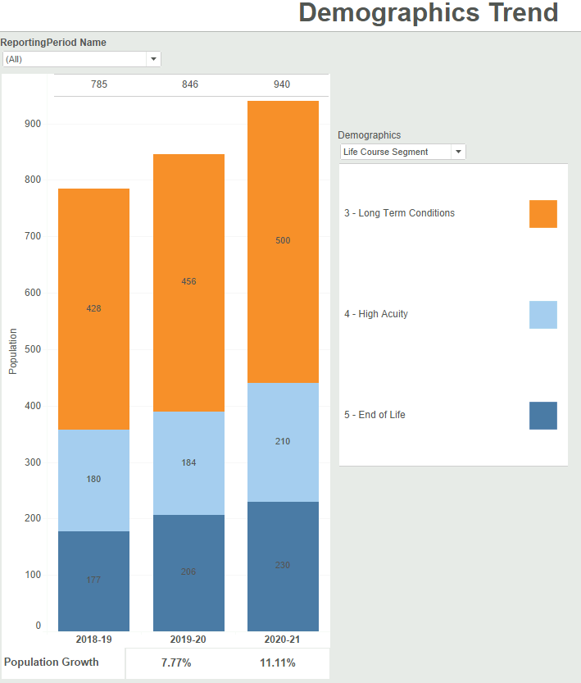
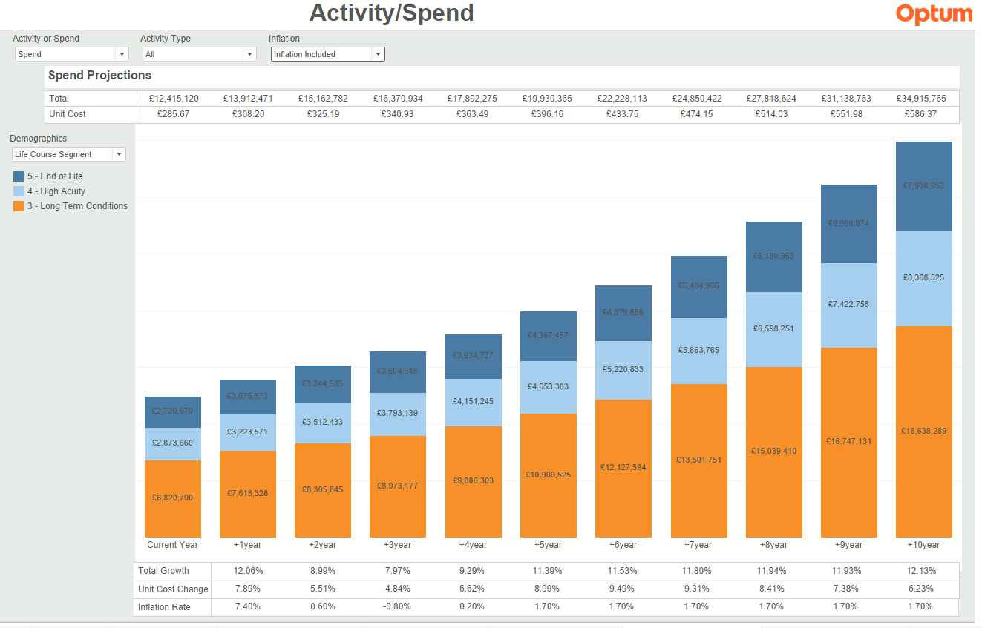
PHM-led Projections Module
As shown above, within 10 years those with 2 or more long term conditions will accrue a total spend of 18,000+ pounds
Notes:
Using the PHM RS, Place Programme input, national clinical guidelines and local clinical input; local analytical teams developed a number of models to understand the impact of various possible interventions on outcomes and financial sustainability
Several possible models of care were modelled for our targeted population, considering a 10 year population change. Graphs show the ‘as is’/ unmitigated risk across activity, financial, and demographic trends for our chosen cohorts’ life course segment, if we do not intervene

Slide 23
Intelligence-led Care Design
1
Population segmentation to understand the specific needs of the local population, the impact of wider determinants and to explore gaps in care and unwarranted variation.
Understanding Population Health and care needs
Opportunity analysis and targeting
Predictive system modelling
Design and begin to implement interventions
Active monitoring and rapid improvement
Evaluation: Whole system impact assessment to measure net impact on population groups (utilisation, cost, outcomes and experience).
5
2
Risk Stratification: Model impact to identify high and emerging risk groups most amenable to interventions.
4
3
Intervention: Design and implementation of multidisciplinary, cross-organisational interventions that are targeted at appropriate population segments through a bio-psycho-social approach.
Prediction: Actuarial modelling of unmitigated and mitigated system financial risk using people level costing data and mitigated scenarios.

Slide 24
Design and begin to implement interventions
Practical steps for implementing |  | PHM PMO Offer
Identify the cohorts in the population most in need, align on the problem to solve, and agree the goal Know the alignment to which segment and system-wide measure you are targeting impact Align the cohort to the skill set and resources available to ensure impactability Encourage a focus on more proactive approaches to patient care on a day-to-day basis Coordinate acute, community and mental health trust’s support to primary care teams for the delivery of preventative programmes Maintain top-of license work to free resource capacity, use technology to reduce the low-value workload Define SMART outcomes measures and work with analyst community to ensure effective measure |  | Facilitate and coordinate 3rd sector and social care organisations across the ICS to come together and work toward a common goal/ cohort Socialise and communicate to wider partners in order to remove barriers to implementation Interact with multiple levels of care providers to understand and influence behaviour change to drive BAU towards proactive preventative care Identify Lincolnshire-wide initiatives that will impact whole population and provider environments Support development through understanding of data insights and available resources including Care Coordinators and Health Coaches. Discuss how to structure these services for best population impact.

Slide 25
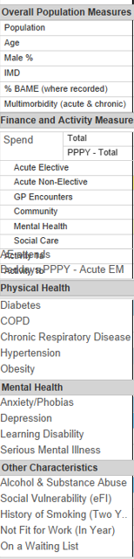



Cohorts Comparisons
Cohort 1
Cohort 2
Cohort 3
Cohort 4
Cohort 1 – 10+ ULHT AE Attends
Cohort 2 – 4+ ULHT AE Attends, 5+ MH activities, 5+ Comm activities, High GP Users
Cohort 3 – 6+ ULHT AE Attends, High GP Users
Cohort 4 – 6+ ULHT AE Attends,Low GP Users
Cohort 1 – High ULHT A&E Users
High Frequency Users (Cohort 2) are older, with more LTCs (8.2), and higher prevalence of physical health conditions.
AE Attends
Acute EM Beddays PPPY
Cohort 2 – High Frequency Users All Services
The high AE users (cohort 1) have the highest spend across all services. Highest MH prevalence, particularly in Depression and Alcohol/Substance abuse
Cohort 3 & 4 – High A&E and Contrasting GP Use
Stark differences between cohorts 3 and 4 across demographics, spend and prevalence of conditions

Slide 26
Intelligence-led Care Design
1
Population segmentation to understand the specific needs of the local population, the impact of wider determinants and to explore gaps in care and unwarranted variation.
Understanding Population Health and care needs
Opportunity analysis and targeting
Predictive system modelling
Design and begin to implement interventions
Active monitoring and rapid improvement
Evaluation: Whole system impact assessment to measure net impact on population groups (utilisation, cost, outcomes and experience).
5
2
Risk Stratification: Model impact to identify high and emerging risk groups most amenable to interventions.
4
3
Intervention: Design and implementation of multidisciplinary, cross-organisational interventions that are targeted at appropriate population segments through a bio-psycho-social approach.
Prediction: Actuarial modelling of unmitigated and mitigated system financial risk using people level costing data and mitigated scenarios.

Slide 27
Active monitoring and rapid improvement
Practical steps for implementing |  | PHM PMO Offer
For each project or programme, ensure a valid measure in the data set and create feedback loops that bring process, qualitative and quantitative outcomes back to implementation team for rapid review and action Re-visit goal statement and outcomes to ascertain success Implement the PHM RS evaluation tool, and use outcomes to influence the mitigated financial model |  | PHMRS evaluation tool training and adoption activities Facilitate conversation with clinician, analyst and manager team to consider evidence and plan best way forwards based on outcomes Support the coordination of interdisciplinary teams to come together and assess outcome With renewed understanding, review the goal and update system-wide outcomes framework Communicate and socialise the insight to all ICS partners

Slide 28
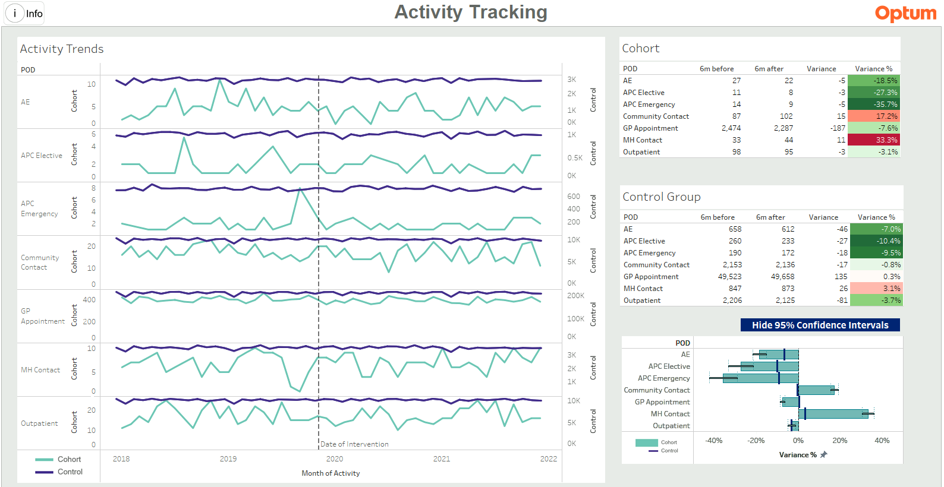
Evaluation Module
Notes:
To rapidly understand the state and effects of our intervention is a crucial part of PHM, and supports understanding of ROI and further business cases
We are using the PHM RS Evaluation module to assess the activity of our chosen cohort following intervention (compared to a control group), with the aim we can track progress over time and see the potential benefits our intervention has made
We have only just finished the Place programme, so are continuing to monitor with the aim for positive system benefit

Slide 29
Summary of Optum’s support offer
Build knowledge, confidence and experience in using linked data to support priority-based discussions and actions with primary care leaders
  PHM RS Navigation sessions
  PHM RS Insights sessions
Identify where data can add value to existing Primary Care team’s priorities
  Produce actionable insights
  Use of Logic Model Framework to underpin Outcomes focused discussions
  Support with intervention design
  Support with evaluation as part of the all cycle and as a key foundation of improvement and success
Individual coaching / mentoring
  Strengths-focused mentoring around PHM, PMO, QI, etc.
  Coaching individuals to meet their objectives and needs
Team reflection
  Create the thinking space to reflect on progress and opportunities for furthering PHM approach embedding
  Be the challenging friend that is there to question the norm
  Identification of teams and individual needs and work on a plan to overcome issues

Slide 30
Appendix

Slide 31
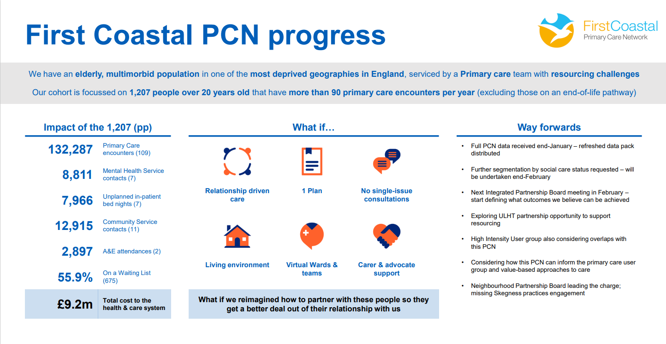
NHS Lincolnshire Integrated Care Board

Slide 32
PHM Achievements
Data, Infrastructure & Intelligence
First ever joined, pseudonymised, patient level dataset for intelligence purposes
Access for analysts across ICB, LCC, AGEM and Optum UK
Processes for sub-licencing to come into place at the end of February
Established processes for re-ID of cohorts of individuals in primary care
Upskilled system analysts, with ongoing programme of activities
Intelligence generation through facilitated discussion with decision makers and MDTs
Intervention, Incentives & System Development
Completed National PHM Development Programme Summer 2022
Successful engagement strategy across statutory orgs, groups & system progs.
Alignment of objectives in partnership with HI & Personalisation progs.
PHM baked in to three new PCN Partnership Boards
9 PCNs engaged with PHM Programme
Culture Compact exercise completed with first group of system leaders
Design phase of a Strategic Segmentation Model
PHM Projections workstream commenced

Slide 33
Population Health Intelligence & Analytics

Slide 34
Opportunities and Requirements
We can:
Understand patient & cohort journeys through health and ill-health, across our services and across their lives.
Compare outcomes of individuals and groups through pathways, and evaluate whole system impact of services and interventions.
Understand issues at system level, and parts of it, as well as how changes in one part of the system might impact another.
Identify where things aren’t working and start to understand why, enabling us to better target and intervene, supporting health inequalities and personalisation agendas.
Identify opportunities for prioritisation and to stop doing things that don’t work for groups of the population, providing evidence to inform alternative provision.
Support working to shared priorities and understanding of how different parts of the system can contribute to outcomes.
We need:
Infrastructure, skills, peer support, controls and other measures to ensure we add the most value from the intelligence, whilst mitigating against misuse and misinterpretation.
Shared understanding of how to employ evidence-informed decision making and how to access intelligence & analytics support.
To make best use of our analysts to ensure needs and priorities are effectively met through a coordinated programme of work, specialist management and mentoring, and team/community support.

Slide 35
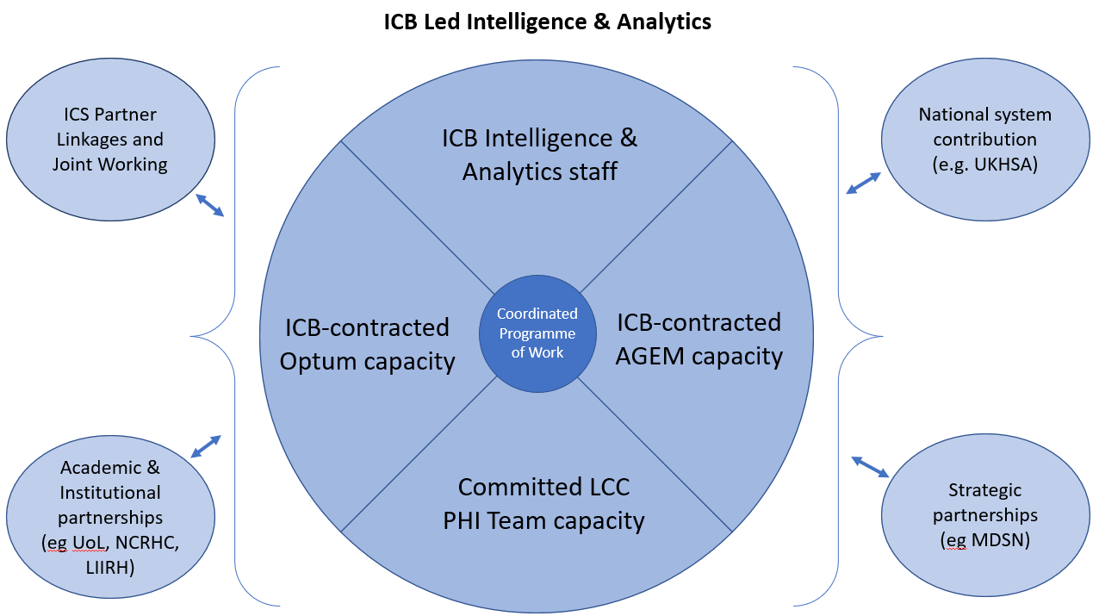
NHS Lincolnshire Integrated Care Board

Slide 36
Benefits
Supports effective and efficient delivery of priorities:
Coordinate an agreed programme of work across resources which best meets priorities;
Fully understand and manage capacity, capabilities, focus and skills to ensure the right work is directed to the right individuals;
Provide flex and work in an agile way to meet urgent and emerging priorities and provide commissioning, delivery and programme teams with analytical resilience;
Reduce duplication;
Reduce the need to recruit orphan roles and challenges this brings, including associated higher staffing costs;
Release Programme Lead time from line management of specialist staff;
Improve provision through strategic intelligence leadership of a distinct, recognised, intelligence function.
Supports cohesion and development:
Support cross-fertilisation of ideas and innovation through collaboration and skills transfer;
Increase effectiveness and efficiency of intelligence generation and reduce organisational and financial risk through Improved analytics understanding and interpretation;
Manage and develop staff alongside specialist peers and leadership to provide the direction, support and mentoring they need;
Improve development and recruitment into hard to fill analytics vacancies through the career development structures and opportunities a wider intelligence function provides.
Improves quality, efficiency, effectiveness and workforce wellbeing

