Slide 1




PHM Reporting Suite
Introduction- Orientation
Developed in partnership with Optum UK

Slide 2

What is Population Health Management?
      Population Health Management...
      Population Health Analytics...
...is the application of quantitative methods to population health management to reach more sophisticated insight about groups or determine the most optimal strategies for treating health issues within that group (Duke Business School)
...improves population health using data driven planning and delivery of proactive care to achieve maximum impact given available resources
It includes:
Use of analytical techniques such as segmentation, stratification and impactability modelling to identify local ‘at risk’ cohorts.
Designing targeted interventions to prevent ill-health and to meet the triple aim.
Can include risk-based contracting approaches for managing integrated provider networks
And support people with ongoing health conditions and reducing health inequalities.
It includes:
Focuses on person-centric analytics and population need – not organisations and service lines
Considers the triple (or quintuple) aim as the ‘north star’ for understanding populations
Utilises linked data to ensure a holistic approach
Can be predictive and incorporate risk management techniques, rather than focusing on high intensity users
However – there are many definitions of what PHM and PHA include! Please share your own in the chat

Slide 3







PHM Reporting Suite- Evolution
Evolved from work done during the
PHM Development Programme
...delivered by Optum in partnership with NHSE over a 3-year period
Linked Data Set
Linked data represents a whole population, at a person level
Population Insight
Giving opportunities to improve population outcomes and reduce unwarranted activity
Multiple Workstreams
Workstreams at System, Place, PCN and Analytical levels
ICS Input
ICS leadership, clinical and analytical input
Action Learning Sets
Discussions across action learning Set (ALS) sessions across a 22-week period
Integrated Care Partnerships
Organisations across the ICS
Integrated Reports
Identify interventions and prioritise according to 80/20 rule

Slide 4
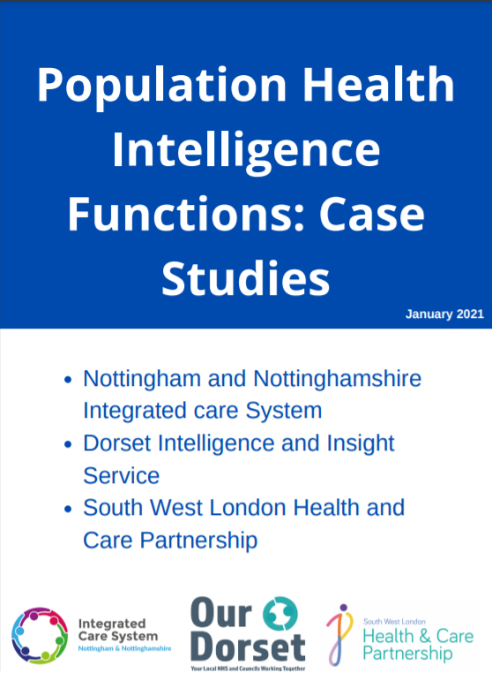
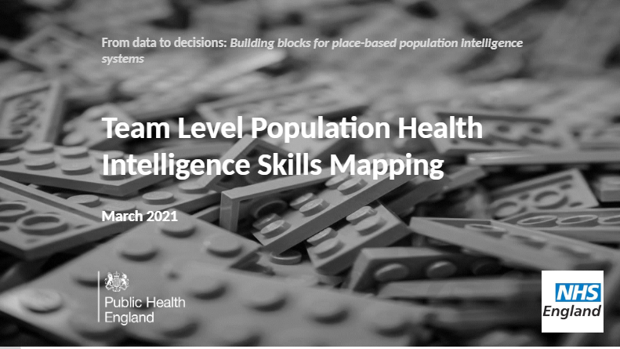
Analytical teams are at the heart of integrated care development
The ICS Design Framework is asking all ICSs to develop a “cross-system intelligence function” that brings analytical teams together to work on cross-system problems and drive PHM
These intelligence functions should be at the heart of clinical, operational and strategic decision-making
The PHM Reporting Suite will support local population analysis by highlighting anomalies and providing insight
Filtering within the reports facilitates discussion and enables drill down to specific cohorts
Intelligence gained from the PHM Reporting Suite will provide evidence to develop a population-led approach to healthcare delivery

Slide 5

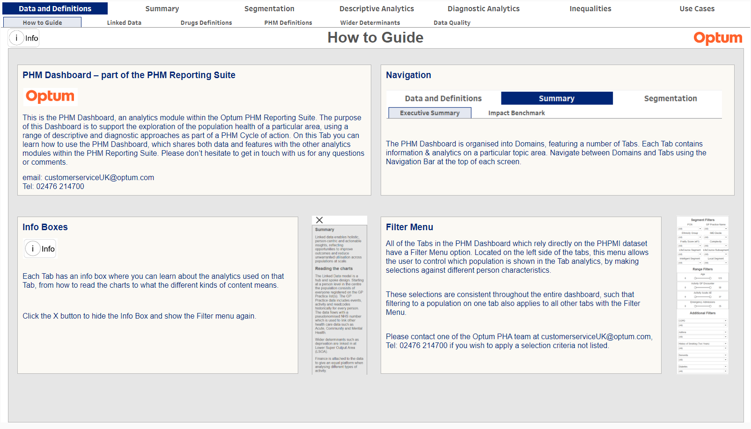



PHM Dashboard: How To Guide
Definitions
How To Guide
Easy navigation
Information on each report

Slide 6
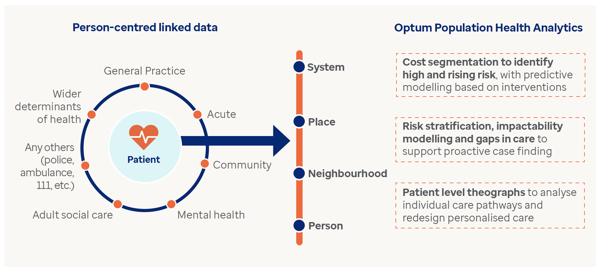
PHM Reporting Suite- Linked Data
Care that fits your communities
Understand the impact of wider determinants of health, identifying unwarranted variation in outcomes and experiences of care across your ICS. Stimulate the right collaboration to achieve the care that your communities need.
Notes:
Optum Population Health Management Reporting Suite provides cross-organisational analytics which help care teams to understand the impact of wider determinants of health, identifying trends and patterns in the data at different levels across the system. Combined with NHS data the resulting analytics help neighbourhood, Place and System teams explore and clarify reasons for variation in outcomes and understand and address health inequalities.

Slide 7

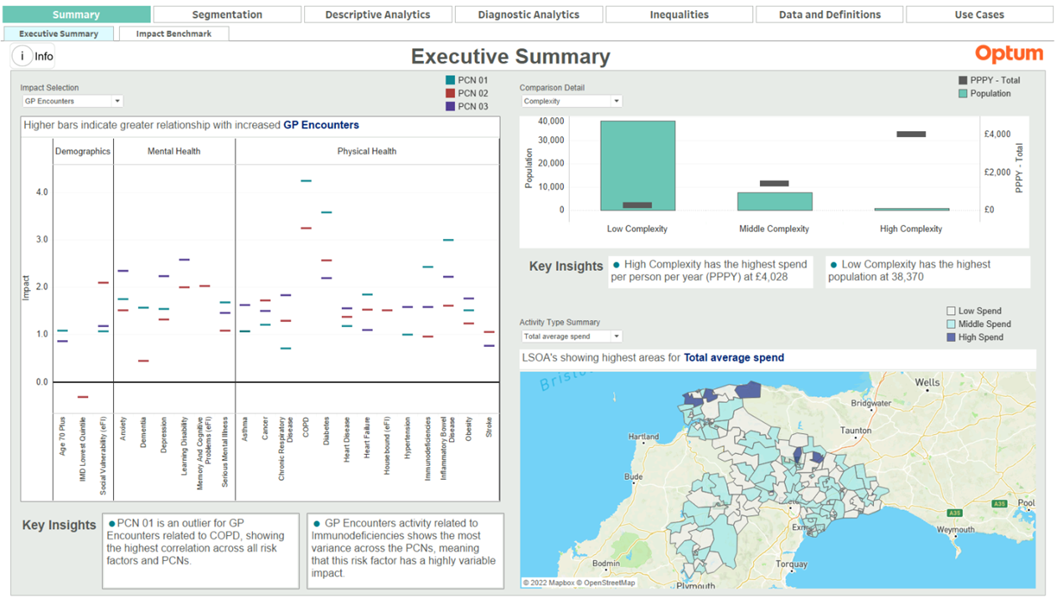

PHM Reporting Suite- Executive Summary
Monitor at-risk groups
Create actionable insights for populations and people
Engage populations that historically do not access care
Reduce unplanned admissions
Understand and address health inequalities
Prevent ill-health

Slide 8
END

