Slide 1
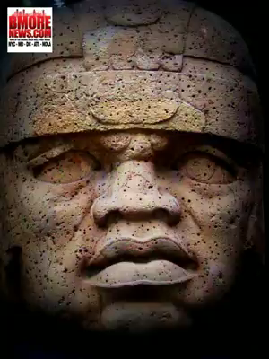
Global Contributions to Contemporary Britain
Concentrating specifically on Africa,
Asia and the Caribbean
Kamljit Obhi and Dr. Iris Lightfoote
DMGlobal
www.bmorenews.com

Slide 2
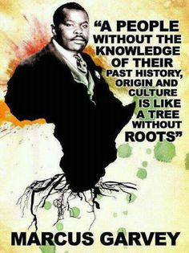
HISTORICAL
https://www.pinterest.co.uk/CorneliaC24/black-history-month-quotes/

Slide 3
Global Contributions to Contemporary Britain –
Focus
Historical
Early presence
Slave trade
Royal connections
India
Military Support
National/Local
Politics
Inventions/Science
Post war Britain

Slide 4
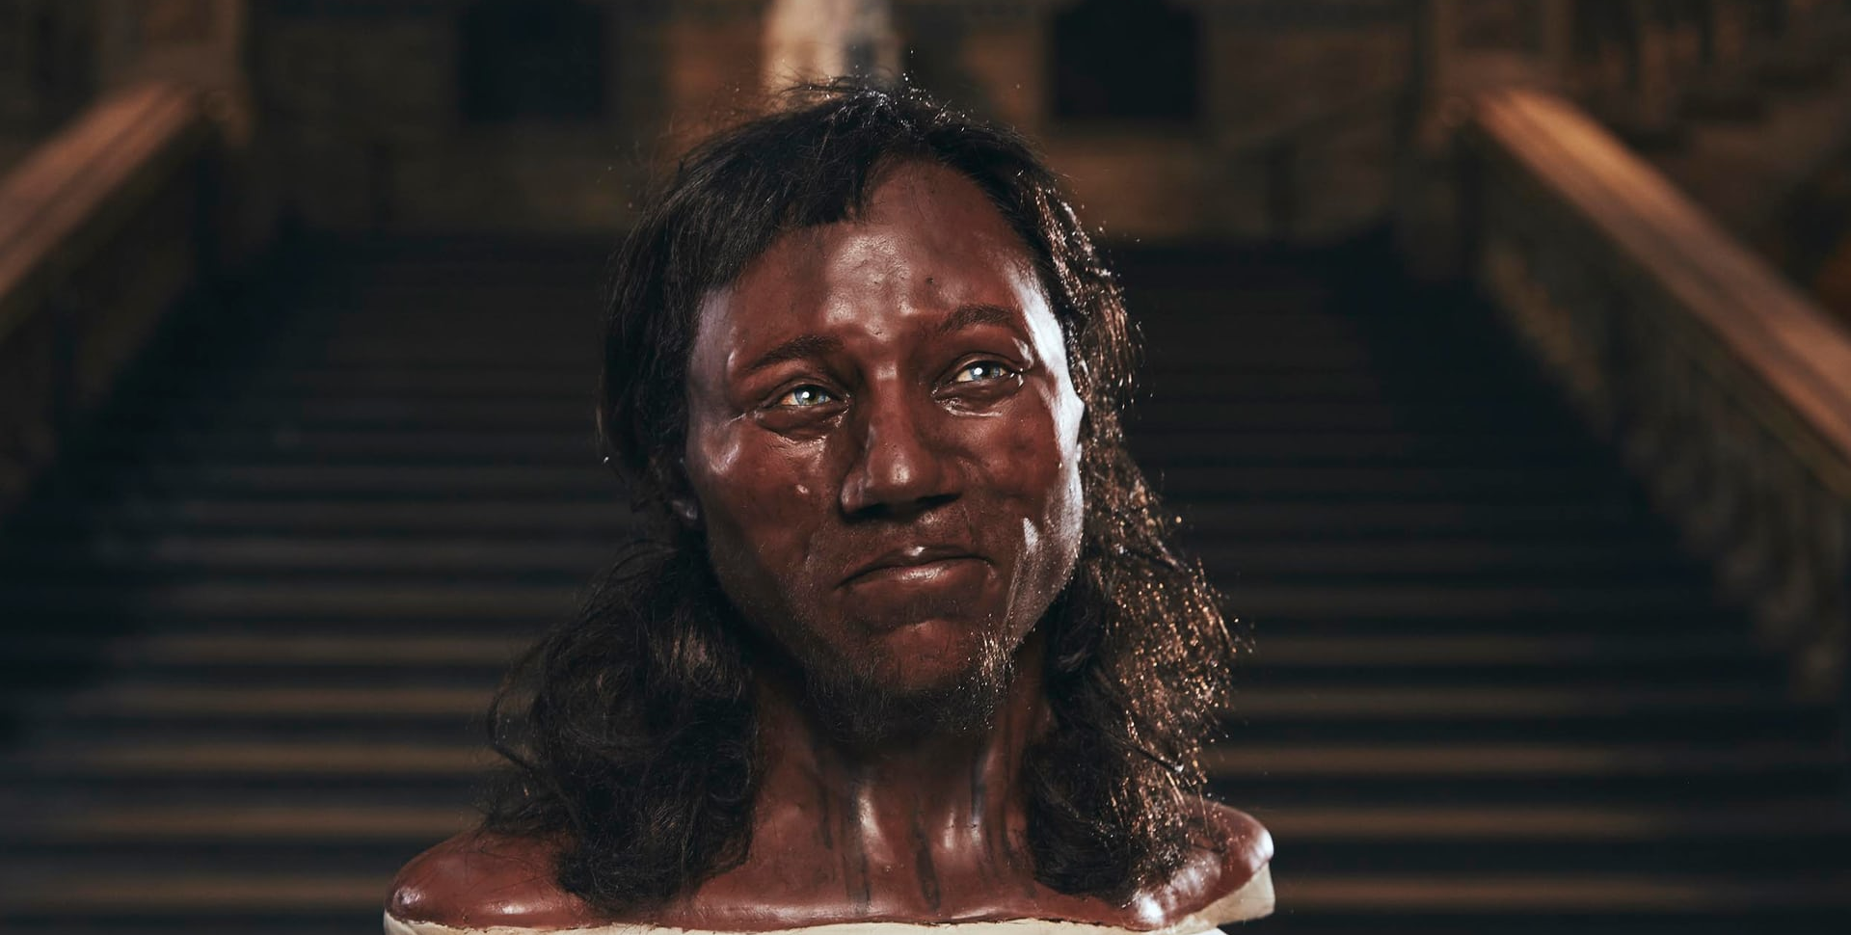
Cheddar Man
Guardian Article. Wednesday 17th Feb 2018
Early Presence: Britain’s history has always shown the existence of African and Asian people:

Slide 5
Slave Trade
Records show that black men and women have lived in Britain in small numbers since at least the 12th century
A newspaper report from 1764 also describes how 57 black men and women ate, drank and entertained themselves (The First Black Britons By Sukhdev Sandhu)
Mary Prince was born in 1788, to an enslaved family in Bermuda. ... She became the first woman to present an anti-slavery petition to Parliament and the first black woman to write and publish an autobiography.

Slide 6
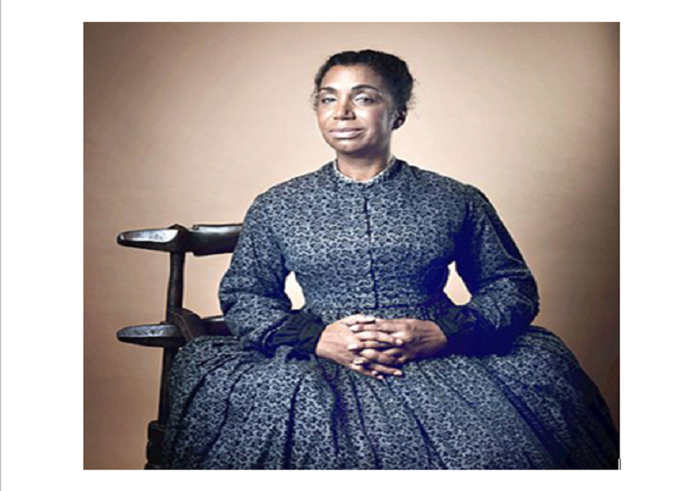
Image taken from: Face2Face Africa

Slide 7
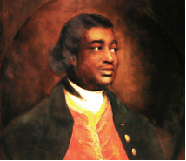
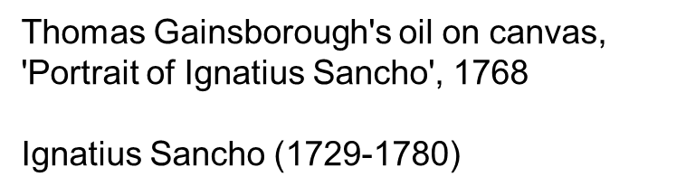
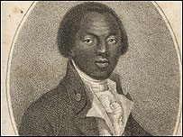
Edward Juba - died in Wanlip August 25 1839

Slide 8
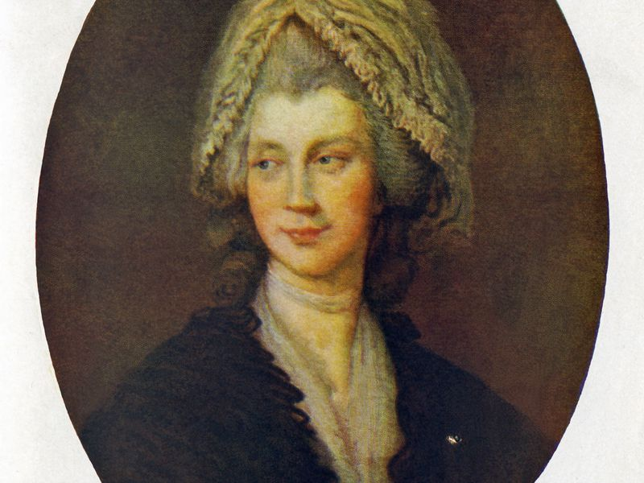
Royal connections
England’s First 18th century Black Queen, Sophie Charlotte
Born in 19th May 1744. She married George III of England on September 8, 1761, at the Chapel Royal in St James’s Palace, London, at the age of 17 years of age becoming the Queen of England and Ireland.
Thomas Gainsborough painting (Ivy Close Images/ Alamy Stock Photo)

Slide 9
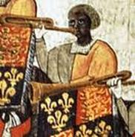
Royal connections
John Blanke, a Black trumpeter, was a regular musician at the courts of both Henry VII and Henry VIII. Musicians' payments were noted in the accounts of the Treasurer of the Chamber, who was responsible for paying the wages.
http://www.nationalarchives.gov.uk/pathways/blackhistory/early_times/blanke.htm

Slide 10
India
A 2014 poll in the UK found that 59% of people thought the British empire was something to be proud of and nearly half believed countries were better off for having been colonised
Inglorious Empire by Shashi Tharoor – What the British did to India
he argues:- Pre-colonial India was not a backward society, but a wealthy, commercialising one with a highly developed banking system. Britain, systematically looted his country for some 200 years.

Slide 11
India
In 1600, when the East India Company was established, Britain was producing just 1.8% of the world’s GDP, while India was generating some 23% (27% by 1700). By 1940, after nearly two centuries of the Raj, Britain accounted for nearly 10% of world GDP, while India, when Britain left, it was around 3%.
India had been reduced to a poor “third-world” country
The British left a society with 16% literacy, a life expectancy of 27, practically no domestic industry and over 90% living below what today we would call the poverty line.

Slide 12
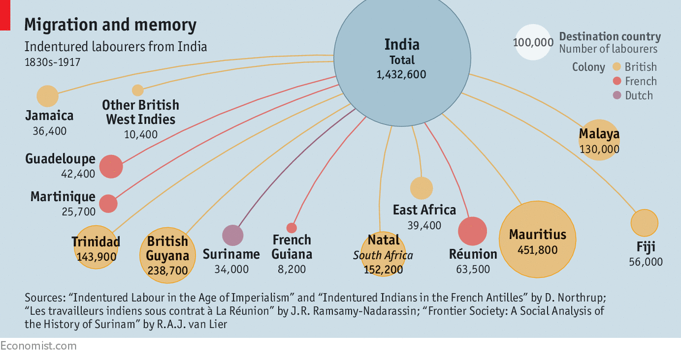

Slide 13
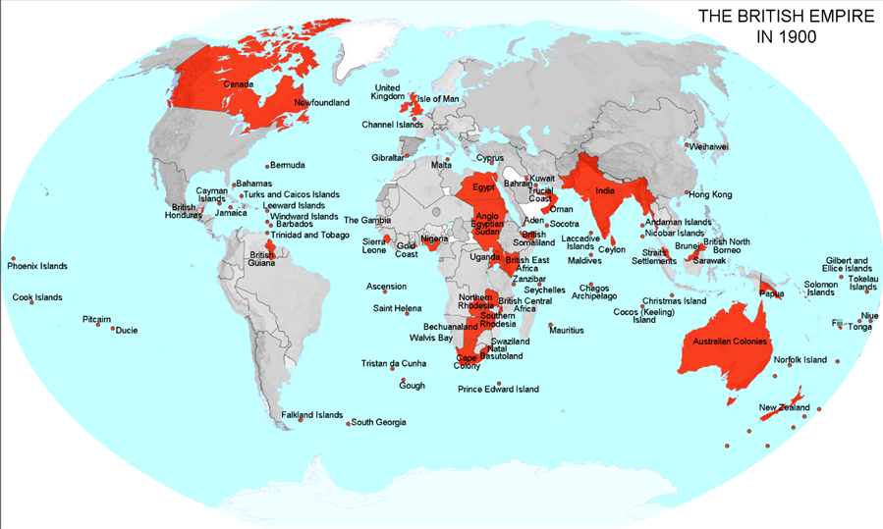
Military support
In WW1
15,600 men of the British West Indies Regiment served with the Allied forces. Over 1,200 were killed or died, while more than 2,500 were wounded;
About 2,350,000 Africans were mobilized between 1914 and 1918;
1.3 million Indian soldiers served in World War One, and over 74,000 of them lost their lives;
Up to 95,000 Chinese men came to the assistance of Britain during World War 1

Slide 14
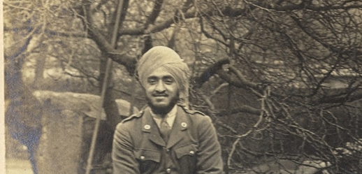
Military support
Hardit Singh Malik
(1894 – 1985)
1st Sikh Royal Flying Corps Fighter Pilot
https://www.youtube.com/watch?v=Zyh2d9X2580&t=1s
Notes:
Video clip – click on link

Slide 15
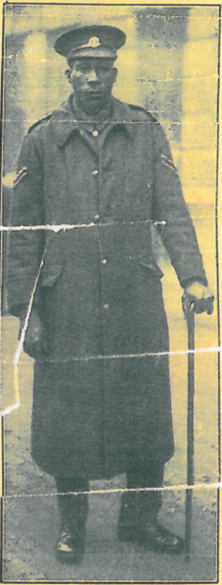
Military support
George Arthur Roberts (1 August 1890 – 8 January 1970)
The Coconut Bomber
https://www.youtube.com/watch?v=Lze_8frZGCw
Notes:
Video Clip – click on link

Slide 16
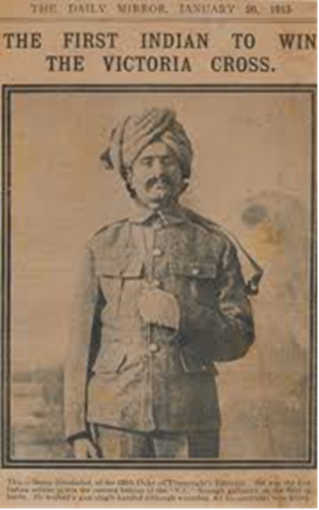
Military support
Khudadad Khan (1888 – 1971)
The first Indian Muslim to be awarded the Victoria Cross

Slide 17
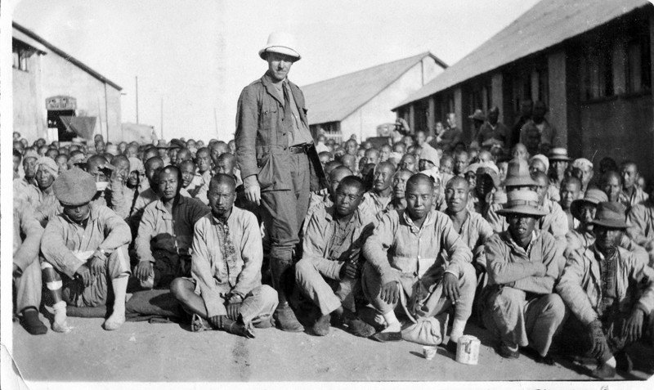
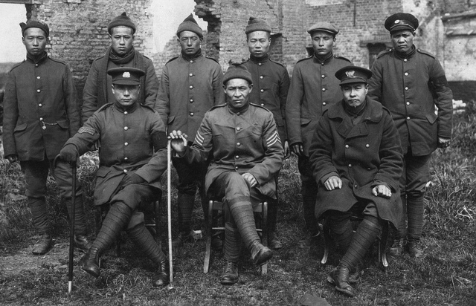
The forgotten army of the first world war
How Chinese labourers helped shape Europe
http://multimedia.scmp.com/ww1-china/

Slide 18
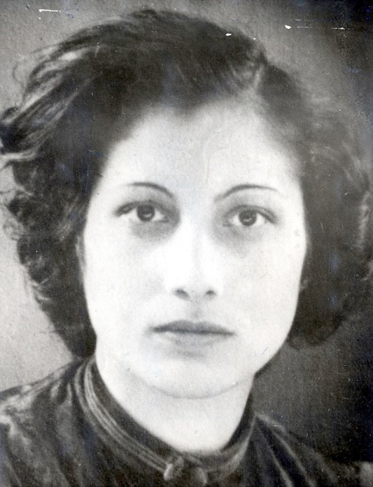
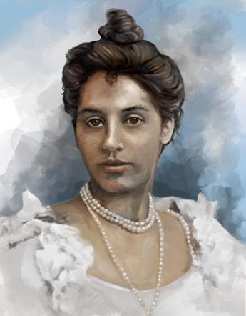
Military support
Noor Inayat Khan (1914 - 1944) British Secret Agent
Sophia Duleep Singh (1876 – 1948)

Slide 19
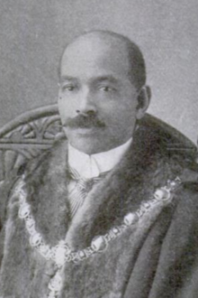
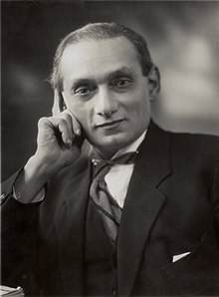
Politics
John Richard Archer (8 June 1863 – 14 July 1932) First black mayor in London
Shapurji Dorabji Saklatvala (28 March 1874 – 16 January 1936)

Slide 20
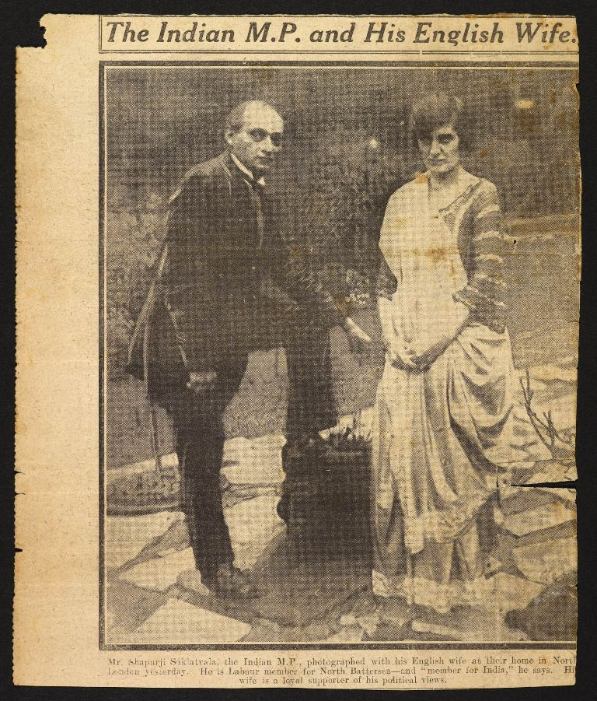
Politics
An undated newspaper cutting showing the Indian MP with his wife, Sarah Marsh, who hailed from a working class background. Together they had five children – two sons and three daughters. Photo courtesy: British Library.

Slide 21
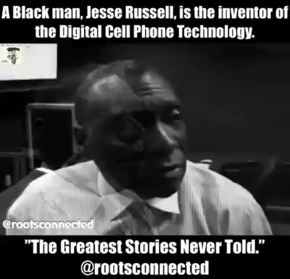
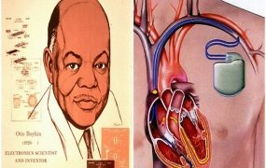
Inventions:
Narinder Singh Kapani – Fibre Optics Pioneer
https://www.youtube.com/watch?v=l69ElZd0weI
Jesse Russell – Digital Cellular communication
Otis F. Boykin 1920-1982
Image taken from: Face2Face Africa
Notes:
Video clips – click on links

Slide 22
Rebuilding Post War Britain
Following World War 2

Slide 23
Post War – skills deficit
Construction sector.
Service sector
Public transport
National Health Service (NHS)
Post Office
Manufacturing
Carpentry
To name but a few

Slide 24
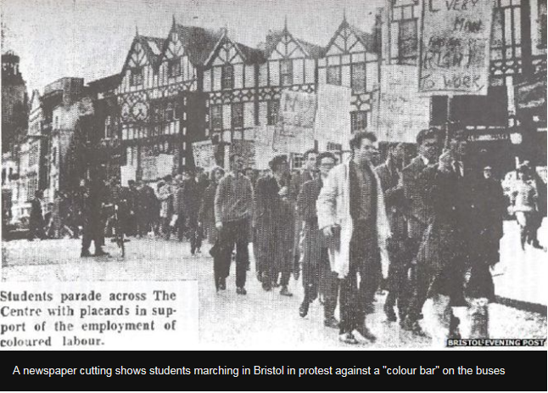
Guy Bailey
A spring afternoon in 1963, eighteen-year-old Guy Bailey arrived on time for his job interview. Bailey was well qualified for the post, but he would not be taken on, because he was black
https://www.bbc.co.uk/news/magazine-23795655

Slide 25
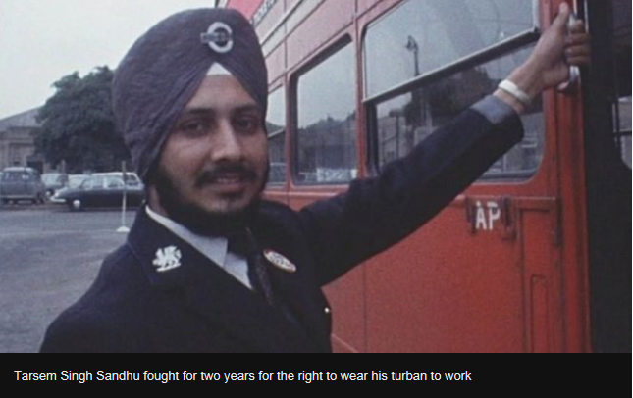
Tarsem Singh Sandhu
Fifty years ago, Sikhs working on Wolverhampton's buses won the right to wear the turban at work. It followed a long-running dispute during which one Sikh man threatened to set himself on fire.
https://www.bbc.co.uk/news/uk-england-birmingham-47853718

Slide 26
Legislation to challenge race discrimination
Race Relations Act 1965 This Act prohibited discrimination on grounds of race in public places and established the Race Relations Board with responsibility for conciliation of discrimination complaints.
Race Relations Act 1968 This Act extended the protection against discrimination beyond public places to include, amongst other things, employment and housing.
Race Relations Act 1976 This Act extended the definition of discrimination to include indirect discrimination.
Race Relations Amendment Act 2000
The Equality Act 2010

Slide 27
Current/local position
Has todays society become more inclusive?

Slide 28
Some facts about immigration and new arrivals
The biggest contributors providing a safe haven to the world’s uprooted people are poorer communities. (Contrary to popular belief of Britain being a soft touch for asylum seekers).
The global displacement figure for 2017 includes 25.4 million refugees who fled their countries to escape conflict and persecution. 2.9 million more refugees than the year before - the steepest increase UNHCR has seen in a single year. Turkey hosted the largest number of refugees worldwide for the fourth consecutive year, 3.5 million people, followed by Pakistan, Uganda, Lebanon, Iran, Germany, Bangladesh and Sudan. UNHCR's annual "Global Trends" study 20 Jun 2018
The world’s six richest countries – responsible for more than half of global GDP – host less than one-tenth of the world’s refugees, according to a new Oxfam report. 18 July 2016
The number of asylum applications in the UK from main applicants was 27,044 in the year ending June 2018 (down 1%)
Over the year, 625,000 people moved to the UK (immigration) and 351,000 people left the UK (emigration). Office for National Statistics Migration Statistics Quarterly Report: November 2018

Slide 29
Demographics – UK Population diversity
Further differences e.g.
  Religion
  Age
  Language
  Disability
  Sexuality
  Marital status
  Social class
  Sex
  Gender
  (Source: ONS and www.parliament.uk)
UK total population
  64,769,452 (ONS 2016)
  UK by ethnicity
  87.2% White
  12.8% All other ethnic groups

Slide 30
The issues…….inequalities still exist
Health
Education
Employment
Mental Health
Criminal justice system

Slide 31
Demographics – NHS
Main facts and figures
as at March 2018, there were over 1.2 million staff employed by the NHS
overall, of staff whose ethnicity was known, 4 out of 5 NHS staff (80.2%) were White, including White ethnic minorities, (nearly 932,000 staff) and nearly 1 in 5 (19.8%) were from all other ethnic groups (over 230,000 staff)
staff from the Asian, Chinese, Mixed and Other ethnic groups made up a higher percentage of those in medical roles (working as doctors in hospitals and community health services) than those in non-medical roles
among the non-medical workforce, staff from the Asian, Black, Mixed and Other ethnic groups made up a lower percentage of those at senior grades (bands 8a to 9) and the ‘very senior manager’ grade than at the support (bands 1 to 4) and middle roles (bands 5 to 7)
there was a higher percentage of staff from the Black, Chinese, Mixed and Other ethnic groups among junior doctors than among senior doctors
compared with September 2017, the percentage of staff who were White decreased slightly (from 80.7% to 80.2%) and who were from all other ethnic groups increased slightly (from 19.3% to 19.8%)
Source: https://www.ethnicity-facts-figures.service.gov.uk/workforce-and-business/workforce-diversity/nhs-workforce/latest

Slide 32
Demographics – Lincolnshire
LATEST POPULATION
Lincolnshire 751,200 Total
Within which:
Boston 68,500
East Lindsey 139,700
Lincoln 98,400
North Kesteven 115,200
South Holland 93,300
South Kesteven 141,700
West Lindsey 94,300
Source: ONS 2017 Mid Year Population Estimates/ GP Registrations April 2019 (NHS-HSCIC)
3% of residents born in new EU accession countries (mainly Poland or Lithuania) compared to 2% in England.
1.9% from other European states
1.1% Middle East and Asia
0.6% African countries

Slide 33
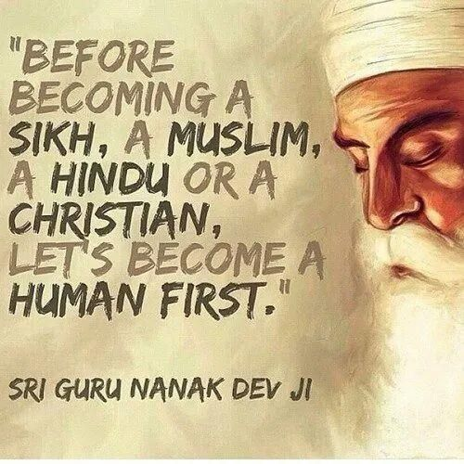
And finally…
https://www.pinterest.co.uk/pin/599823244092006482/?lp=true

